Slide 1
SIP FLOW

Slide 2
SIP Flow
Simple Mean reversal Concept combine with Bolinger Band and Fibonacci to trade and take profit with 100% Win Rate in every batch of trading orders

Slide 3
SIP Flow
Functions of Bol Band V1.4.1
Take Profit/ SL
Take Profit on Retracement
Setting of Bollinger Band
Martingale
Equity Management
Advance Risk Management (TOD and DOW)

Slide 4
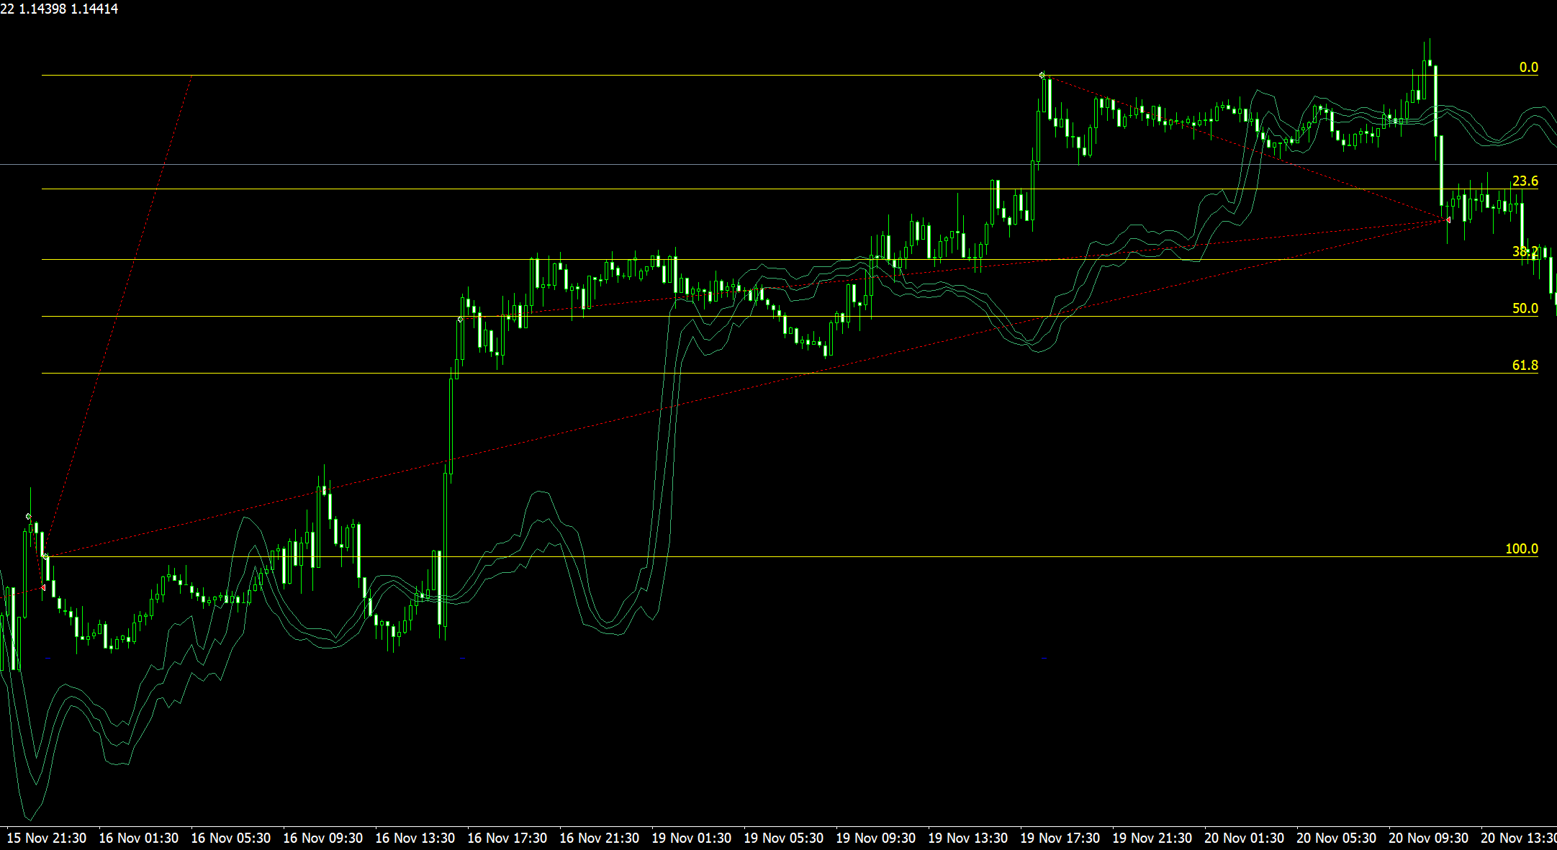
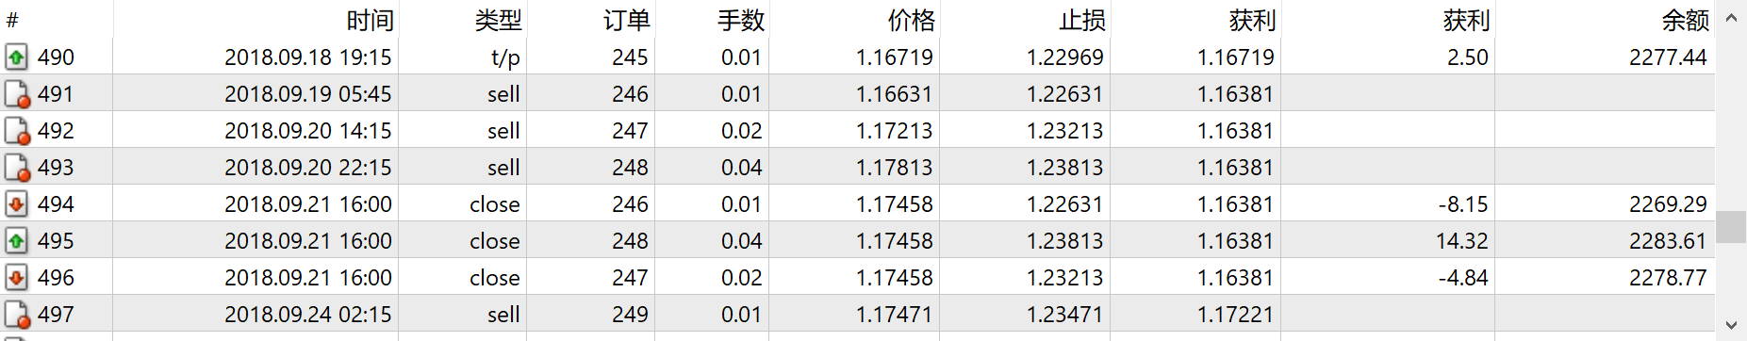
SIP Flow
Visual of Bol Band V1.4.1
3 trades at 600 points away from
Previous trades
Batch profit at 30% Retracement

Slide 5
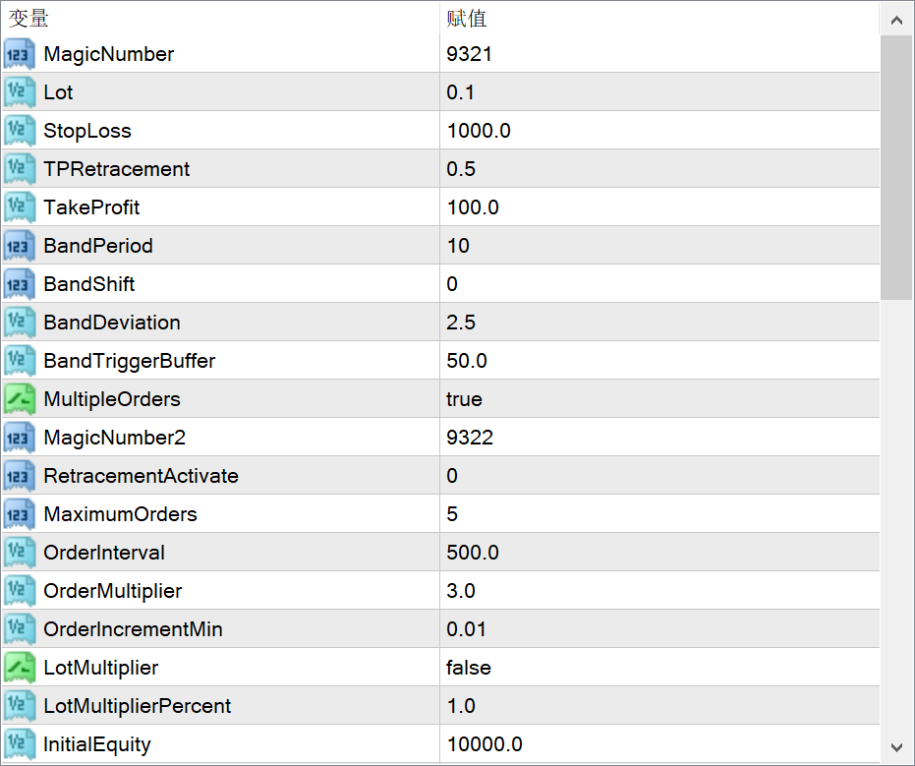
SIP Flow
Visual of Bol Band V1.4.1 Settings Basic
Take Profit and Stoploss in Points
Batch order take profit at X level
Eg 0.5 = 50% retracement
Not relevant for Basic
Settings for Bolinger Band

Slide 6
SIP Flow
Visual of Bol Band V1.4.1
Settings Advance (Martingale)
Martingale Function will open larger trades on the previous opened trades.
Not relevant for Adv
Select true to have more concurrent trades
Not relevant
Activate Retracement Take profit after which trade?
After how many points enter next trade
Multiplier Function for next trade

Slide 7
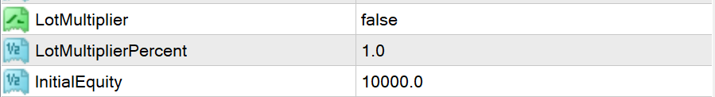
SIP Flow
Visual of Bol Band V1.4.1
Settings Advance
Lot Multiplier, the function to compound the equity and size of your account Automatically
Set to true to activate
1= 100% For instance
Initial Equity at 10K, initial Lot Is 1 lot
If Equity is at 11K the Lot will be 1.1
If set to 2=200%
If Equity is at 11K Lot will be 1.2
Enter Amount for Equity to be updated to the next
Thousand or 10 Thousand

