Slide 1
Price parabolic behaviour
Fibonacci & Fractal of Price
1 Octave = Price Range / 8

Slide 2
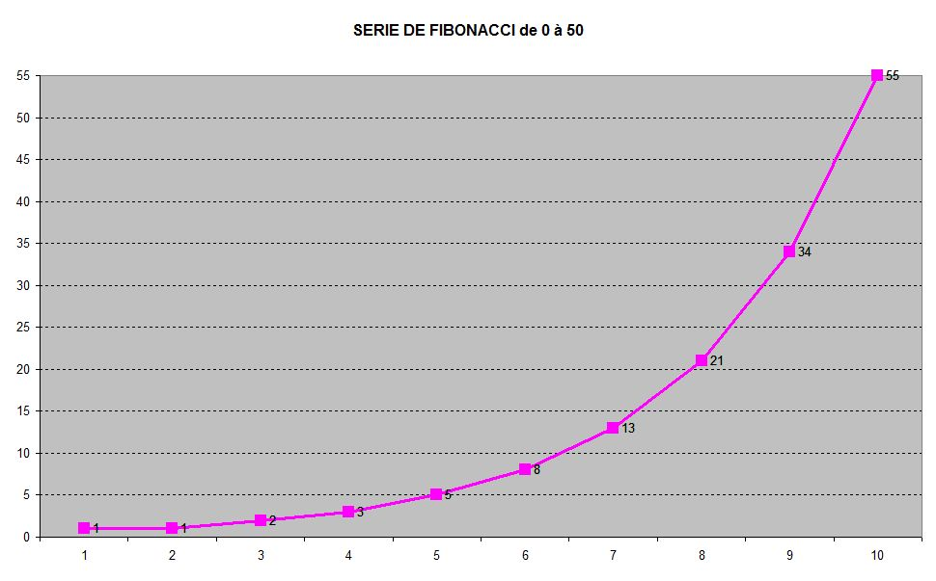
Fibonacci – 0 / 50

Slide 3
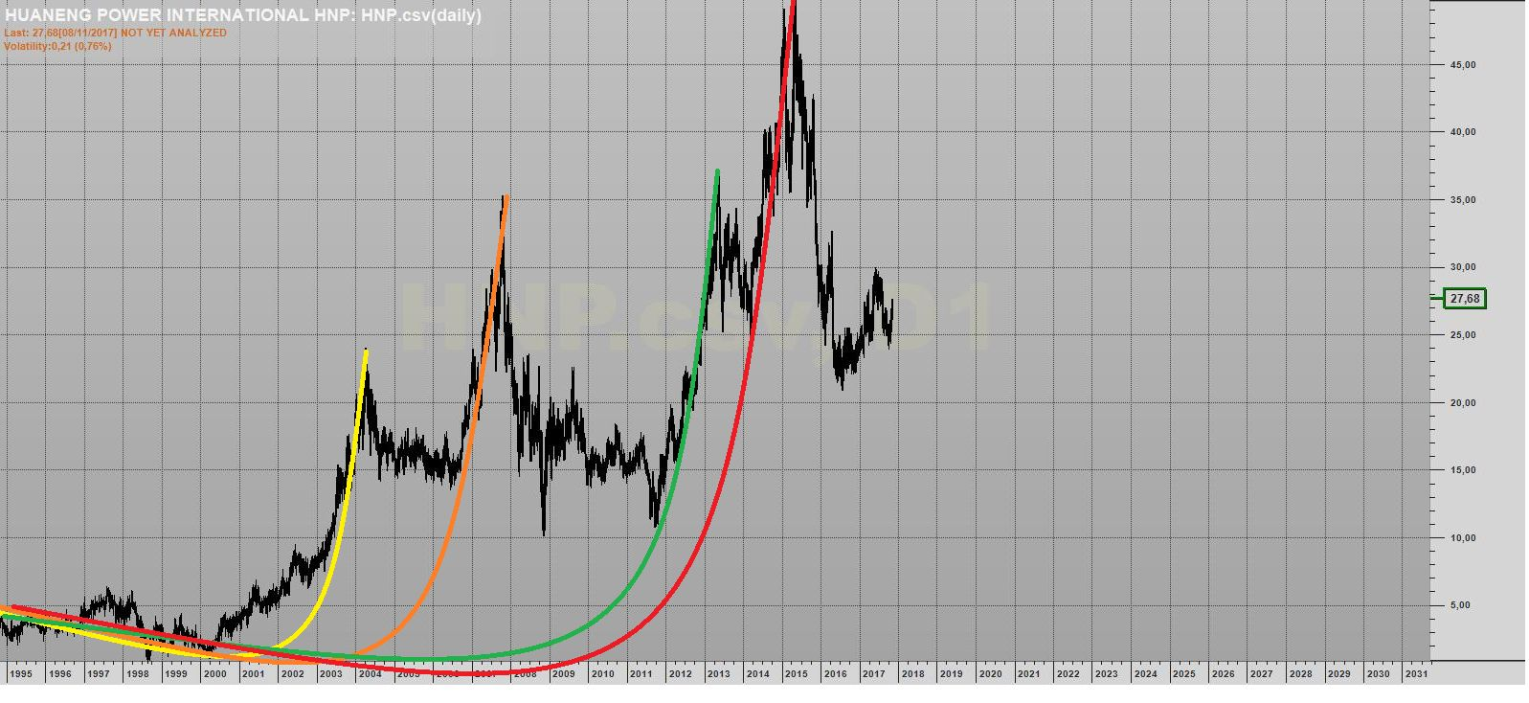
Even chinese stocks show a parabolic behaviour

Slide 4
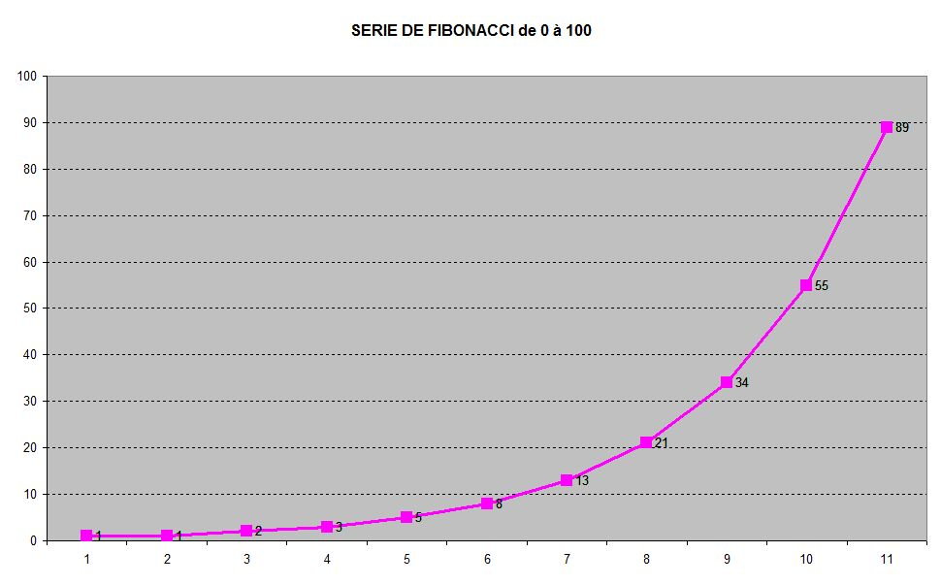
Fibonacci – 0 / 100

Slide 5
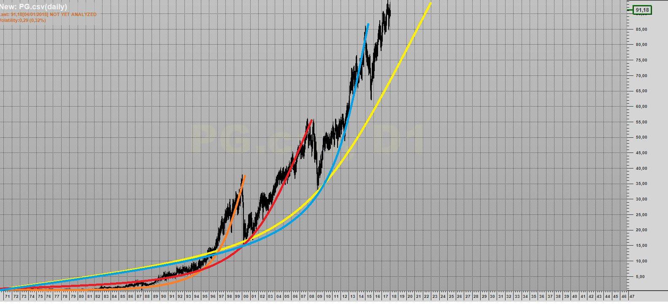
Procter & Gamble

Slide 6
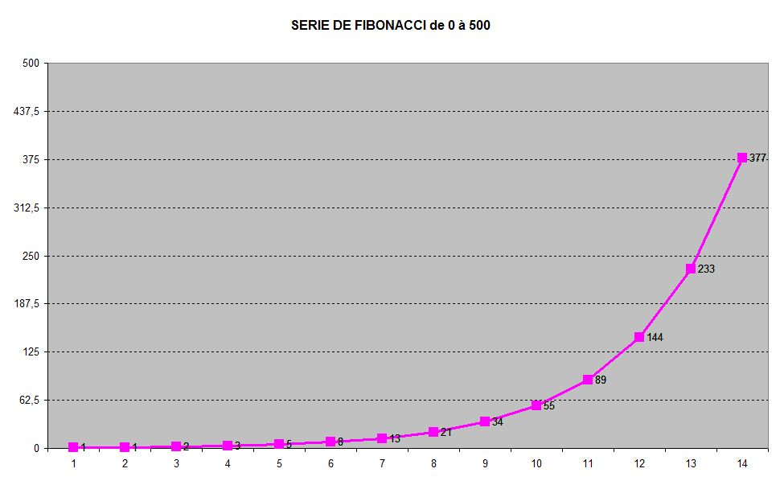
Fibonacci – 0 / 500

Slide 7
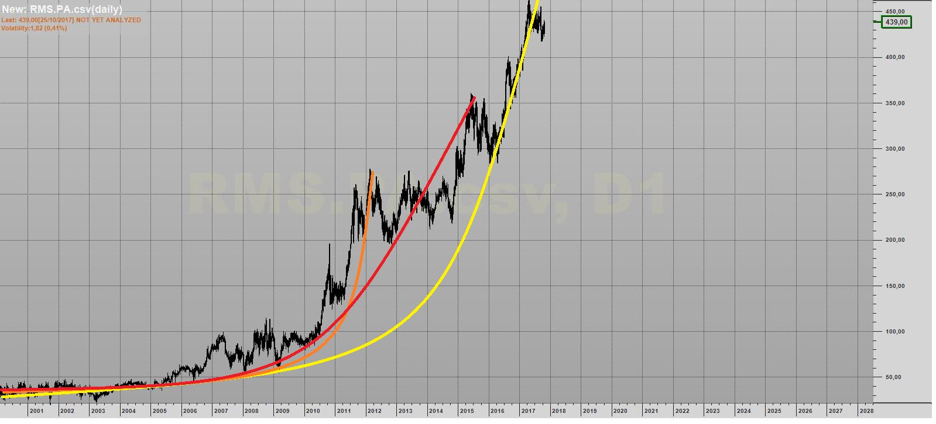
HERMES

Slide 8
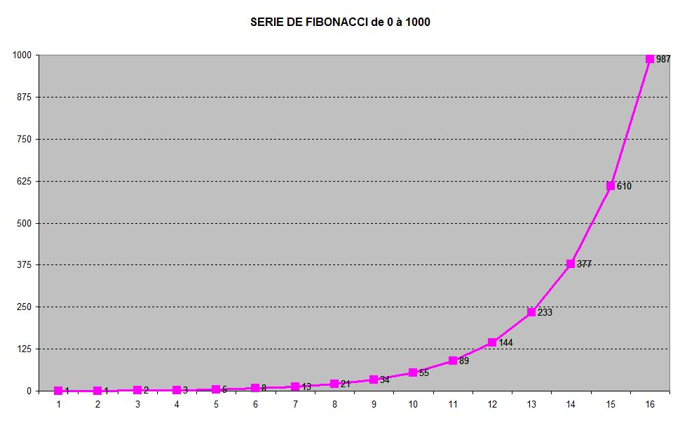
Fibonacci – 0 / 1 000

Slide 9
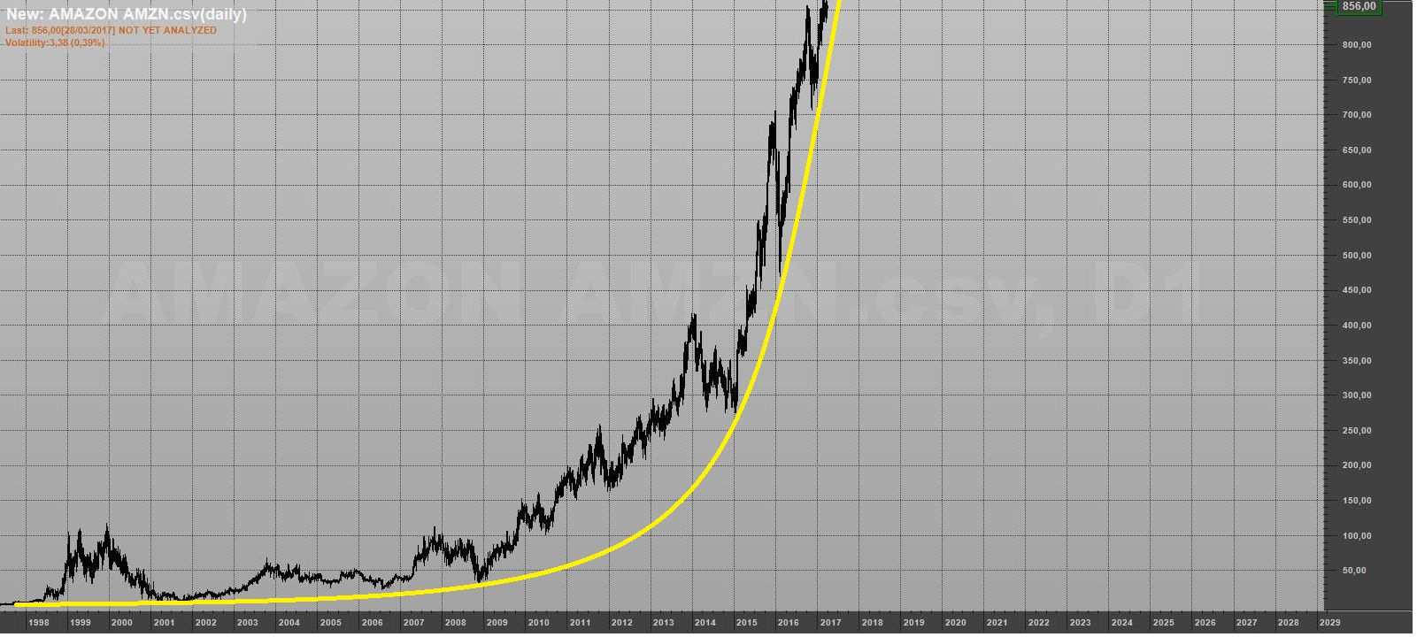
AMAZON

Slide 10
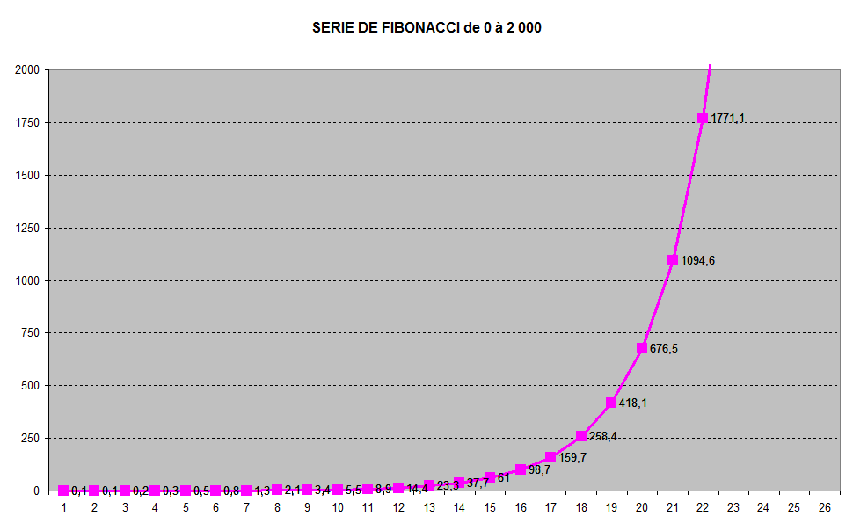
Fibonacci – 0 / 2 000

Slide 11
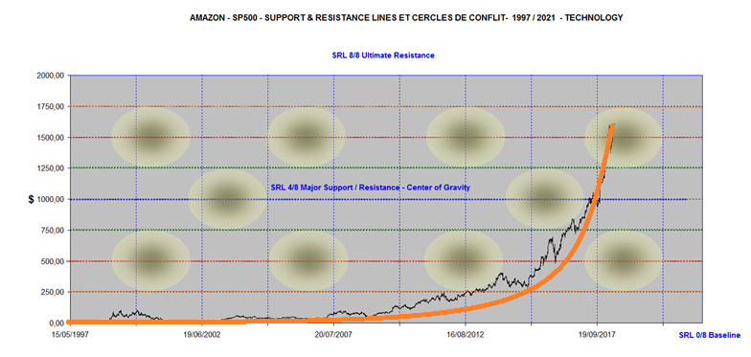
AMAZON – 0 / 2 000

Slide 12
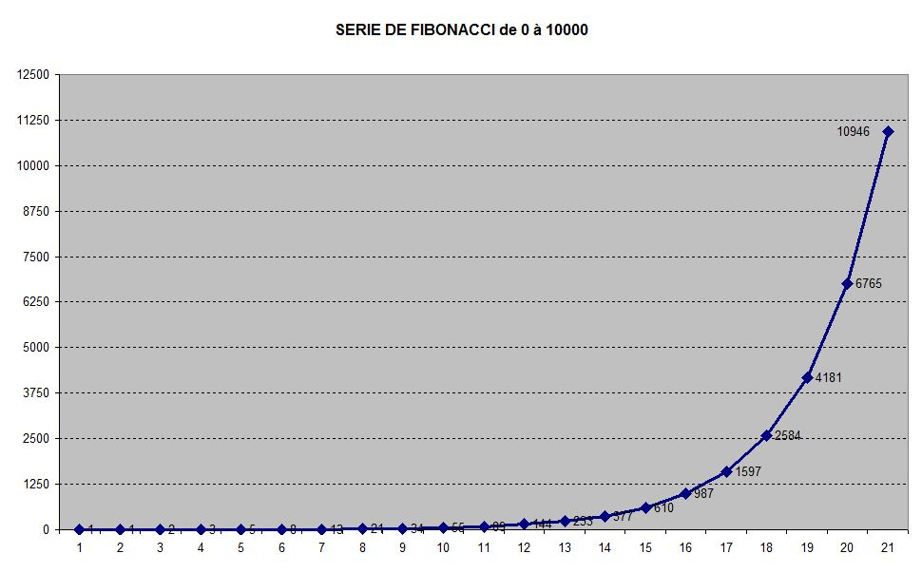
Fibonacci – 0 / 10 000

Slide 13
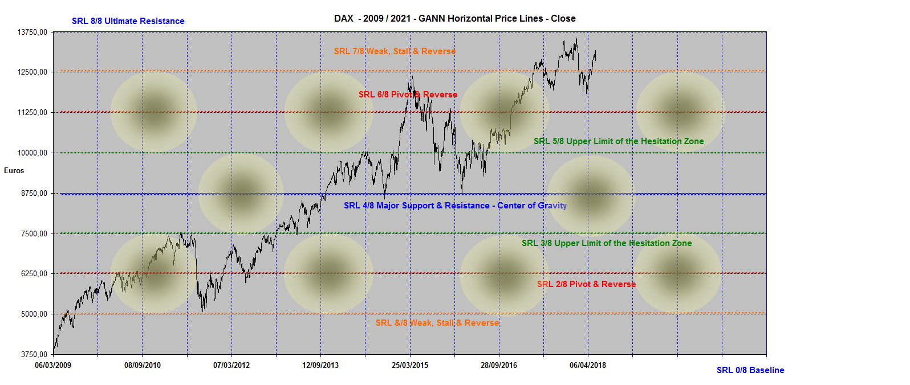
DAX 2009 / 2021 – 3 750 / 13 750

Slide 14
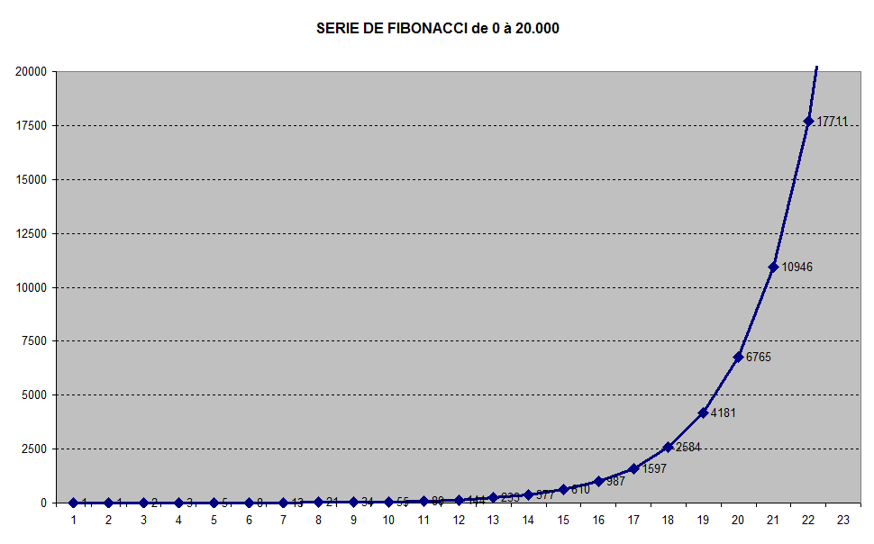
Fibonacci – 0 / 20 000

Slide 15
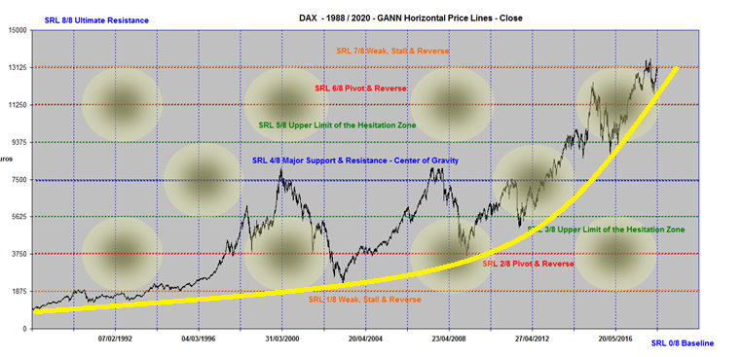
DAX – 0 / 15 000

Slide 16
Fibonacci – 0 / 25 000

Slide 17
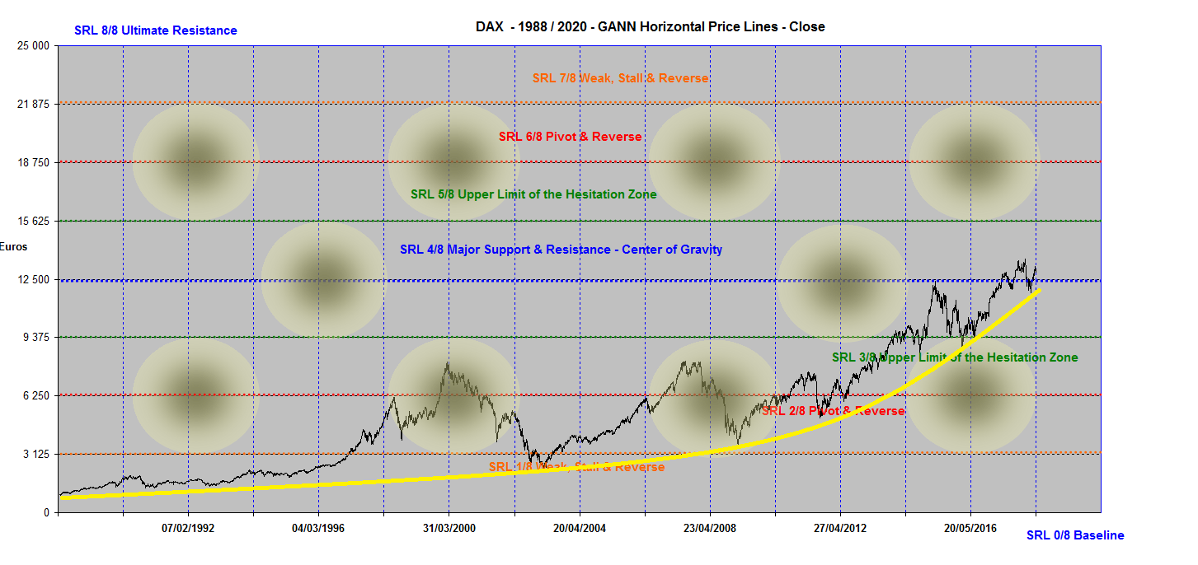
DAX - 0 / 25 000

Slide 18
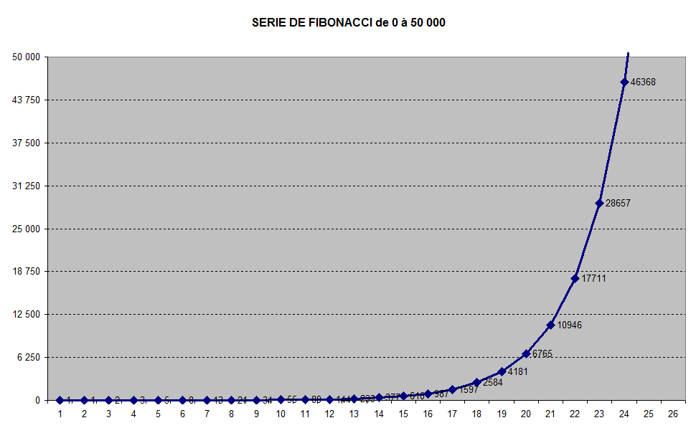
Fibonacci – 0 / 50 000

Slide 19
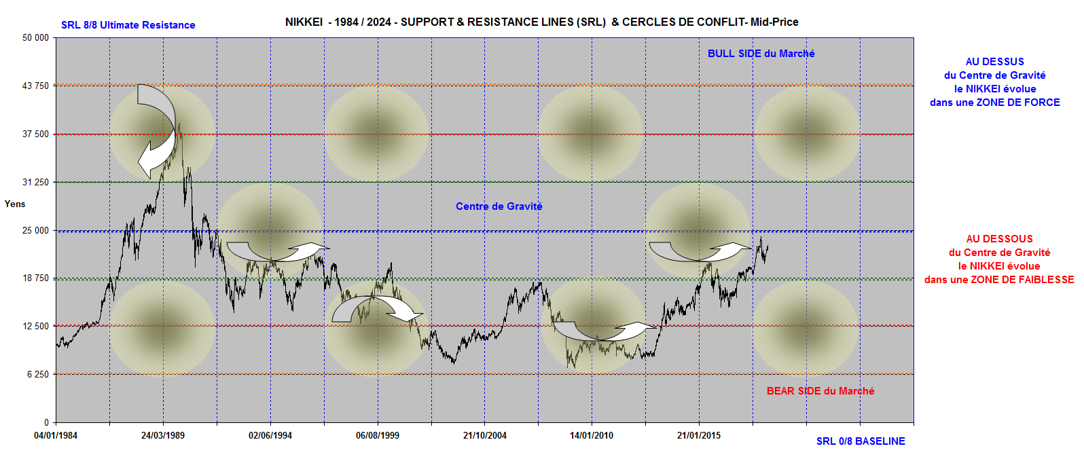
NIKKEI

Slide 20
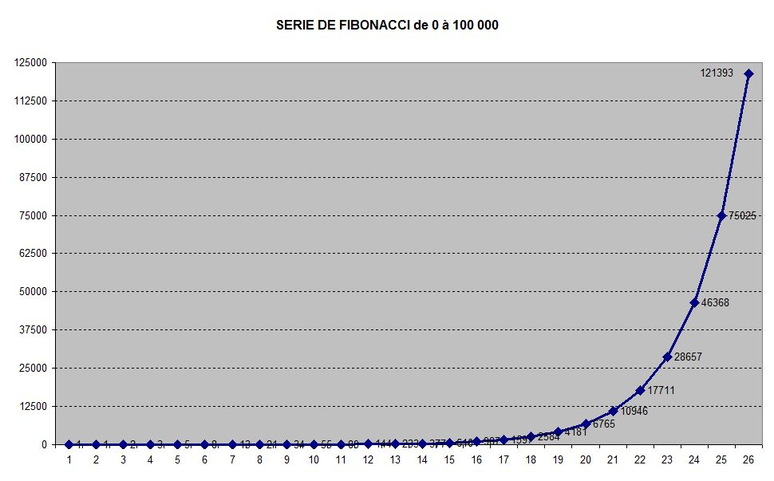
Fibonacci – 0 / 100 000

Slide 21
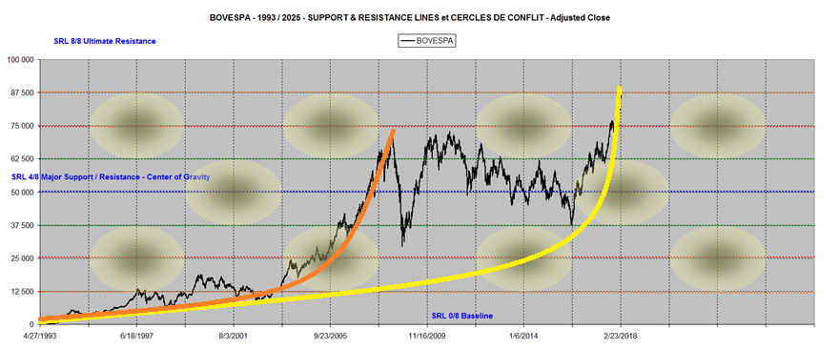
BOVESPA – 0 / 100 000

