Slide 1
NALA
No you can trade this way on any pair but why would you want to bother making more work for yourself.
The GBP/USD reliable produces 50+ pips which is all we need.
You have nothing to fear but fear itself.
Numbers are only simple mathematical processes i.e 40 pips x $25 = $1000.

Slide 2
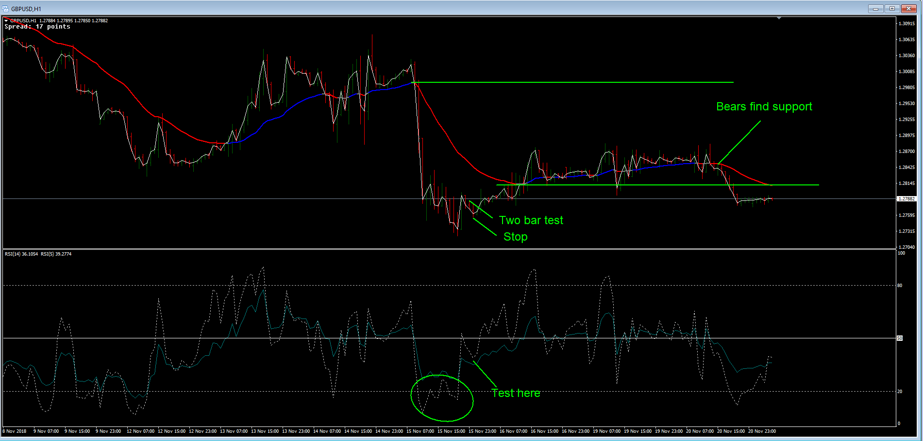
There is something I call the two bar test, for entries. You don't need to have whacking great lines going back to the dawn of time to get an entry a simple two bar test will do it.
Here on the 1 hour I have an example..
Remember we are dealing with a divergence here so we should at least make it back across the EMA and as it turned out went a nice 100 pips or so, far more than we need.

Slide 3
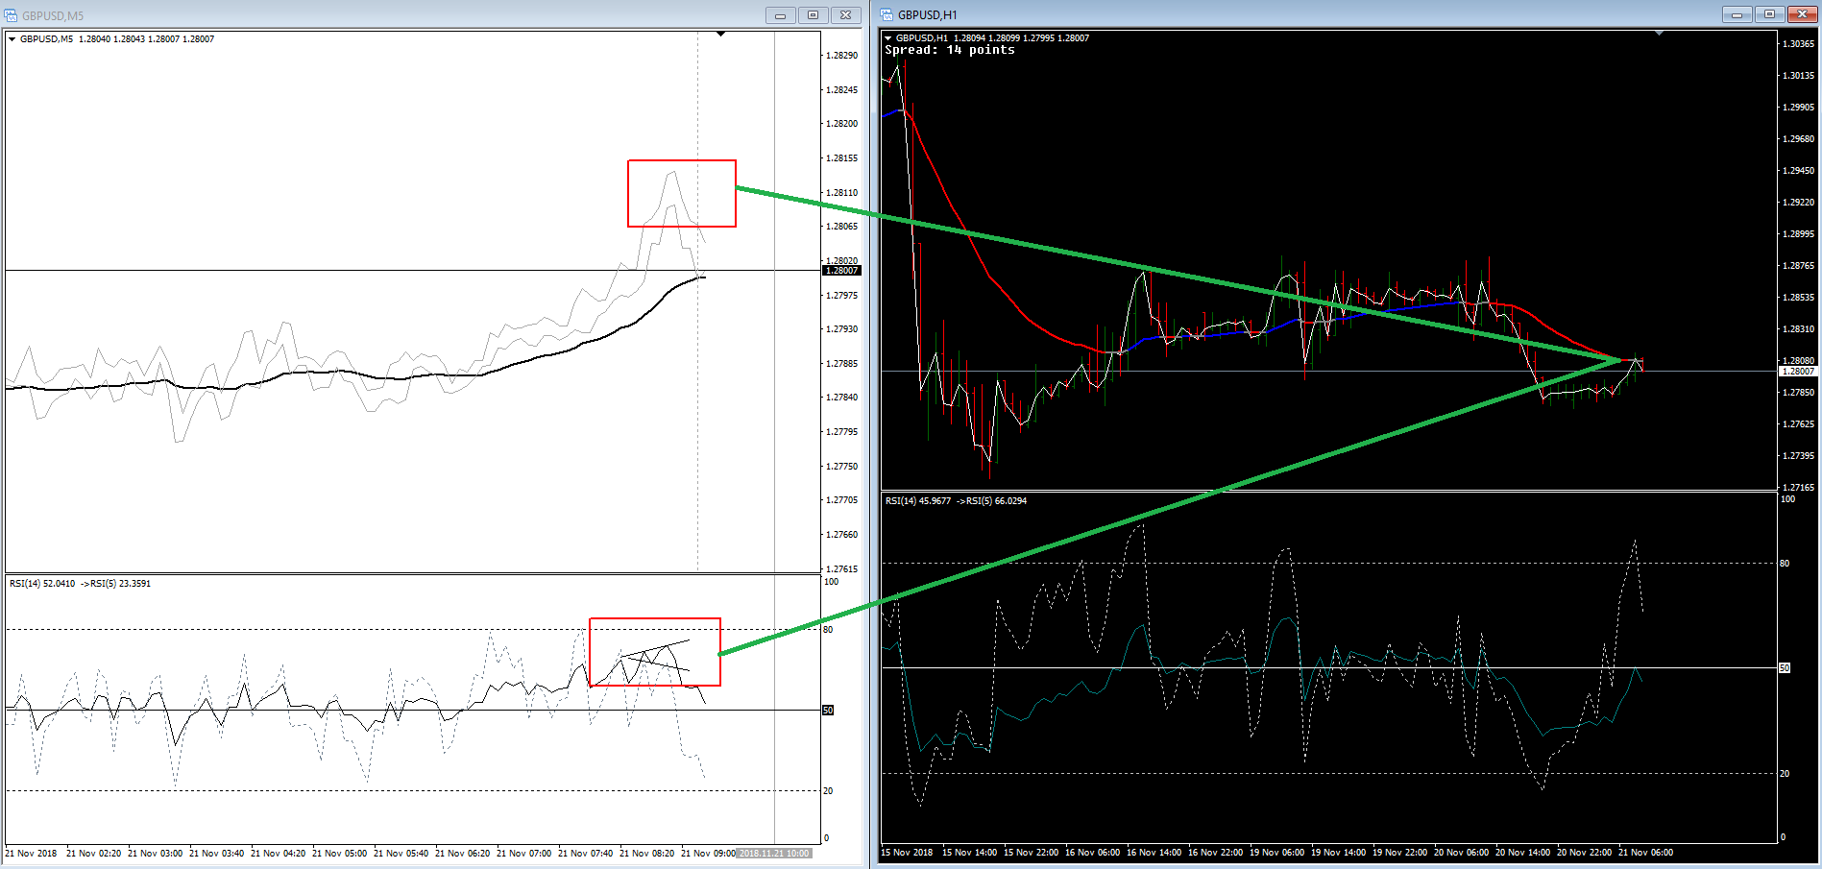
See how in the 1 hour price is at the EMA when on the 5 min we have a divergence on the RSI. The divergence tells us price is going to get back across the EMA on the 5 min..

Slide 4
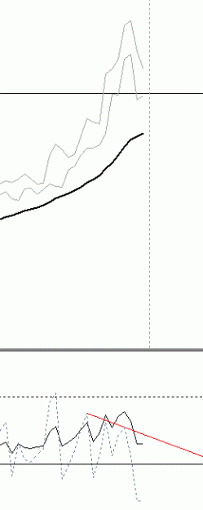
The fast RSI is already showing weakness because of not crossing the slow and to be in divergence like that adds to the weakness of the bulls. For now I will just refer to them all as divergences.
We want to see these signals on the higher 1 hour chart so we can drop to the lower time frames to look for entries.

Slide 5
These divergences can get us in or out or even hedge trades.
The signs are in the question 'Are we trading above or below the average, if below we look to short the tops, if above we look to long the bottoms
As far back as you can,mark the swing levels.
The market has a longer memory than our charts have history for so it is not a bad idea to keep a logbook of the levels that are getting old. In this way you can simply drop a line on the chart when price is in the area

Slide 6
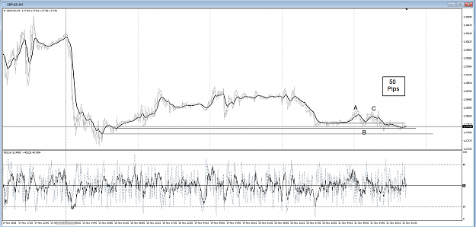
Remember the divergence is going to take price back across the EMA . Then another divergence at the bottom again took price back up across the EMA. So on this particular if we haven't got our 50 pips on the first trade then we could have taken another trade long to make up the difference.
See the chart below and all three, A, B and C are all divergences.
At C the average fails to make the HH so it tests the opposite and makes the LL easily

Slide 7
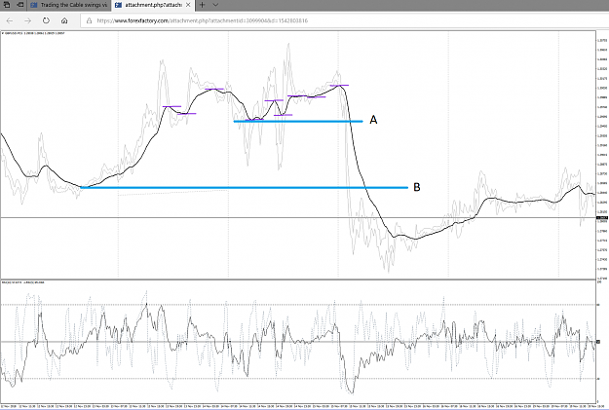
When price breaks A it is dragging the average to make the LL. To make the average break the lower low price pulls down to B (the next average level) In this case price passes through B so it is trying to drag the average below B also and price will make the next lower level (not shown)
Now at the 5 min level this mostly happens much sooner so you can get in earlier for the domino effect of stepping up through the time of the charts. If you look at the 1 hour chart of this move price probably stopped on that chart`s time frame of an average swing.
So we use all the time frames and that is why I only trade one pair. If you have the charts side by side like I have you can see clearly what is happening.
It is not possible to draw the swings differently, a swing is a swing is a swing.

Slide 8
So I am going to use a $1000 daily profit as an example here.
Now I said previously 50 pips is a very common move for this pair. It can be a heck of a lot more or sometimes a tad less but 50 is the number I work with.
So if 50 is the target and in money terms 1000 is the objective then we just look at the relationship of these two figures.
First off I am going to try to get my trades on within the first 10 pips (Can't always do this but that's trading for you). This leaves me with 40 pips to make my objective. So 1000 divided by 40 = $25 per pip.
Now I am not going to risk $25 for an entry (well not yet anyway) what I want to do is make entries in progressive stages each time adjusting the stop to limit the damage when things go wrong. This can happen and we should never be complacent about this occurrence.
I aim for 40 pips above my last entry to make my money.
price pulls the 26EMA to make a HH or LL

Slide 9
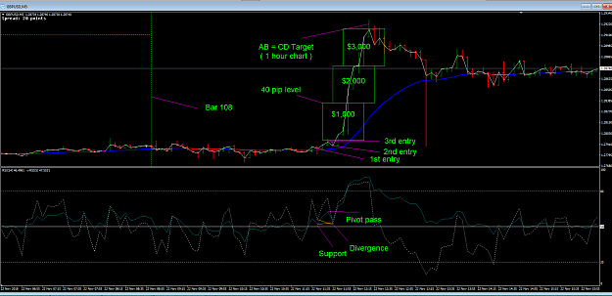
Firstly we should be aware of flattish markets, these are a warning of big things to come and the unwary trying to grab scalps can easily get caught on the wrong side and receive a severe finger burning.
The trouble is we do not know how long these flat spots are going to persist so we have to be very careful and busy plotting the charts for the story that may unfold quicker than we can say SH*T what happened?
We look hard for the signals that something is up and about to happen. You simply do not have time to slip out for a coffee when working, this will have to wait until you get your stops to break even. I am not joking, this is a very busy time where you need a clear head and no distractions.
Using the same section of chart as above and in this case looking at the bulls finding support. We see this...

Slide 10
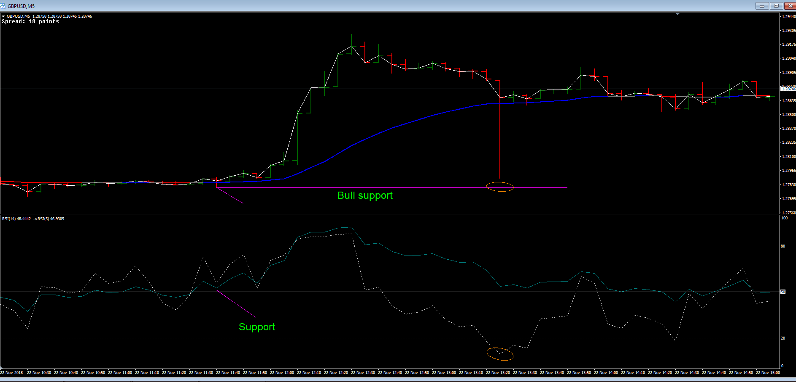
Both price and the RSI have formed a distinct pivot, price above the EMA and RSI above the waterline (50%). Not confirmation as yet but worthy of our my first entry with the stop just below the wick (very tight, low risk).
This happens most of the time on the 5 min chart.
Then we see the bears are failing to recross, the fast RSI gets below the blue but we see failure to cross the EMA. A good reason for my second entry and moving the stop. A two bar test at this point gives me the third and final entry and again moving the stops ASAP until all are at the minimum of break even above the last entry.
Only now can we take a break but as you see from this example the whole thing took less than an hour to make an incredible $3,000 bucks for a very tiny risk.
These moves do not happen every day because of the setup and execution processes.
Generally we would scalp the setup and trade the execution.

Slide 11
Remember I want to risk as little as possible and a warning here is due to NEVER ADD TO A LOSING TRADE. People only do that with good skills, small entries, large accounts. My rationale is completely different, I do the pushing as hard as I can, I don't let the market push me.
See how it works:.
Smallish test entry, second more encouraged entry, even more confident entry.
The potential for making far more money than I risk is foremost in my opinion.
I spend very little time at the PC and relatively not long in a trade, tiny losses versus huge wins.
Sometimes I see nothing so I simply don't trade at all, it is not compulsory it is an option.

Slide 12
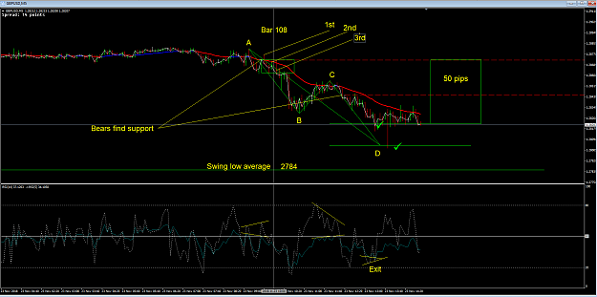

Slide 13
2) The trade often begins with a small RSI divergence. Divergence sends price across the EMA (This happened)
3) Bears find support below the EMA. (This happened)
4) Price ran down but on the RSI it ran into exhaustion so a hedge is attempted to protect profits thus far. (This happened)
5) The hedge ran into divergence so we remove it along with the profits made. (This happened)
6) We measure the pullback in relation to an AB=CD. (This happened)
7) It hit the AB=CD target by which time we had already made our 50 pips. (This happened)
8) All the time watching the action as it is attacking the next average swing low 2784. (This may still happen)
So the trade is completed albeit taking a tad more time than usual. Like detectives we looked for the clues and take the appropriate actions without trying to guess what may or may not happen. So this is not a system as such it is simply paying attention and reacting accordingly

Slide 14
As long as we just dip our toes in the water first then add as we become more confident and move the stop to limit damage we should be fine. A stopped out trade is not the end of the world and these trades pay so well that tiny losses just become par for the course. One thing I have noticed over the years is that people put tiny lot sizes on so they can add to the position if it goes against them, well if it going against them then the analysis was wrong and it becomes a wing and prayer situation as hope springs eternal.
This is the trouble with tiny lots, they give a false confidence to the trader that they can always trade out of the situation. Mostly we could do this but it only takes one that we can't fix and we blow heaps of our account defending it. Then people begin to chase losses and the hole just gets deeper.
Maximising our trade in the first place stops any attempt to do this and the rewards are far greater.
Anyway this is the way I trade and it is very profitable.

Slide 15
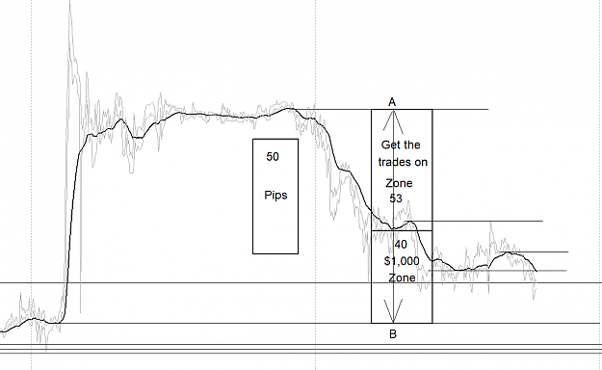
Look at the 5 min chart here where we are expecting price to run from A to B. We had a 53 pip movement to get our trades on and still have the 40 left to complete the task. Once we see the bears have FOUND support and we see the 1 minute chart making those lower low average swings we have heaps of time to add to our position

