Slide 1
BUILDING YOUR ENVELOPES
WITH THE GANN OCTAVE
"Construction of such an Envelope is always the starting point for observational cyclic analysis"
Jim Hurst- Profit Magic - page 37

Slide 2
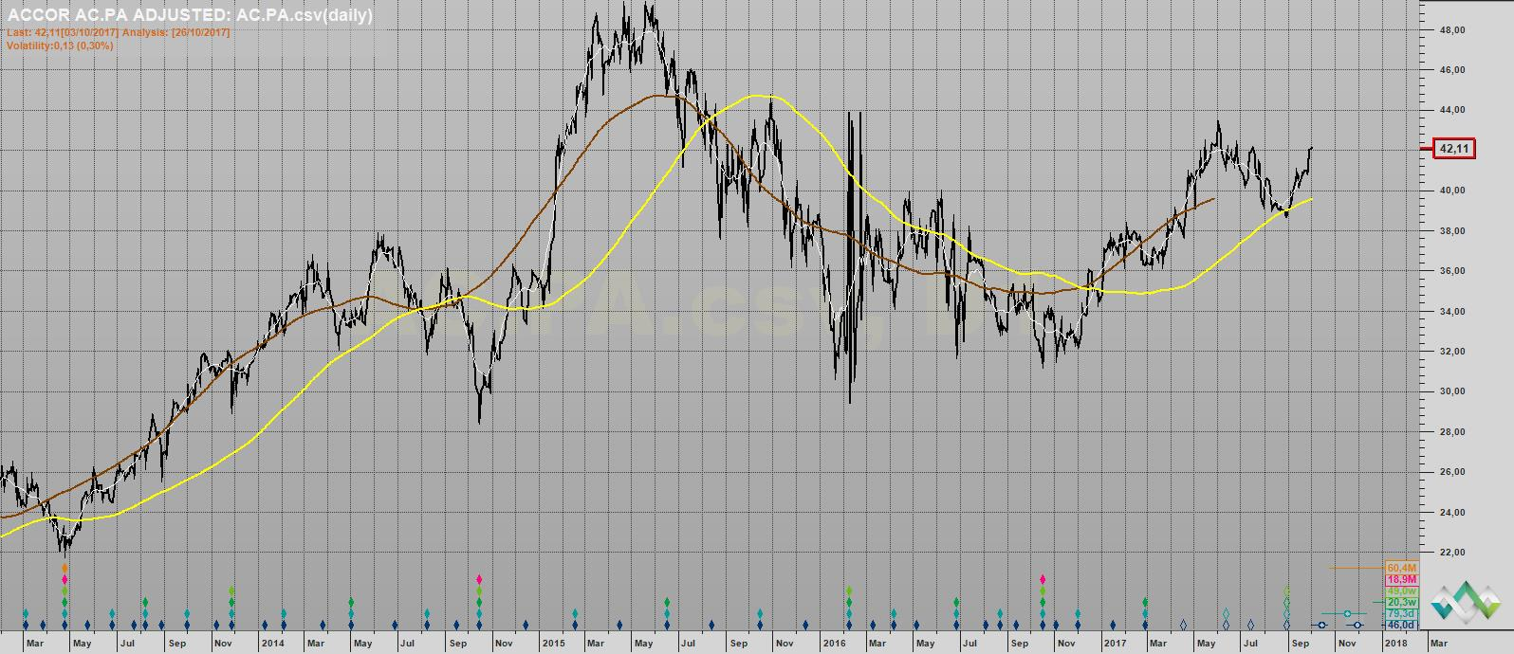
Why using a Centered Moving Average ?

Slide 3
Calculating a Centered Moving Average
The last point of a Centered Moving Average (CMA) is positioned ½ period back
Example : If we consider a Centered Moving Average 21 days, the last calculated value of CMA 21 is positioned 10 days back at D-11.

Slide 4
A Centered Moving Average of any given Time Span acts as a « Low Pass Filter ».
Reduces to zero the magnitude of all fluctuations (cycles, frequencies) of duration equal to that time span
greatly reduces the magnitude of all fluctuations (cycles, frequencies) of duration less than the time span of the moving average
- let « come through » all fluctuations (cycles, frequencies) of duration greater than the time span of the moving average

Slide 5
Practical Example :
The 4 Months Centered Moving Average
- eliminates the 4 Months cycle.
- greatly reduces the magnitude of cycles of duration less than 4 Months (3 Months, 2 Months, 1 Month, 2 Weeks etc)
- let « come through » all cycles of duration greater than 4 Months (18 Years, 9 Years, 6 Years, 4.5 Years, 3 Years, 18 Months, 9 Months, 6 Months)
The 4 Months Centered Moving Average shows us the Trend of the sum of all Cycles of duration greater than 4 Months .

Slide 6
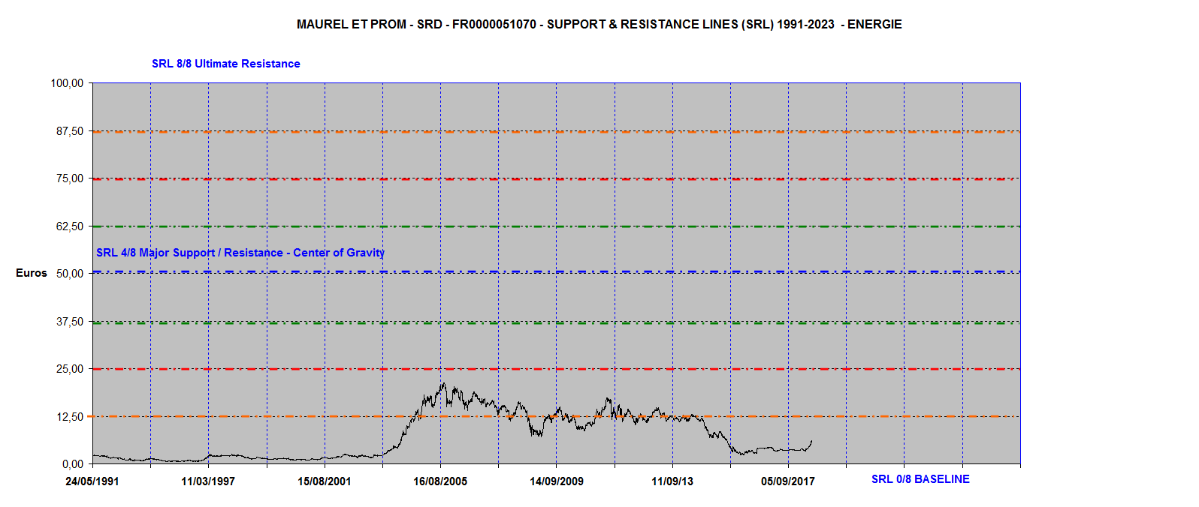
MAUREL & PROM :
Major Fractal = 0 / 100

Slide 7
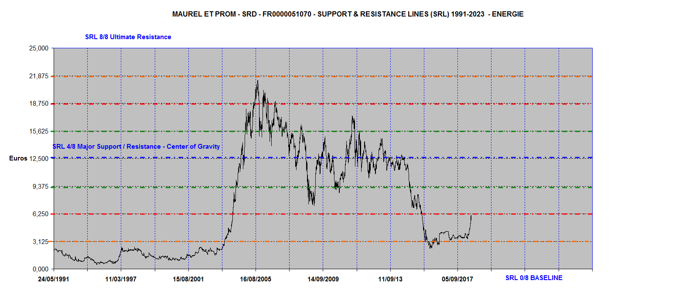
MAUREL & PROM :
Active Fractal = 0 / 25

Slide 8
Defining the 1 Year Envelope Octave
Major Fractal = 0 / 100
Major Octave = 100 / 8 = 12,5
Active Fractal = 0 / 25
Active Octave = 25 / 8 = 3,125
Then 3,125 will be selected as Octave to build the 1 Year Envelope.

Slide 9
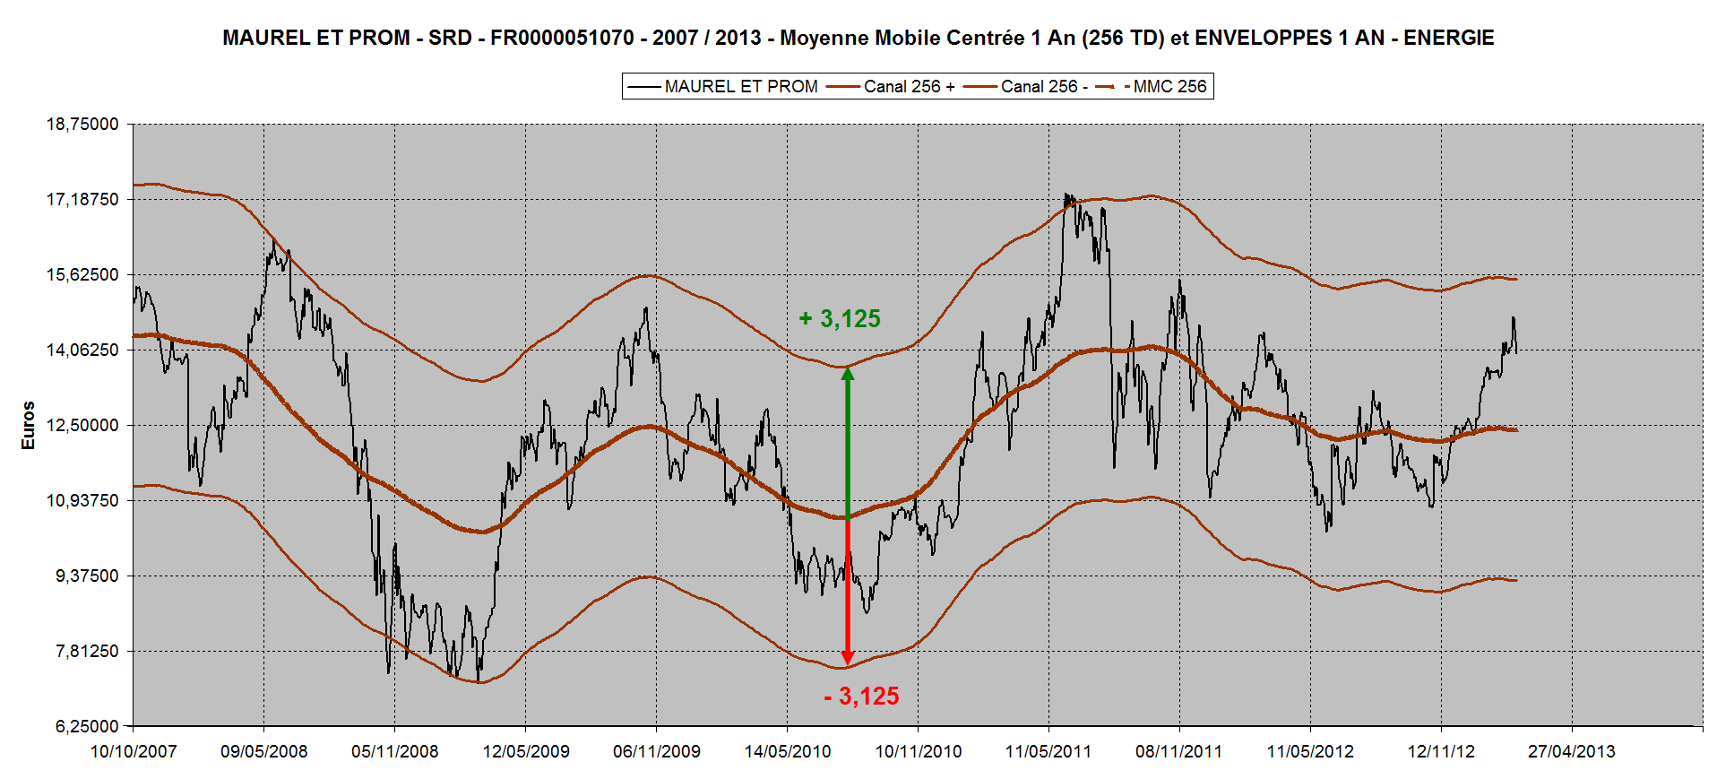
Building the 1 Year Envelope

Slide 10
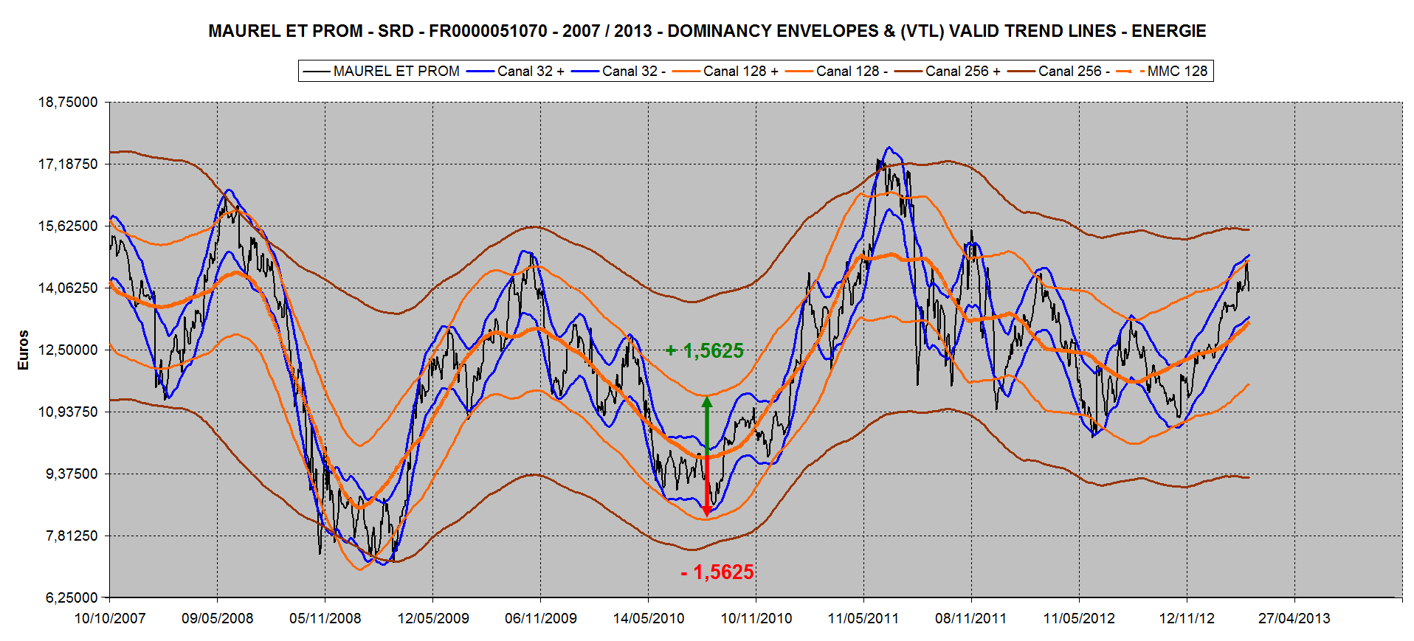
Building the 6 Months Envelope

Slide 11
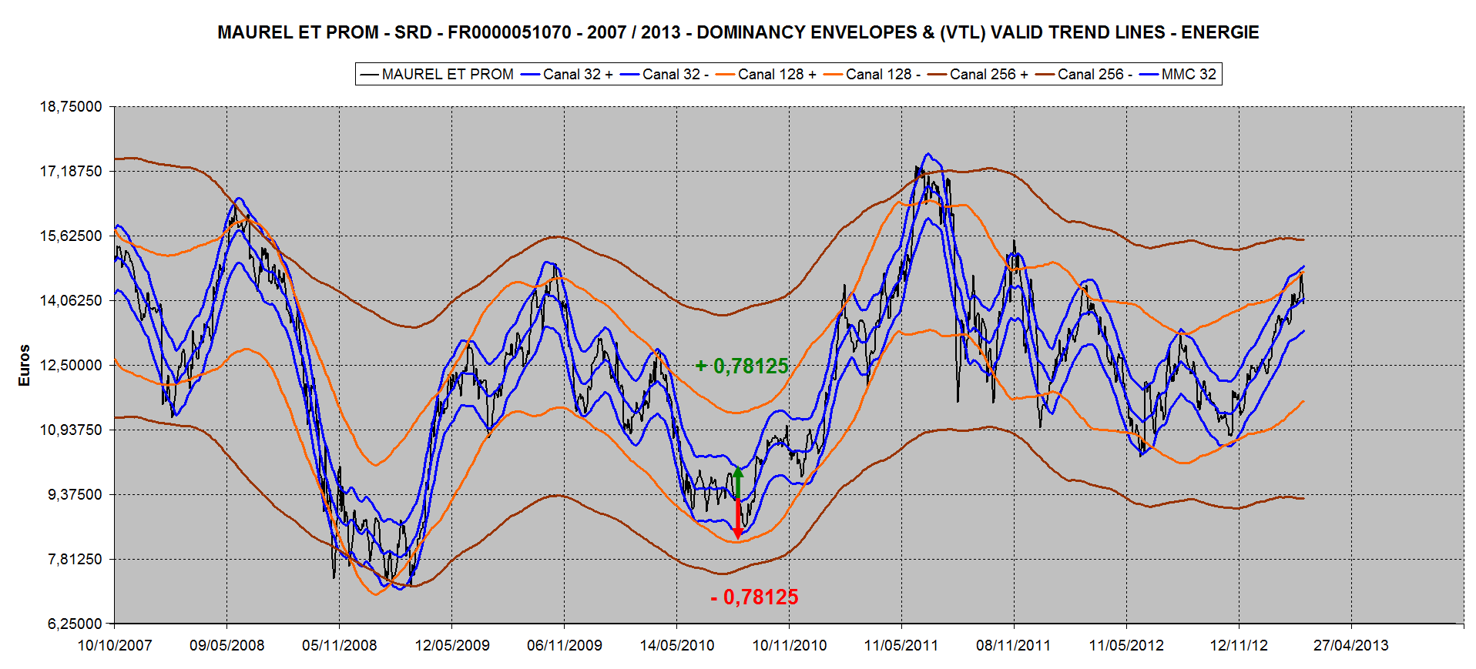
Building the 6 Weeks Envelope

Slide 12
Multiplying or Dividing by 2 the operative Octave
To manage :
- the use of different Time Units (TU)
- Volatility modifications
- GAPS UP or DOWN at the opening of the Market

Slide 13
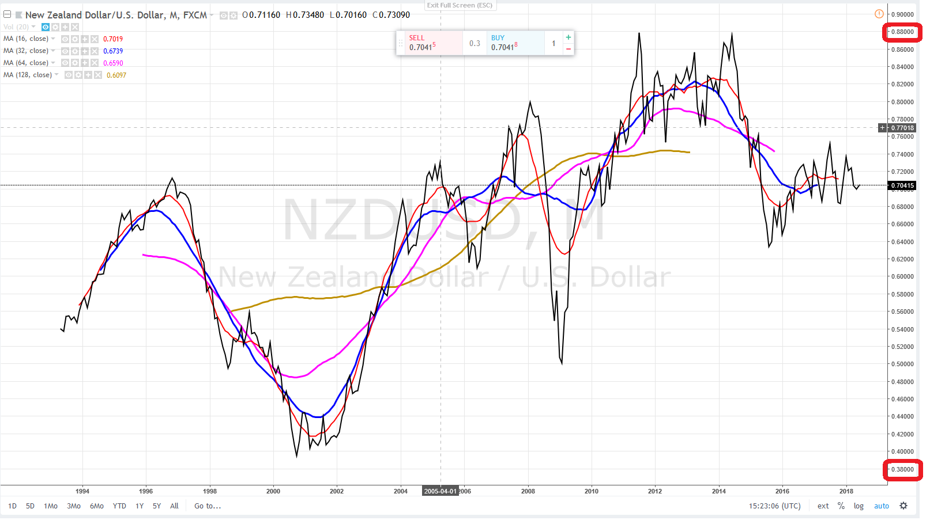
NZDUSD : Price Range = 0,88-0,38 =0.50
Octave = 0.5 / 8 = 0.0625

Slide 14
NZDUSD : Price Range = 0,88-0,38
Octave = 1 / 8 = 0.125

Slide 15
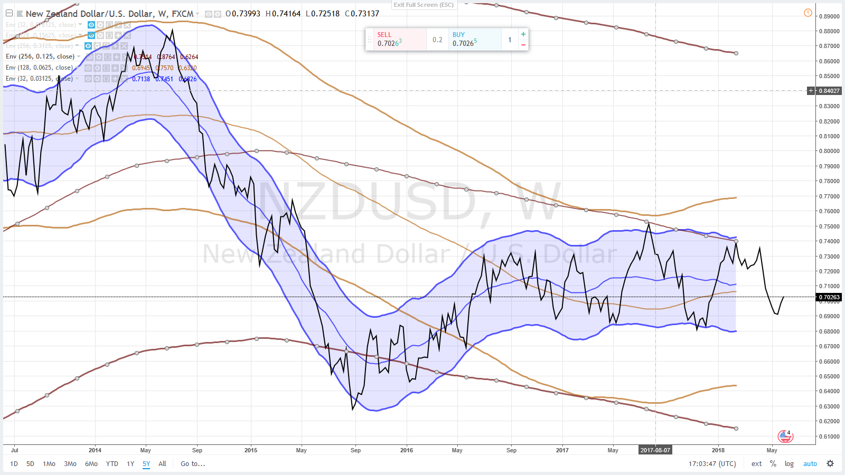
NZDUSD : Envelope Parameters
5 Years - Week
0.125 / 0.0625 / 0.03125

Slide 16
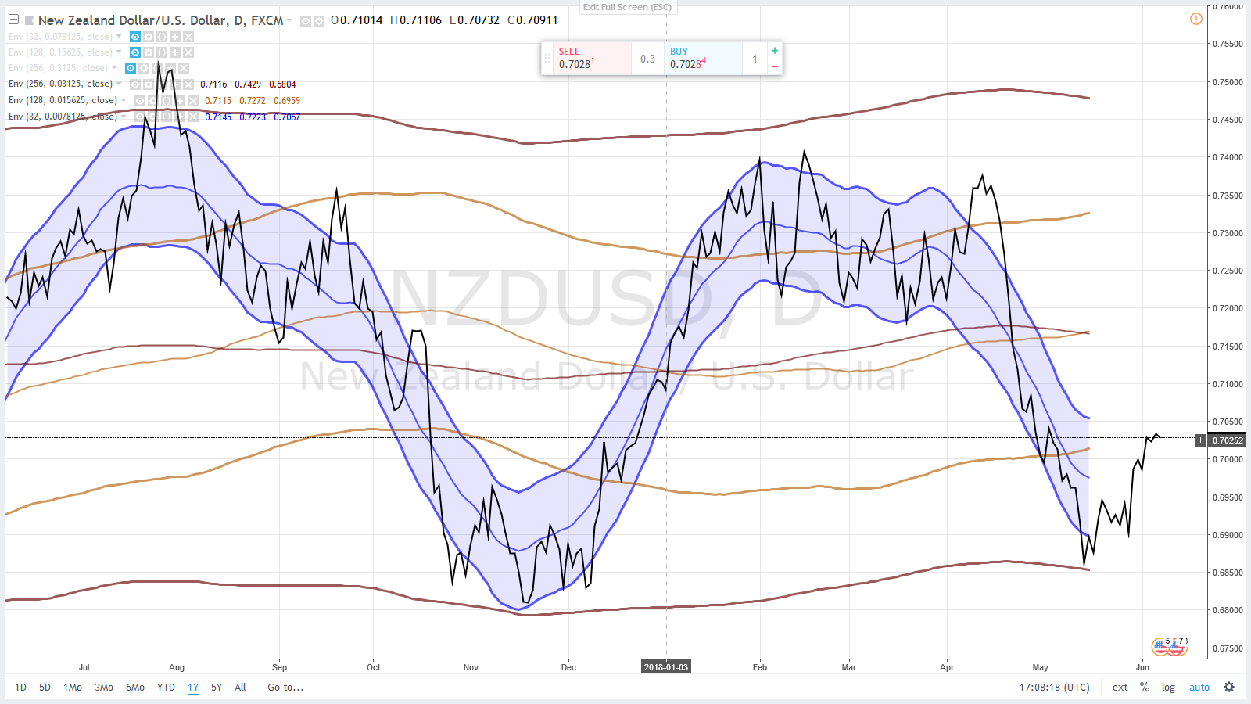
NZDUSD : Envelope Parameters
1 Year - Day
0.03125 / 0.015625 / 0.0078125

Slide 17
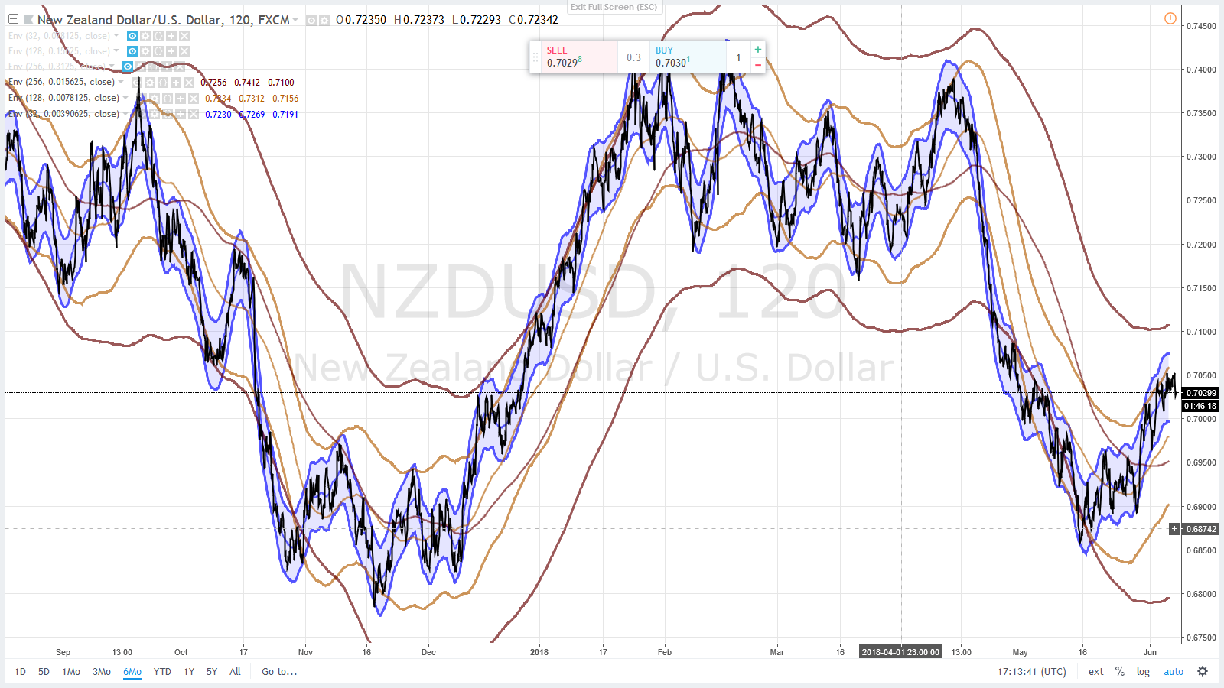
NZDUSD : Paramètres des Enveloppes
6 Mois – 2 H = 120 minutes
0.015625 / 0.0078125 / 0.00390625

Slide 18
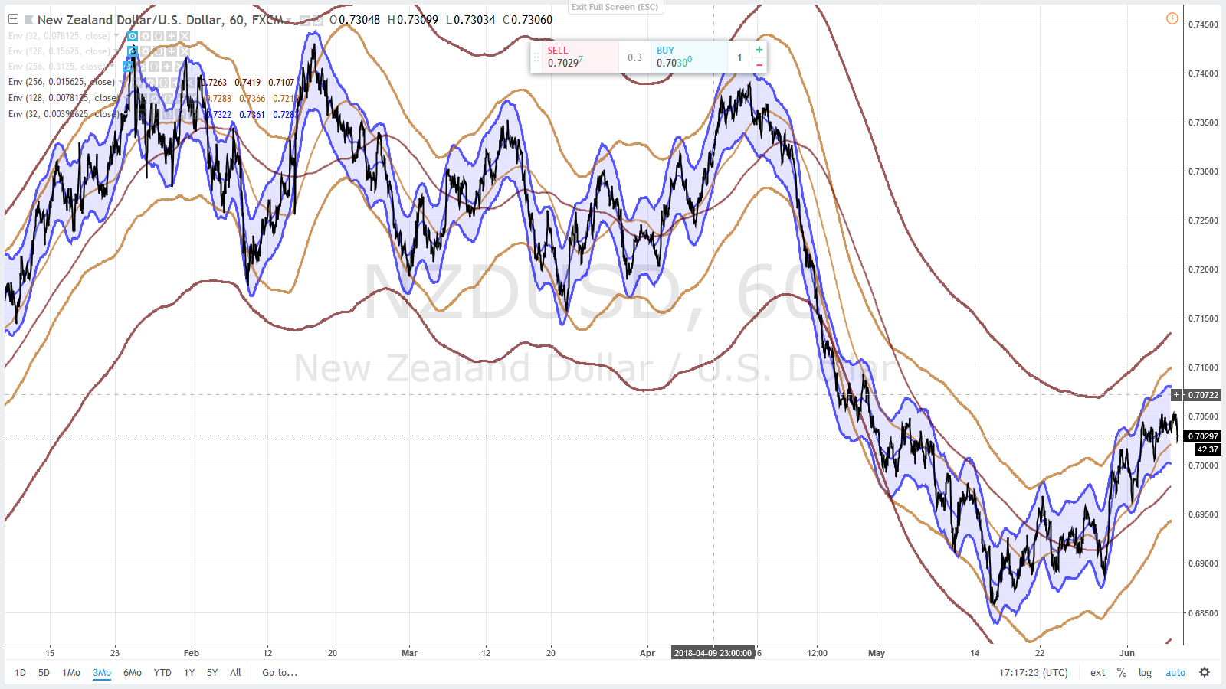
NZDUSD : Envelope Parameters
3 Months – 1 H = 60 minutes
0.015625 / 0.0078125 / 0.00390625

Slide 19
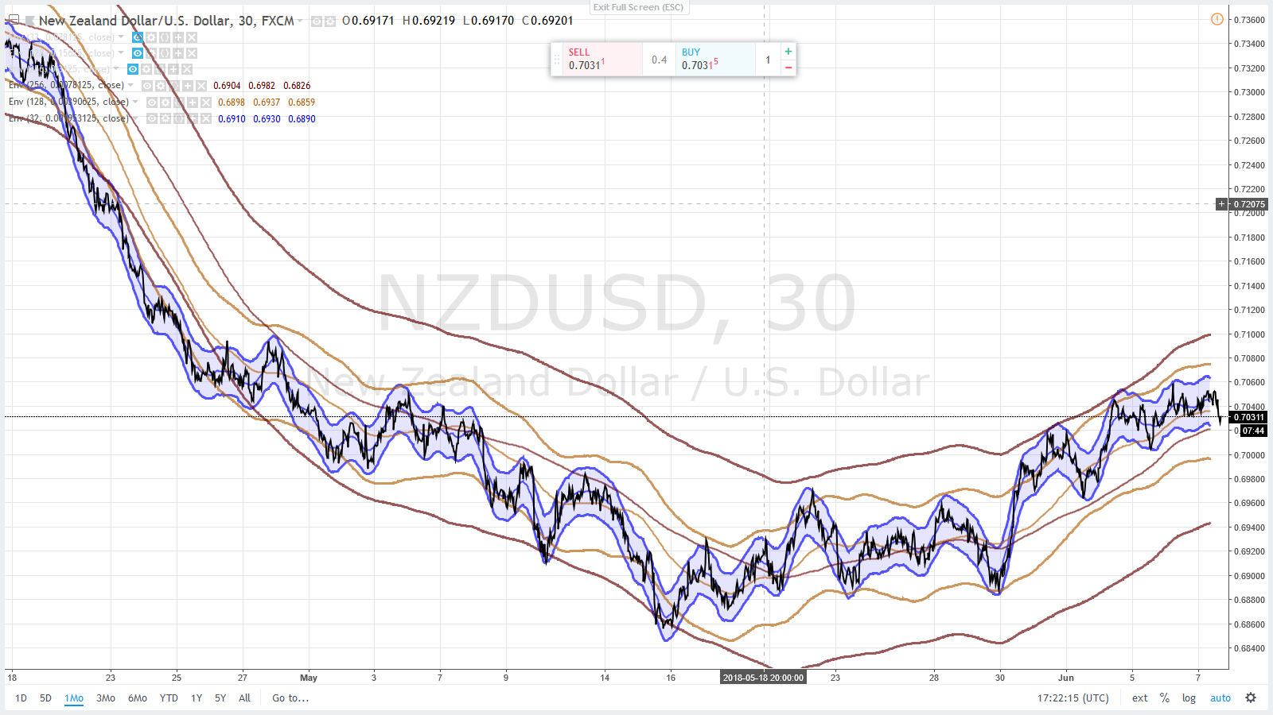
NZDUSD : Envelope Parameters
1 Month – 30 minutes
0.0078125 / 0.00390625 / 0.001953125

Slide 20
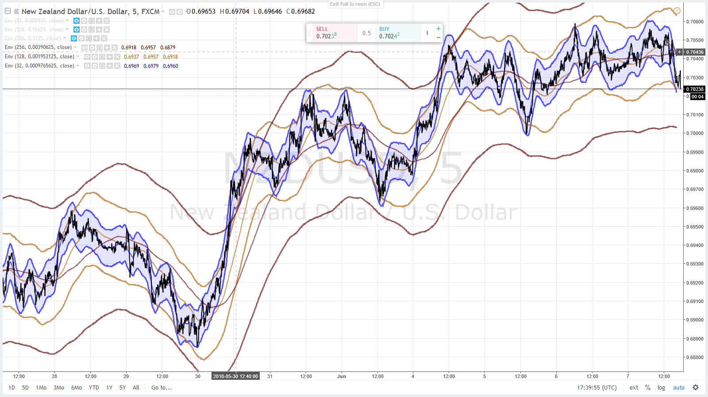
NZDUSD : Envelope Parameters
5 Days– 5 minutes
0.00390625 / 0.001953125 / 0.0009765625

Slide 21
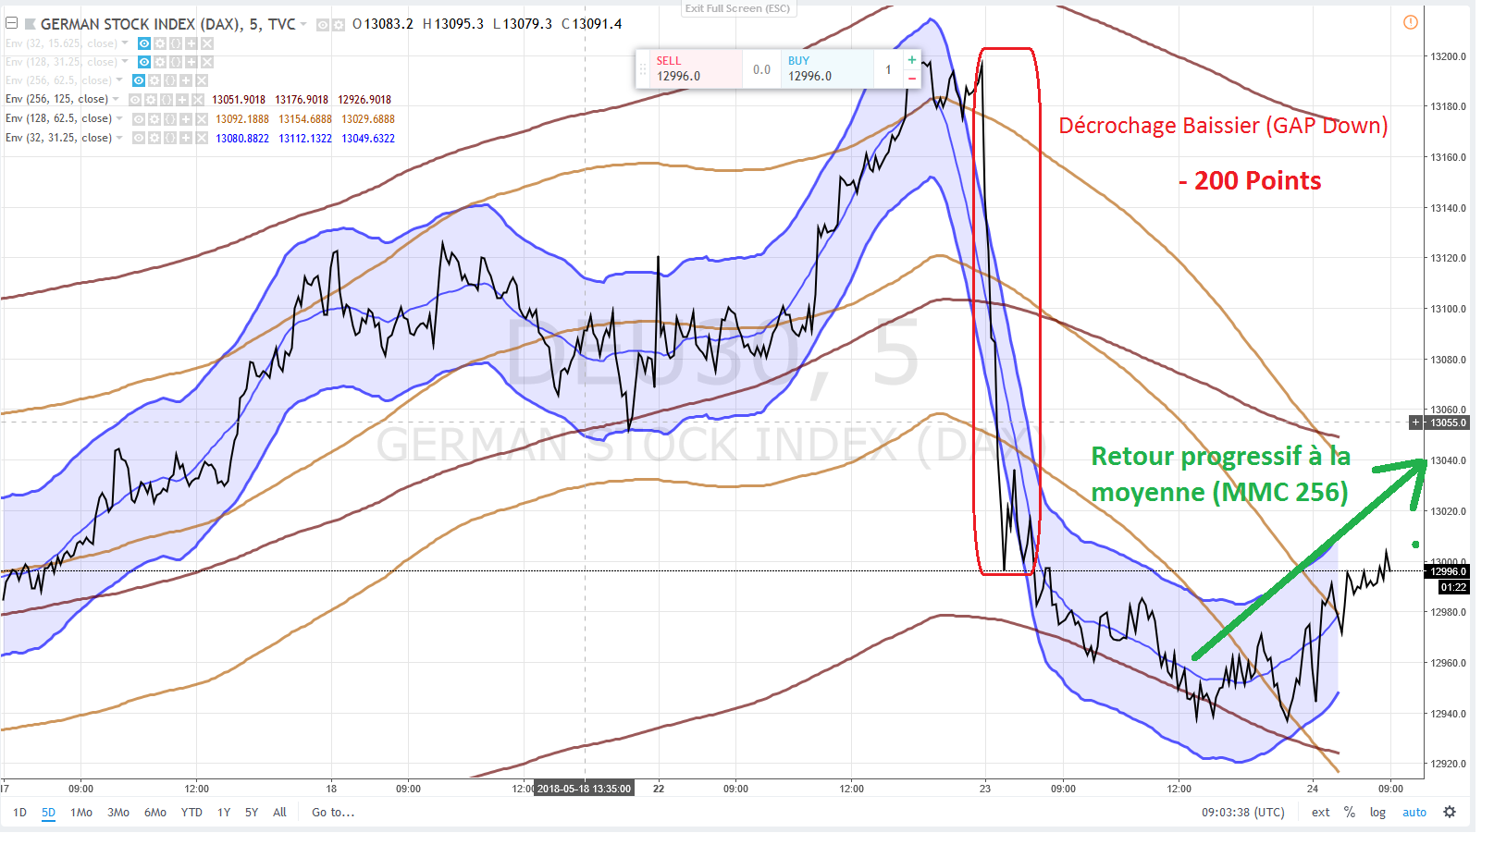
Return to the Mean

Slide 22
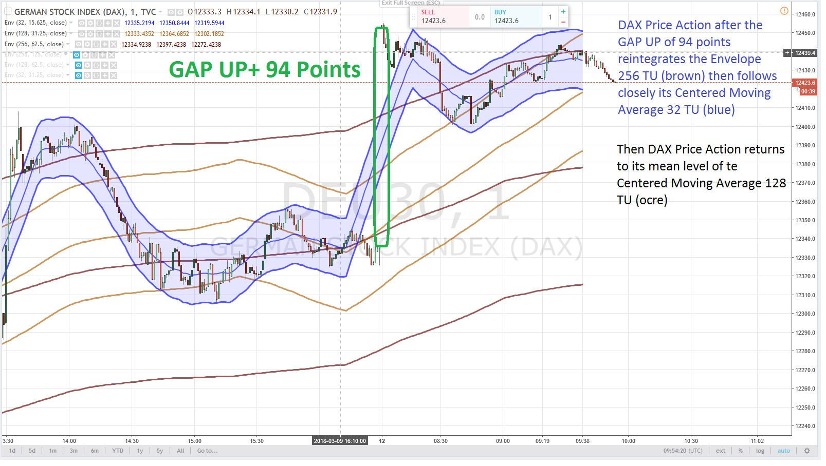
DAX : GAP Up + 94 points

Slide 23
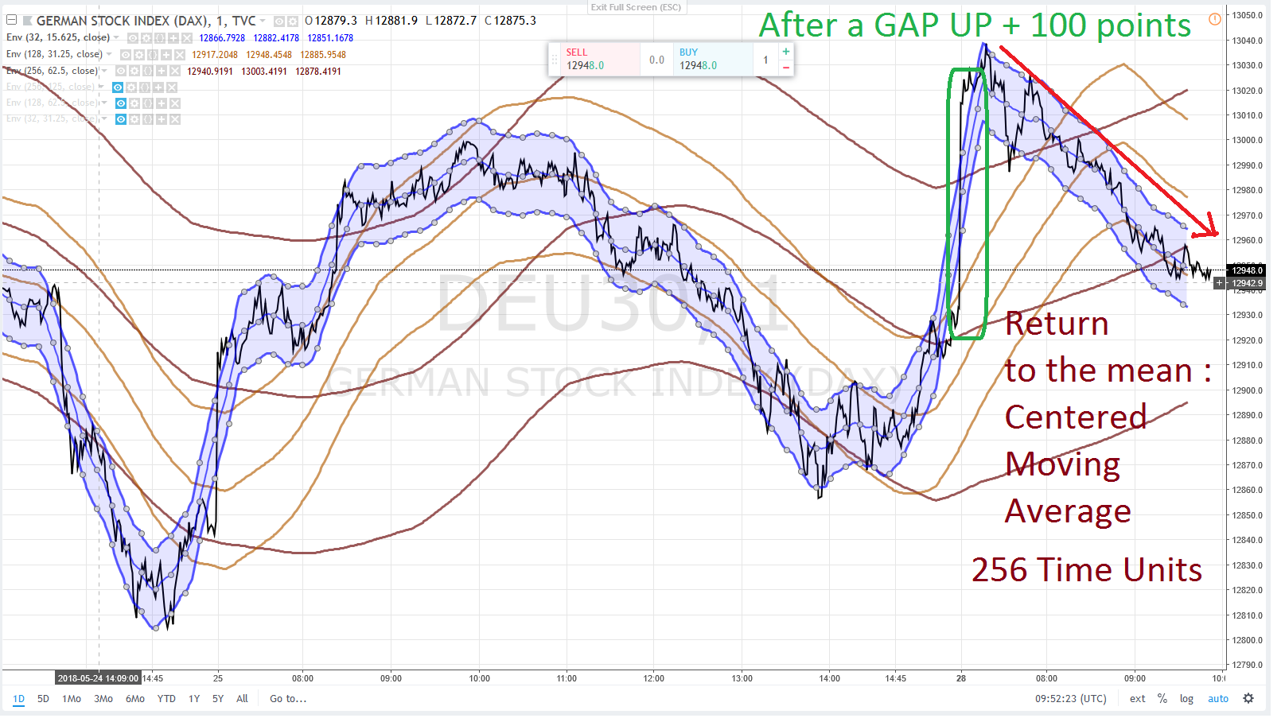
DAX : GAP UP + 100 points

