Slide 1

Kumo Breakout Trade

Slide 2
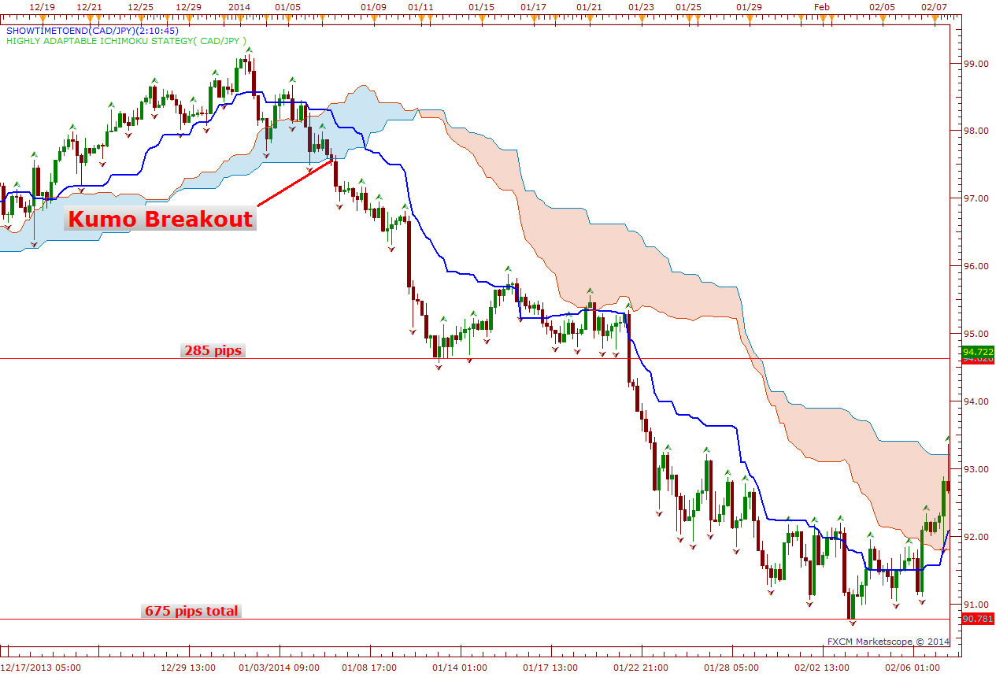
Bearish Kumo Breakout Trade

Slide 3
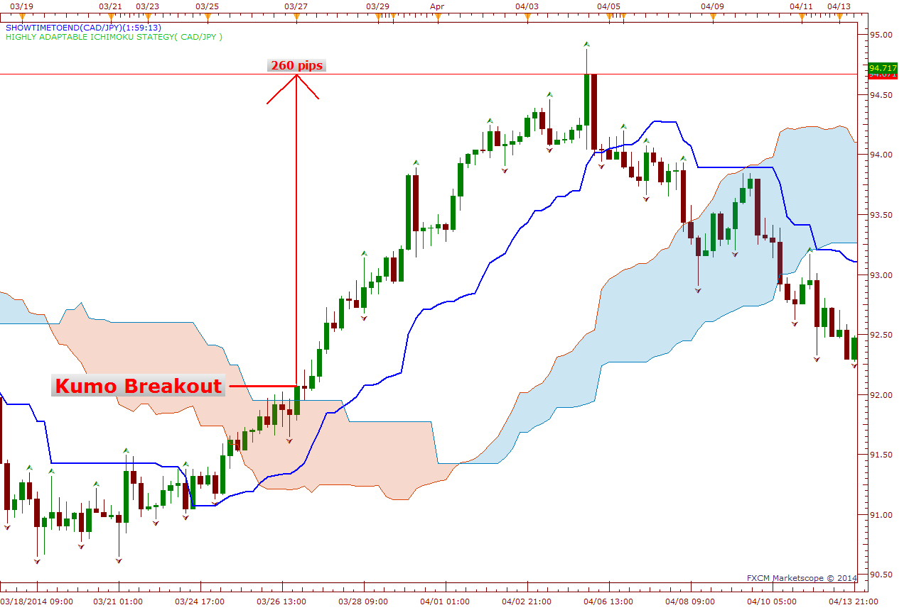
Bullish Kumo Breakout Trade

Slide 4
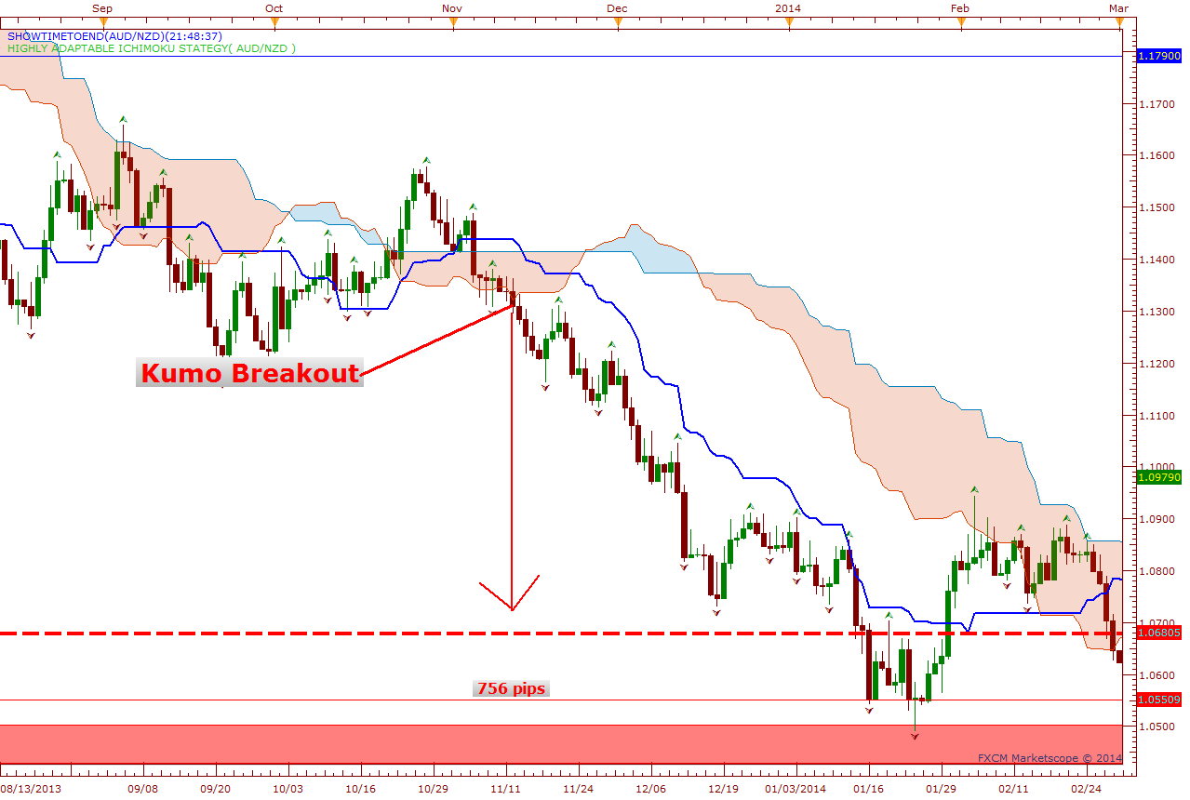
Bearish Kumo Breakout Trade

Slide 5
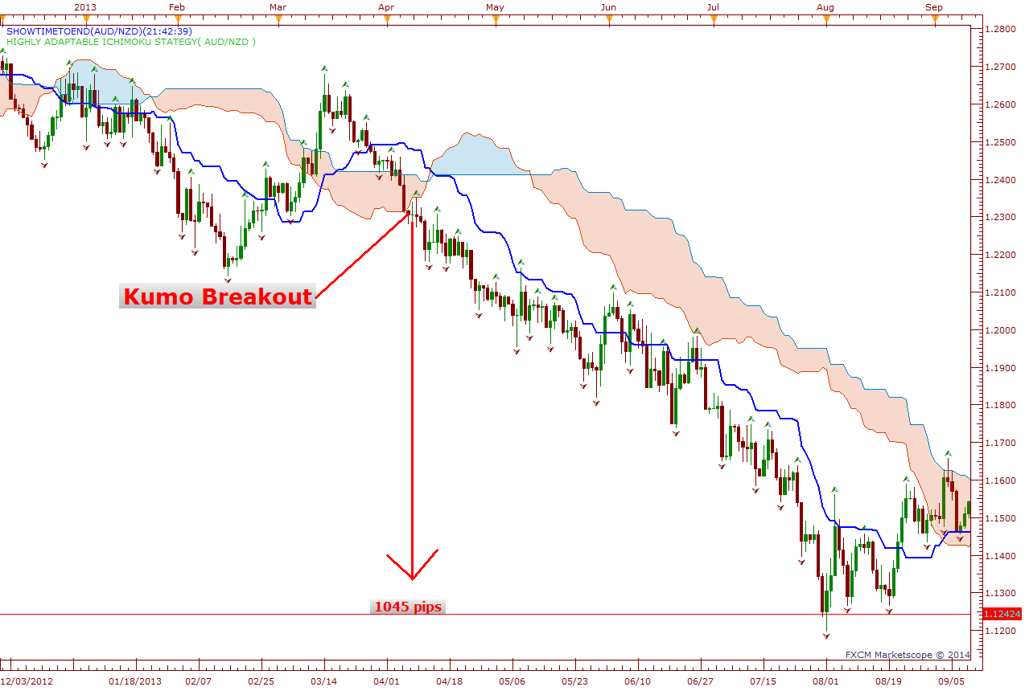
Bearish Kumo Breakout Trade

Slide 6
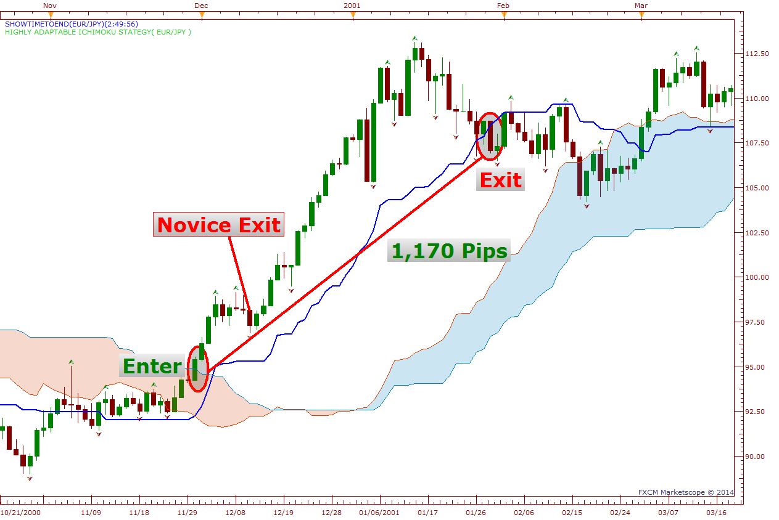
Bullish Kumo Breakout Trade

Slide 7
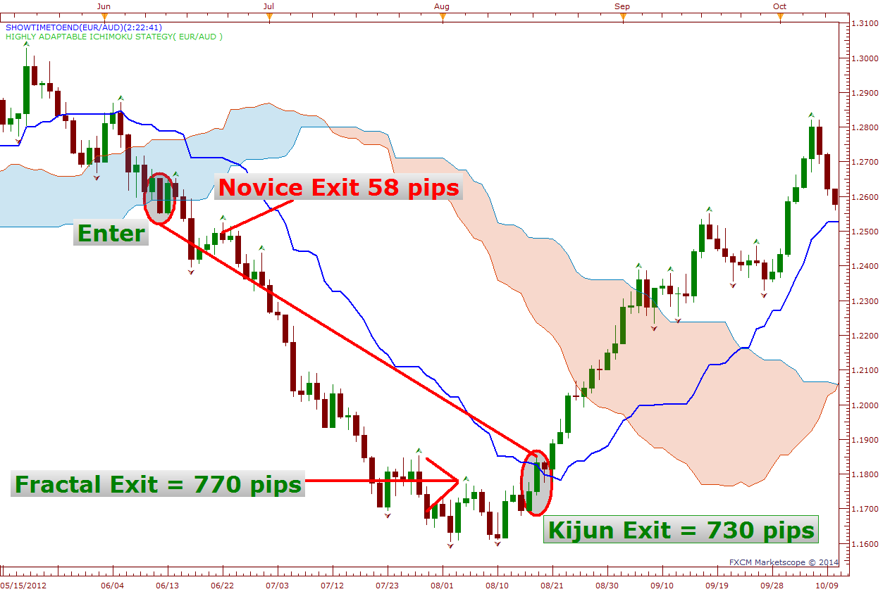
Bearish Kumo Breakout Trade

Slide 8
Kumo Breakout Trade
Bull Rules
Price needs to break and close above the Kumo Cloud (Must be first candle out)
Price needs to close above the Kijun Sen
Need a Bright Future / Bullish Kumo Twist
Chikou Span needs to be above price
Stop loss at either, break out candle open, Kumo Top or Bottom, Kijun or fractal level.
Exit at price close above Kijun or price close above fractal.
Bear Rules
Price needs to break and close below the Kumo Cloud (Must be first candle out)
Price needs to close below the Kijun Sen
Need a Dark Future / Bearish Kumo Twist
Chikou Span needs to be below price
Stop loss at either, break out candle open, Kumo Top or Bottom, Kijun or fractal level.
Exit at price close above Kijun or price close below fractal.

Slide 9
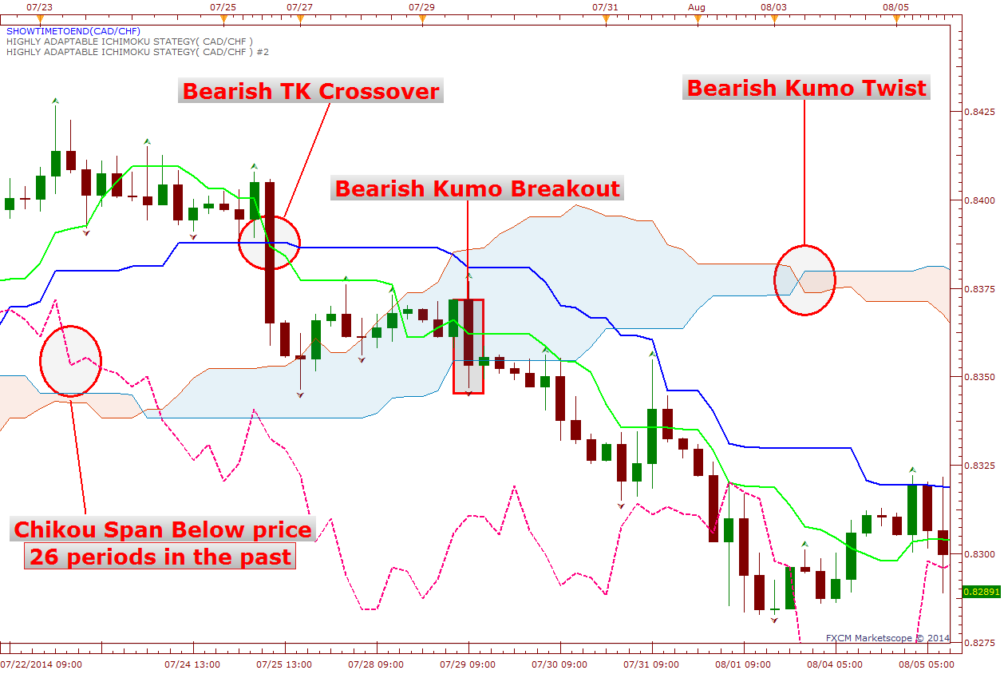

Slide 10
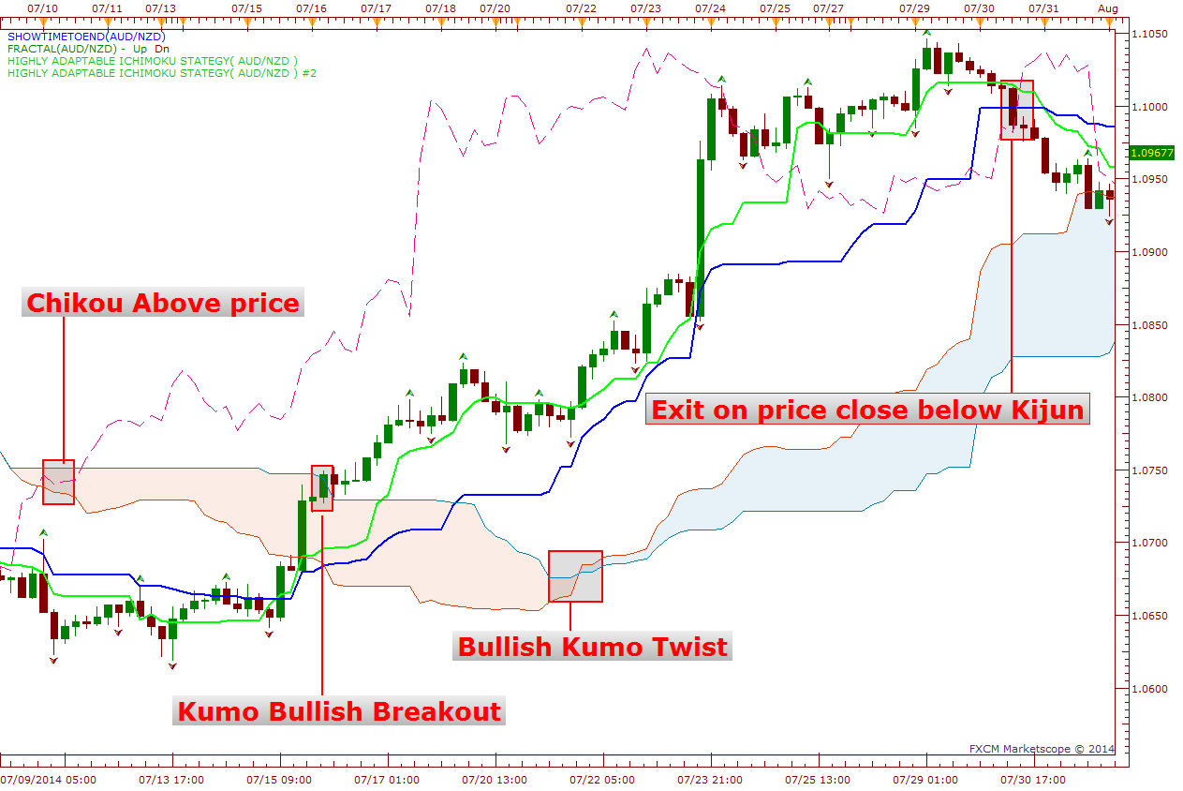

Slide 11
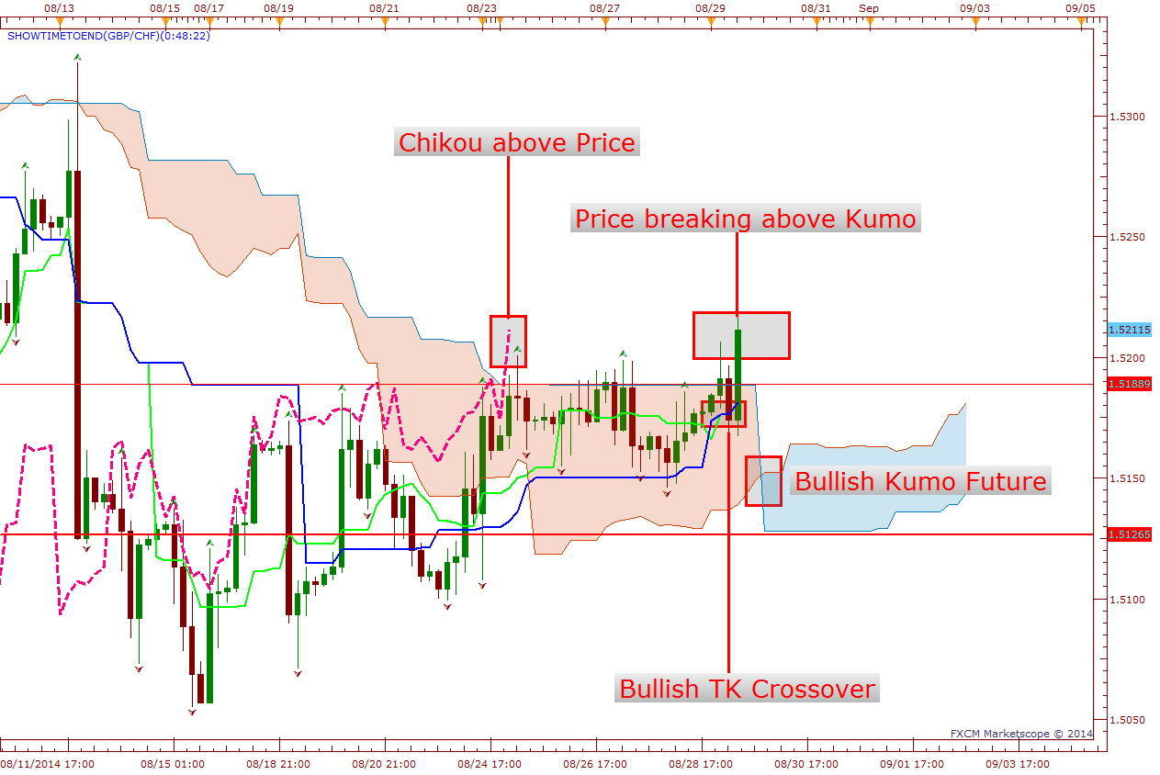

Slide 12
Kumo Breakout Stop Loss Levels
Kijun : Kijun is always our main stop loss level in every trade we use. Since Kijun is the equalizer that’s where price is attracted too.
Kumo Cloud : Kumo forms strong support and resistance levels based on the market volatility. Thick Kumo is a strong support and resistance level while a thin Kumo represents a weaker level of support and resistance.
Fractals : In a long trade bear fractals as stops and in a short trade bull fractals as stops. When market is trending up you rarely see bear fractals broken and when market is trending down you rarely see bull fractals broken.
Support & Resistance Levels: Horizontal, trend lines, psychological levels,

Slide 13
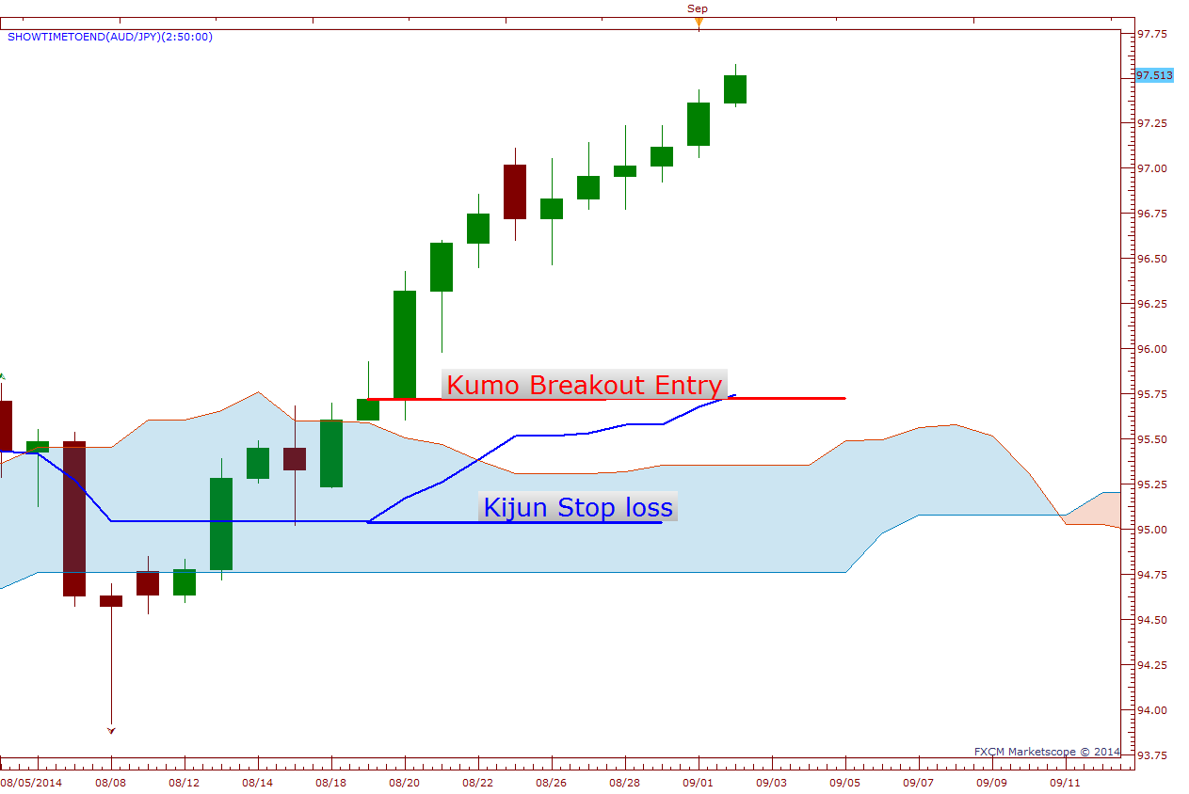

Slide 14
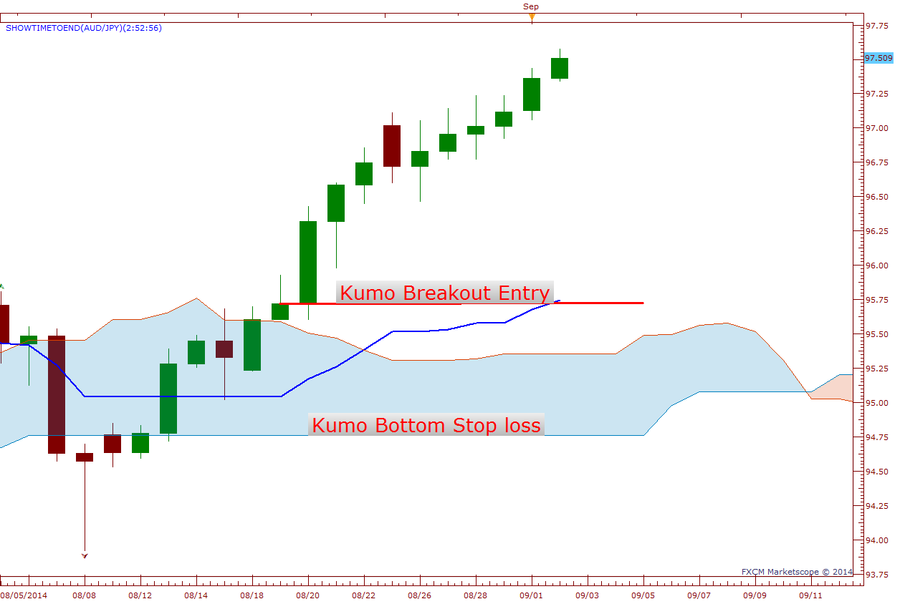

Slide 15
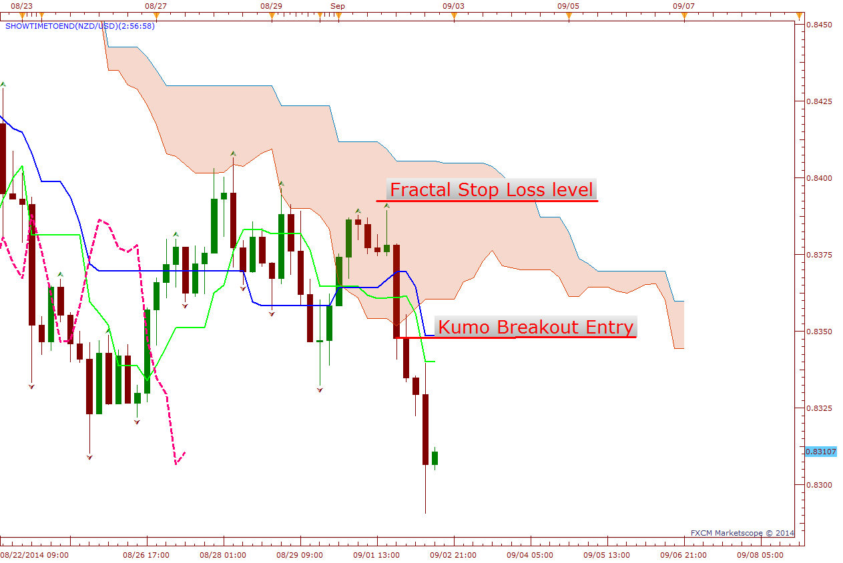

Slide 16
TK Cross Trade

Slide 17
TK Cross Trade
Bull Rules
Price above Kumo
Need a Bright Future / Bullish Kumo Twist
Chikou Span needs to be above price
Enter when Tenkan crosses Kijun from below to above at candle close
Stop loss at either Kumo Top or Bottom, Kijun or fractal level.
Exit if bearish TK Cross, price close below Kijun or price close below fractal.
Bear Rules
Price below Kumo
Need a Dark Future / Bearish Kumo Twist
Chikou Span needs to be below price
Enter when Tenkan crosses Kijun from above to below at candle close
Stop loss at either Kumo Top or Bottom, Kijun or fractal level.
Exit if bullish TK Cross, price close above Kijun or price close below fractal.

Slide 18
TK Cross Trade
The TK Cross Trade ( Tenkan crossing Kijun ) is perhaps the most well known trading setups of the Ichimoku system. This strategy is much the same as the moving average crossover signal except that the moving averages are normally based off of the closing prices where as the Tenkan and Kijun are based off of the highest high and lowest low over a period of time.
This signal identifies that momentum is shifting in one direction and that a strong move is likely approaching. A buy signal is generated when the Tenkan crosses above the Kijun, while a sell signal is triggered by the Tenkan crossing below the Kijun.
As with all trend-following systems, the signals work well when the asset develops a strong trend, but is ineffective when the asset is in a range. This strategy can be used with any time frame but is better suited with the higher time frames such as the 4H and daily.
The best signals occur when both lines are moving in the direction as your trade.
Usually if Kijun has been flat for a while then you will see a lot of whipsaws which means the market is ranging, but strong moves also may come off of a flat Kijun.

Slide 19
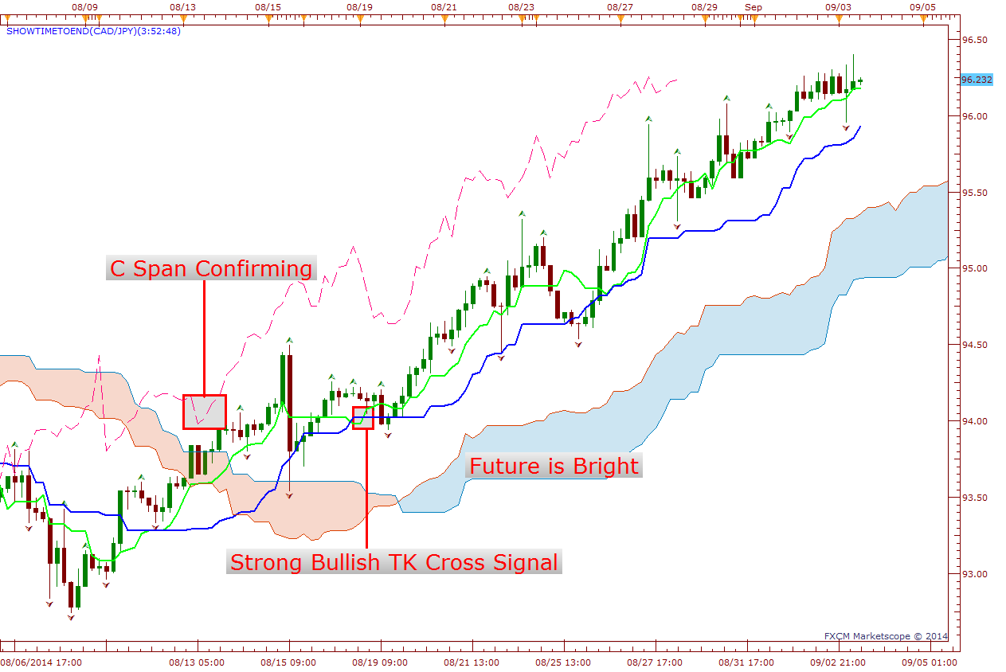
CAD vs JPY Bullish TK Cross Trade

Slide 20
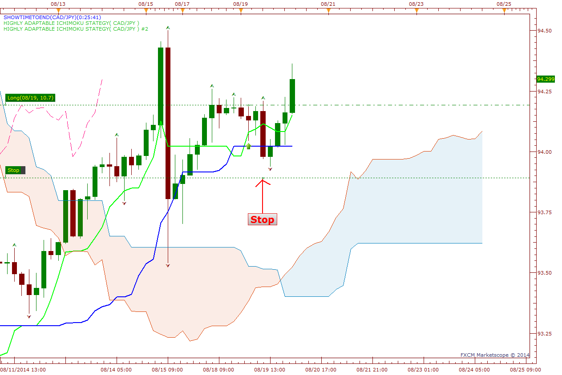
Lets follow this trade!

Slide 21
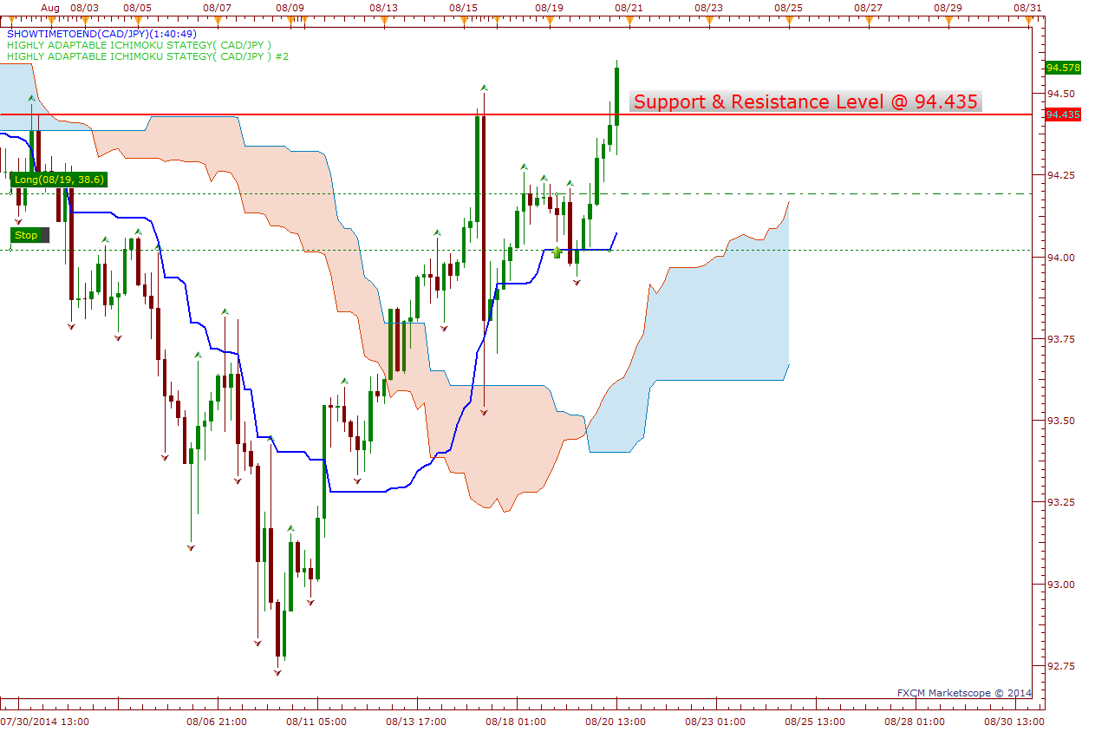
TK Cross Trade

Slide 22
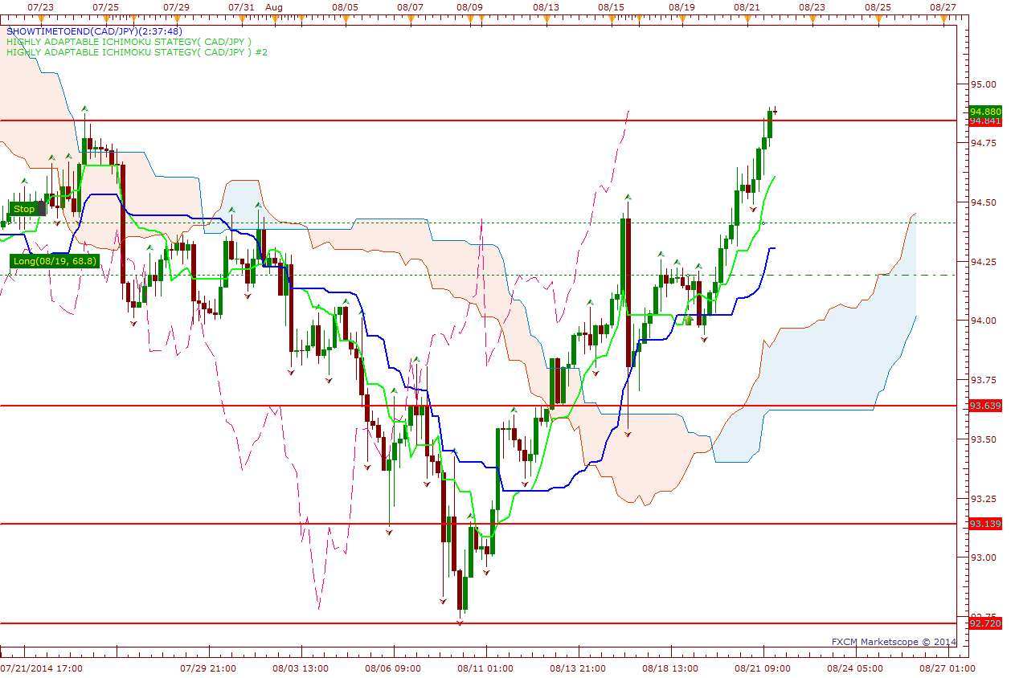
TK Cross Trade

Slide 23
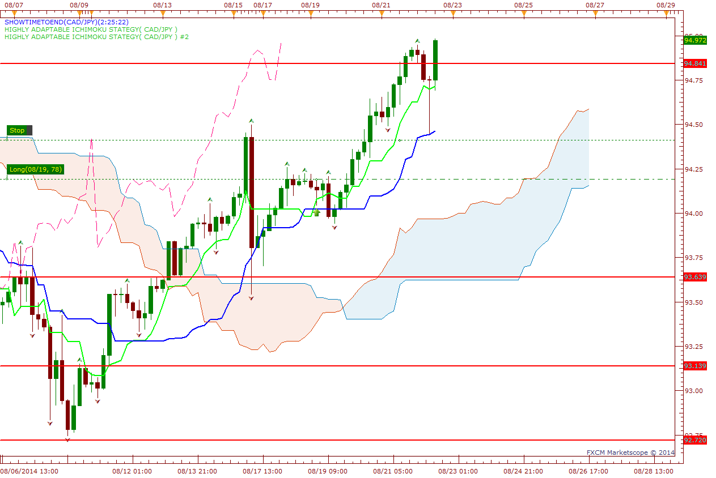
TK Cross Trade

Slide 24
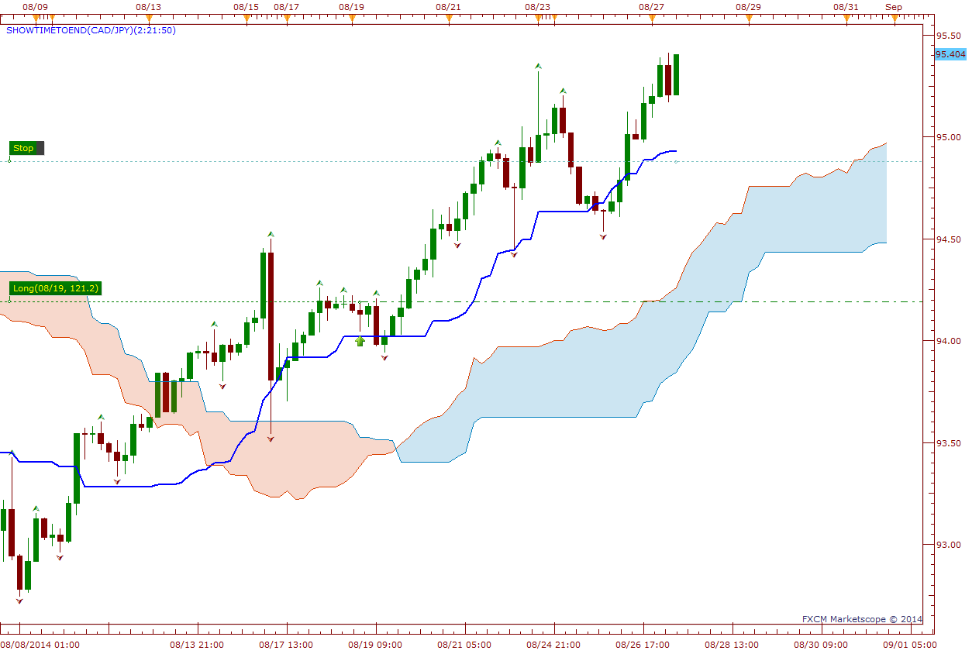
TK Cross Trade

Slide 25
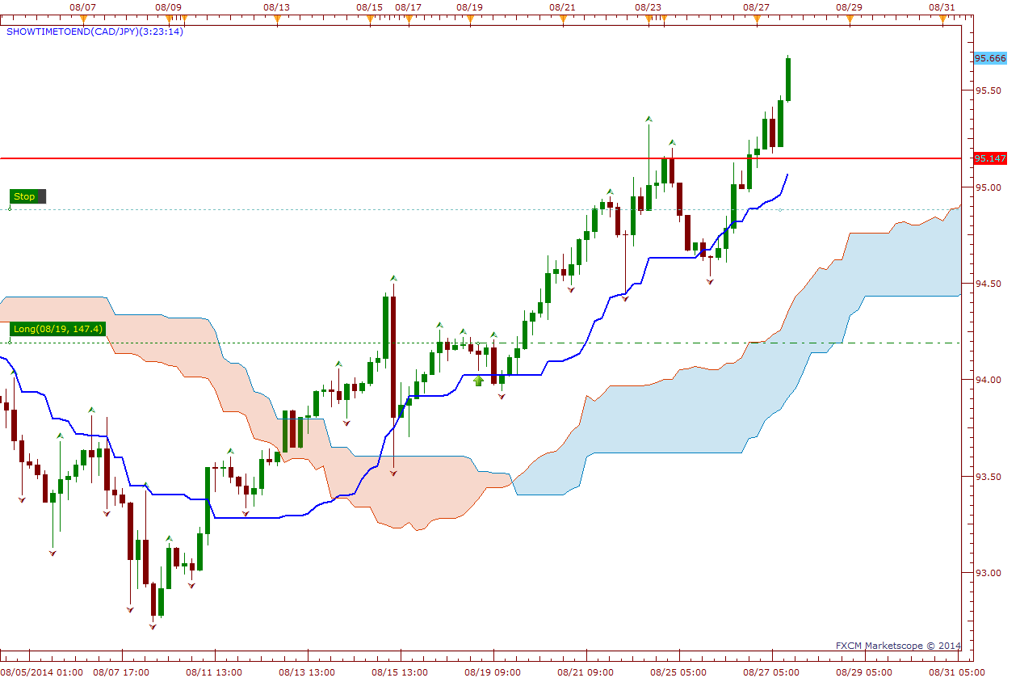
TK Cross Trade

Slide 26
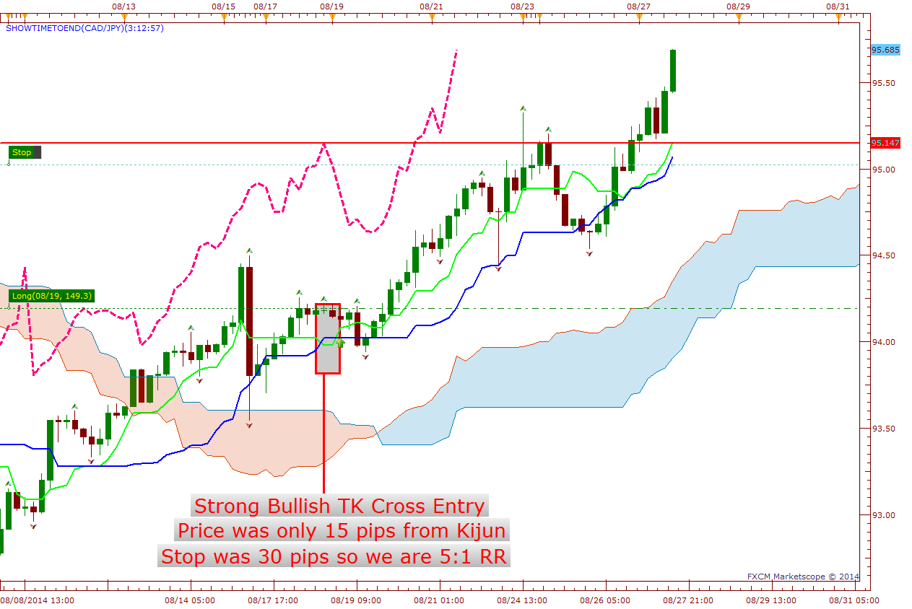
TK Cross Trade

Slide 27
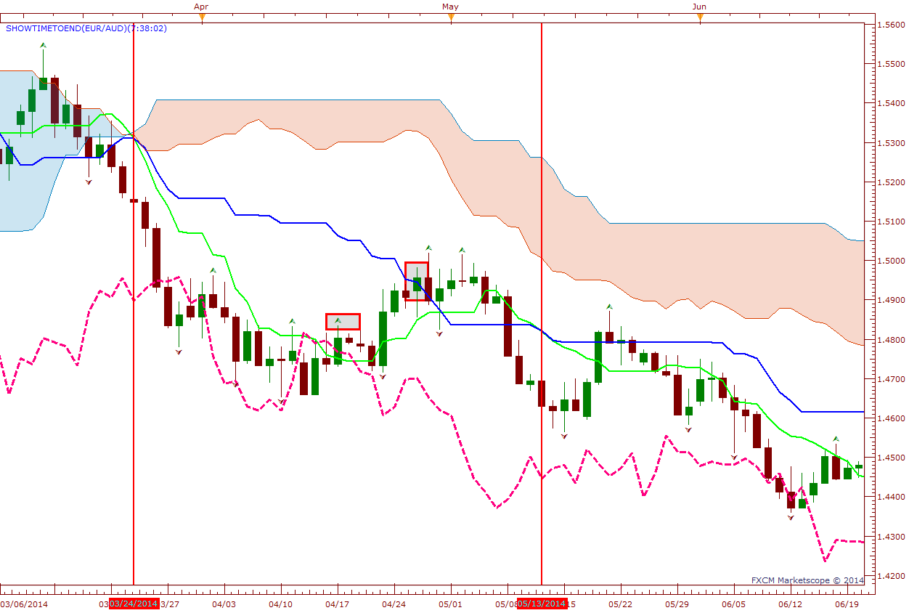
TK Cross Trade

