Slide 1
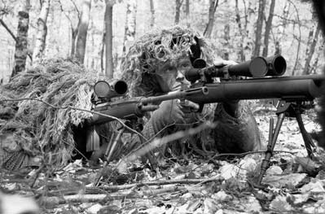
Manipulation
240K Perspectives
Imbalance and Cycles
Produced by George Ambrose

Slide 2
Risk Disclosure
Risk Disclosure Statement
THERE IS SUBSTANTIAL RISK IN TRADING. A LOSS INCURRED IN CONNECTION WITH FUTURES TRADING CAN BE SIGNIFICANT. THE ATW MAKES NO CLAIMS WHATSOEVER REGUARDING PAST OR FUTURE PERFORMANCE. ANY TRADE ALERT IS FOR EDUCATIONAL PURPOSES ONLY. PLEASE READ OUR FULL DISCLAIMER GOVERNMENT REGULATIONS REQUIRE DISCLOSURE OF THE FACT THAT WHILE THESE METHODS MAY HAVE WORKED IN THE PAST, PAST RESULTS ARE NOT NECESSARILY INDICATIVE OF FUTURE RESULTS. WHILE THERE IS A POTENTIAL FOR PROFITS THERE IS ALSO A RISK OF LOSS. A LOSS INCURRED IN CONNECTION WITH
TRADING FUTURES CONTRACTS CAN BE SIGNIFICANT. YOU SHOULD THEREFORE CAREFULLY CONSIDER WHETHER SUCH TRADING IS SUITABLE FOR YOU IN LIGHT OF YOUR FINANCIAL CONDITION SINCE ALL SPECULATIVE TRADING IS INHERENTLY RISKY AND SHOULD ONLY BE UNDERTAKEN BY INDIVIDUALS WITH ADEQUATE RISK CAPITAL.
Any signal generated by the Sniperscalping.com or any learning material produced by George Ambrose is provided for educational purposes in behalf of self-directed traders seeking information regarding trading. Any trades placed upon reliance on SSS systems and its educational material is used at your own risk.
Discretion is advised to all self-directed trade decisions.

Slide 3
Disclosure
This material was created for those who are in live attendance October 20-22, 2014 in Las Vegas or by live web cast.
Replication or sharing any of this information is prohibited…including to vendors/staff, trading schools /staff, or anyone who is either employed, owns, or affiliated with a financial firm. This material is also granted to those who purchase it at a future date…bearing the same responsibility and confidence under this disclosure. This material is copy-protected under law.

Slide 4

Imbalance
and Cycles
Demand & Supply Manipulation
by George Ambrose

Slide 5
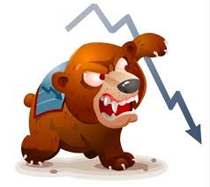
A Word from Mrs. Sister Elephont
Successful traders rarely talk.
Seminars by SniperScalping.com are opportunities to learn from successful traders sharing perspectives to assist traders in maturation.

Slide 6
George’s Background
22 years Stock and trading experience
Formed Syner-G Wealth Group LLC commodity Pool
Perspectives4Trading LLC
“Continued Learning for Traders”
Online “Self-Directed Traders’ Hangout”
Supports local churches and charities
Worship Leader and song composer

Slide 7
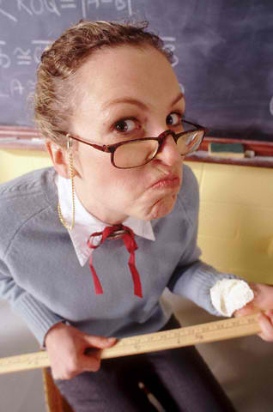
A Word from Mrs. Sister Elephont
If a trader avoids 20 losses a week = -$2400 @ 12 tick stop.
If a trader improves,
allowing a runner to run potential = $300/1200 a day extra capital.
Study, adapt

Slide 8
A Word from Mrs. Sister Elephont
Regardless of the electronic era of trading:
The markets will always have the Market Maker Model.
The structure & price action with specific participant behavior will not change

Slide 9
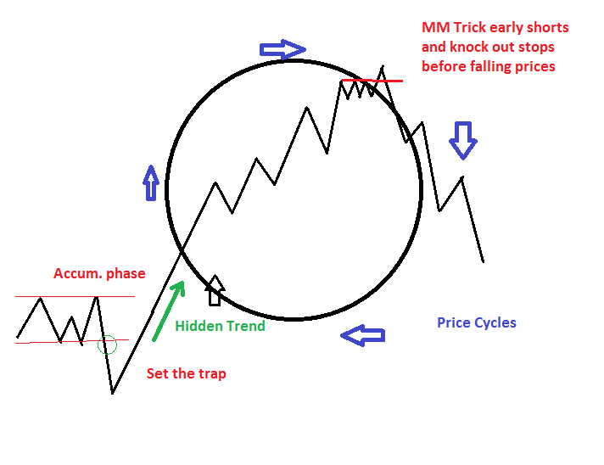
The Market Maker Model of Every Market
Is this model relevant in the electronic era of trading?

Slide 10
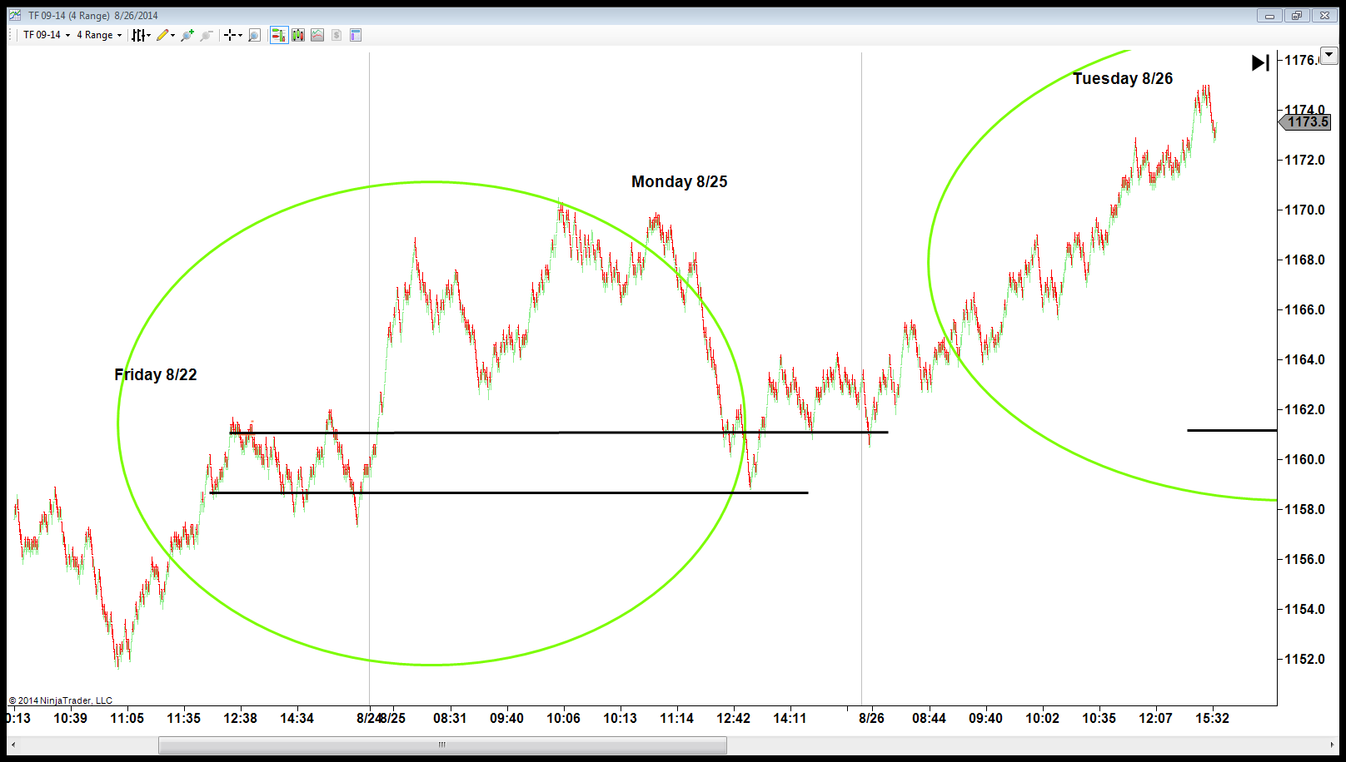
The Market Maker Model of Every Market
Distribution profit taking
accumulation
trap
accumulation
trap
The 2nd move out of a retest is the trap before trend continuation

Slide 11
What is an imbalance?
Bullish imbalance: when institutions are not interested paying more for a market, they display a systematic distribution (supply selling) driving prices lower.
Bearish imbalance: when institutions find value at a specific price zone, they dry up supply and begin accumulation (buying), causing prices to rise.

Slide 12
Following Imbalance
Value areas tend to be “the past day(s) defend test price points.” Banks tend to “value areas” to accumulate more contracts…to trend continuation. Consider the present day…what prices will be defended? It helps to write them down.
Bullish trend days occur when a market does not have a reversal, sustaining the 50 EMA above HTC, and a Bearish trend lends the 50 EMA below HTC with brief retracements.
This is common price movement…my trade plan should accommodate this reality.

Slide 13
Following Imbalance
Each imbalance process consist of macro and micro cycles…therefore, imbalances generate several mini peaks and lows seemingly in relationship to the 13 EMA Action Line:
If below AL = selling. If above AL = buying
(until demand or supply cycles are complete)

Slide 14
Following Imbalance
How far will momentum carry?
Consider 35, 50, 70 ticks per cycle.
Then look for a pullback to the HTF EMA observing for trend continuation or trend reversal

Slide 15
Following Imbalance
A retracement is a brief pause in the present trend sequence.
A reversal is when prices no longer return to the prior high (imbalance) or low (imbalance) of the present day. If a reversal is in play, it will defend the LSP prior to the low of the day

Slide 16
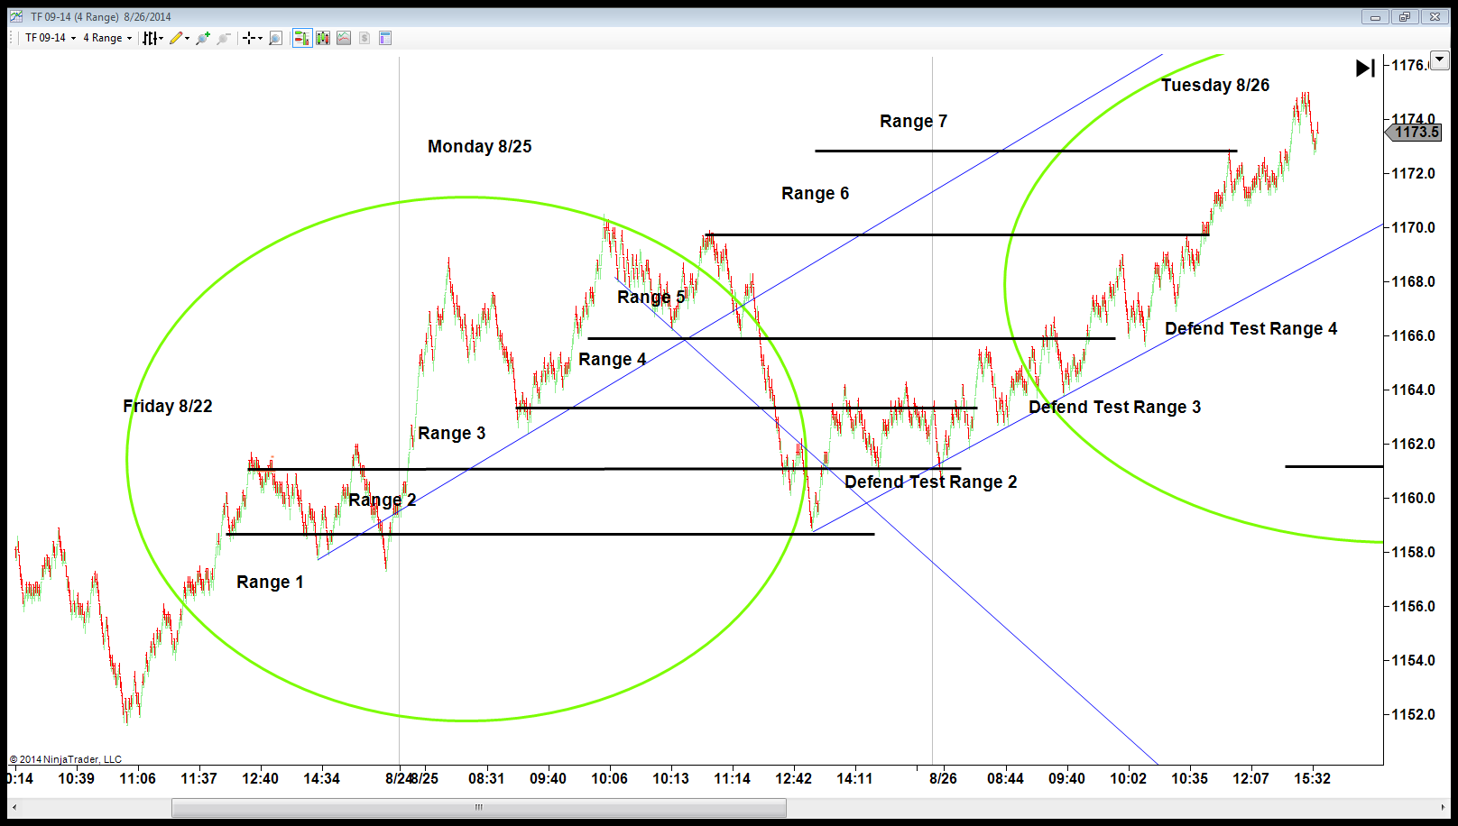
The Market Maker Model of Every Market
trap
accumulation
trap
The 2nd move out of a retest is the trap before trend continuation

Slide 17
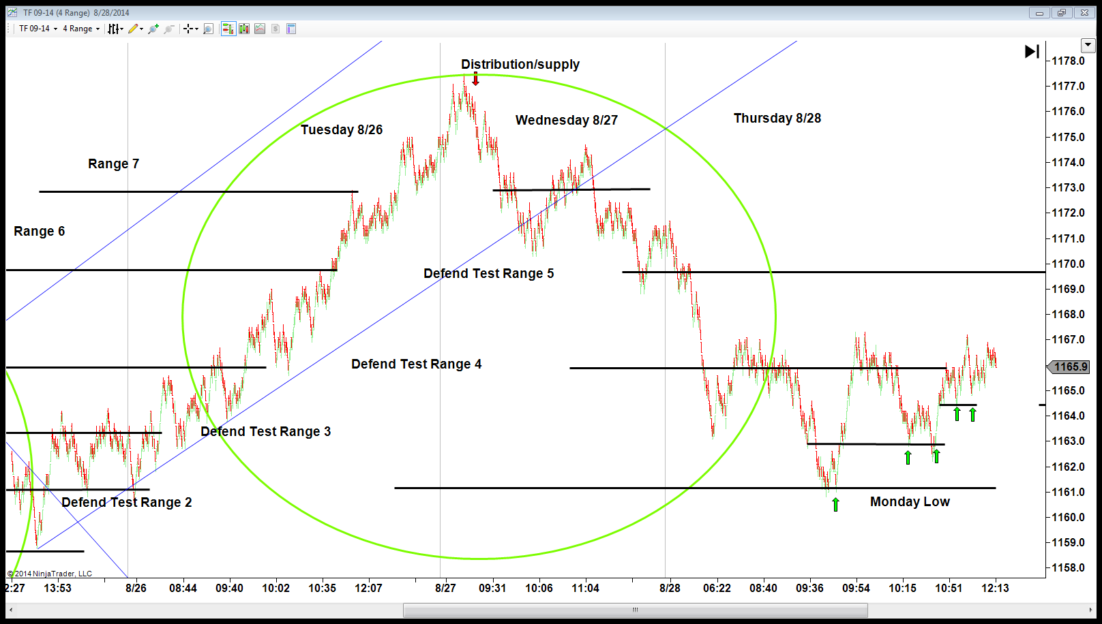
The Market Maker Model of Every Market
trap
trap
trap
The 2nd move out of a retest is the trap before trend continuation

Slide 18
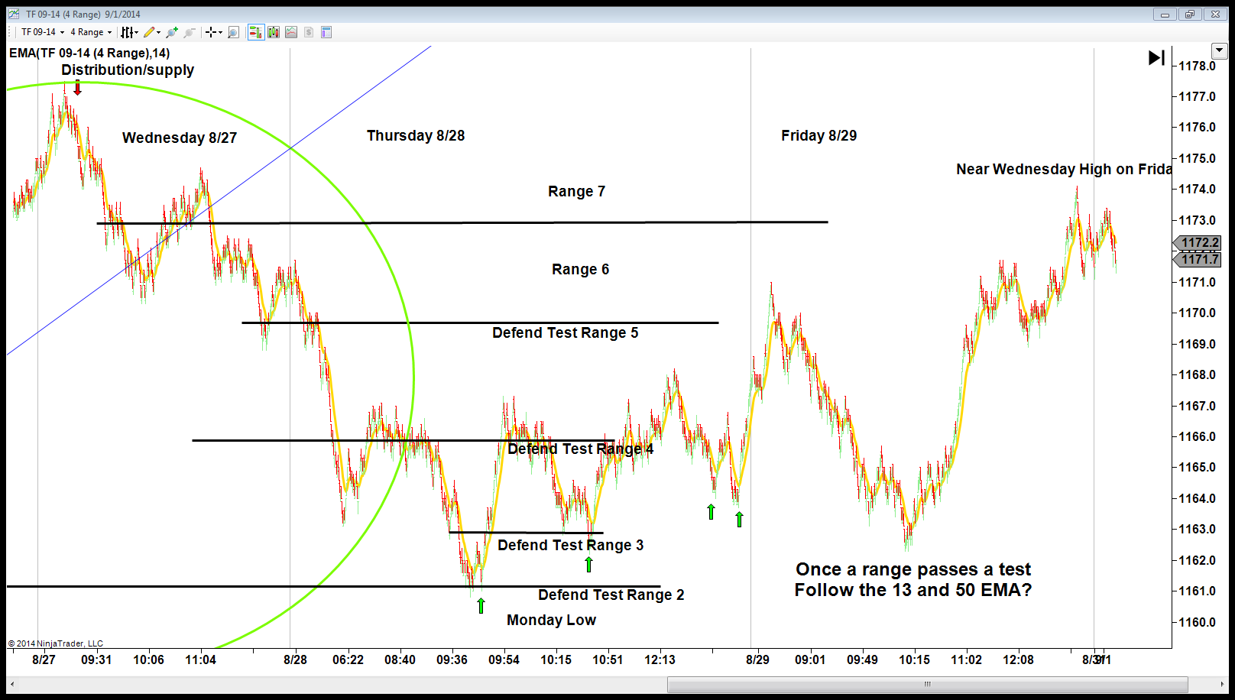
The Market Maker Model of Every Market
trap
trap
trap
trap
trap
The 2nd move out of a retest is the trap before trend continuation

Slide 19
Following Imbalance
Although we see indicator signals, do we perceive the present cycle and their potential completion point? During the course of the day:
The market may take 2 courses of action:
1. Form a price channel: prices revolve around
the 13 EMA and along the slope of the 50 EMA
2. Retest a prior day static price point, observing
for a reversal.

Slide 20
Following Imbalance
Intraday, consider a few static points:
A market may retest:
*a prior day close
*Prior day low
*Several days prior high, low, open, or close
*Prior week high/low
Within the process above will be several mini cycles and trend channels. Be attentive 13/50 EMA relationship for potential short term trend continuations while testing static points.

Slide 21
In the coming slides from August 25 – 29, 2014:
note the cycles, where trend channels formed, where cycles seem to end or continue.
Observe retracements, reversals, and defend tests of price zones.
A mature trader considers cycles and imbalances and the nature of shifting price ranges.
Remember, the Fund Managers have different market objectives than our Sniper Tools…all indictor signals are subject to “cycle sequences and defend tests”. This will become more apparent on the charts

Slide 22
Markets tend to be…
In a limited trade range on the day
(35-50 tick imbalances)
In a Trend Continuation on the day (imbalanced)
(“stair step” price action in 1 direction)
In a major trend cycle, retracing into prior days static price points, then continue in the trend direction
(Hosting 70 and 100 tick imbalances)

Slide 23
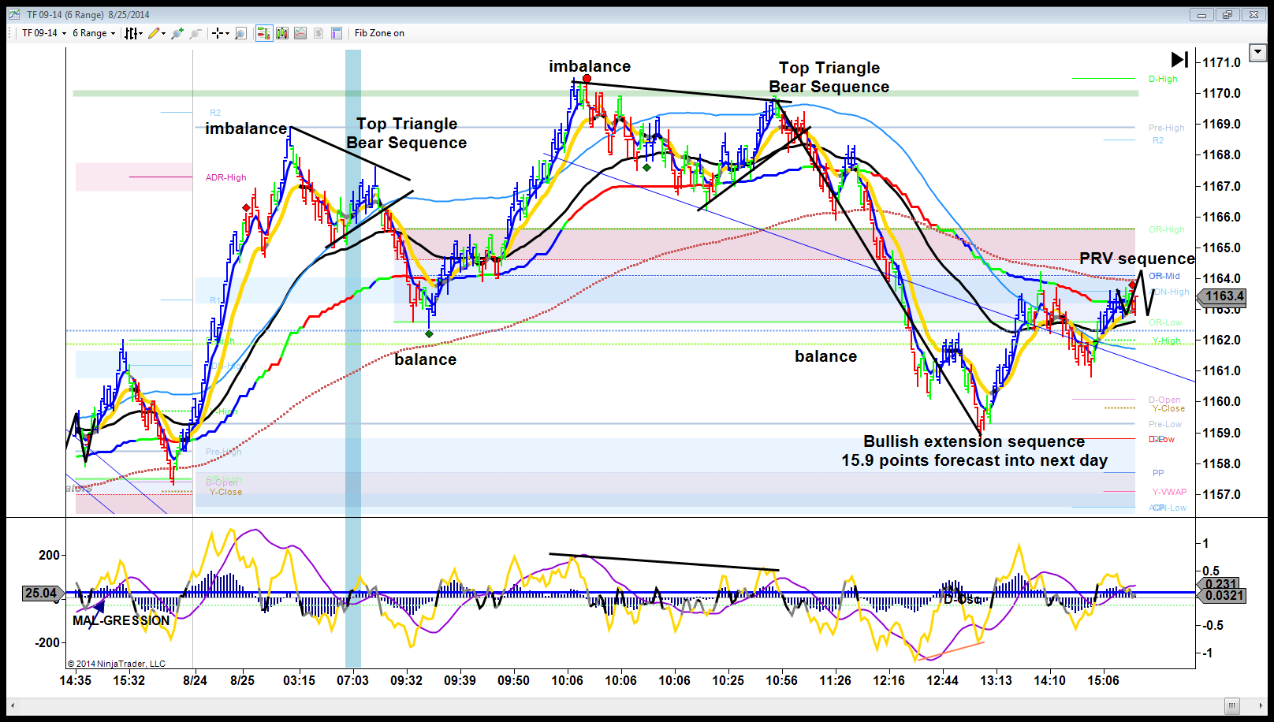
On the left are the prior day pre-market high and open. The market sustains the bullish character of the HTF 200/HTC/50 EMA’s reaching 1169 (imbalance), gives sway to supply and lowers prices to balance = the base of the open range of the present day.
We then observe a new high @ 1171, profit taking into HTC, a retest of the high: then a drop into balance zone (defend test). Yet, participants move to test pre-market low where institutions re-accumulated again….to the 200 EMA (balance)
Prior day open high close

Slide 24
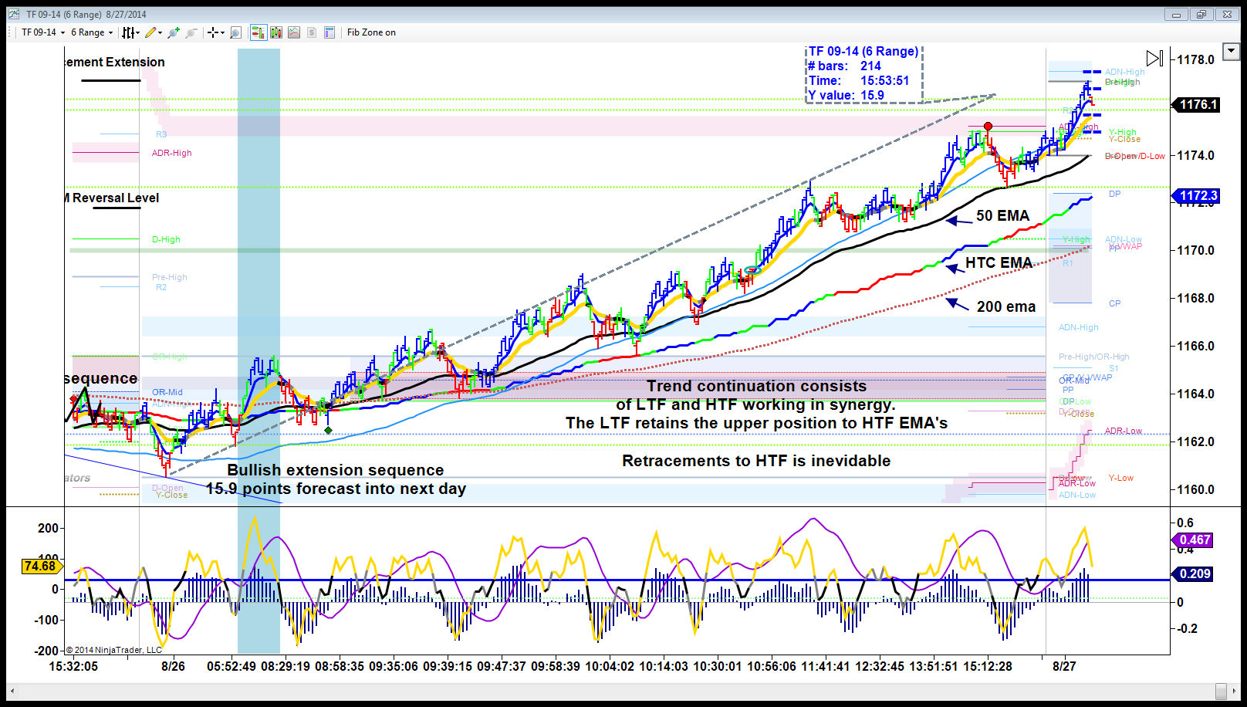
The next day, we note bullish character (HTC/50 EMA). Institutions defends prior day open…to accumulate a retest of 1169. In US RTH, they continue accumulating to retest 1172, and then prior day ADR-High 1174.40.
Note: prices are defended near the 13 EMA…with brief retraces to the HTF EMA’s.
The OSC will reveal 0 line cross or divergence reversals at or near the 13 and HTC EMA.

Slide 25
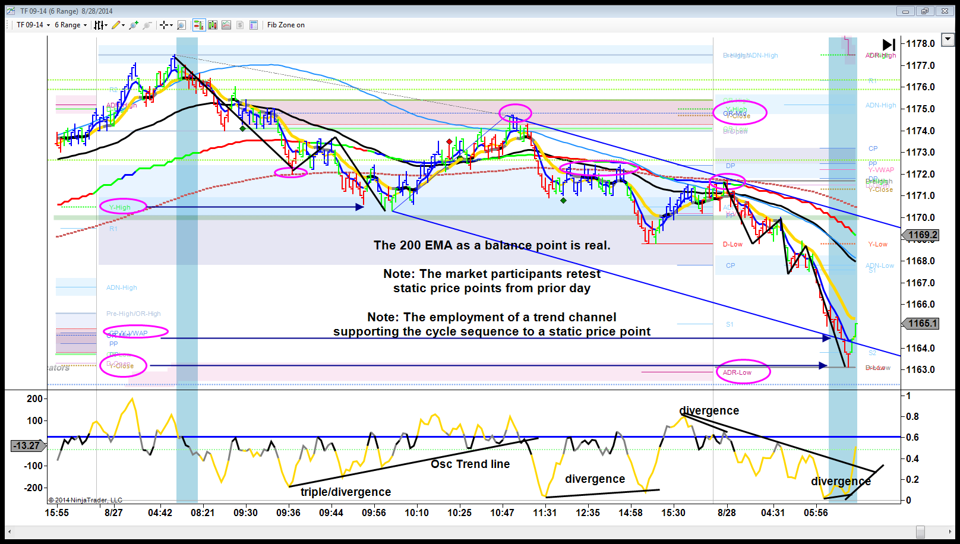
Imbalance Example: TF

Slide 26
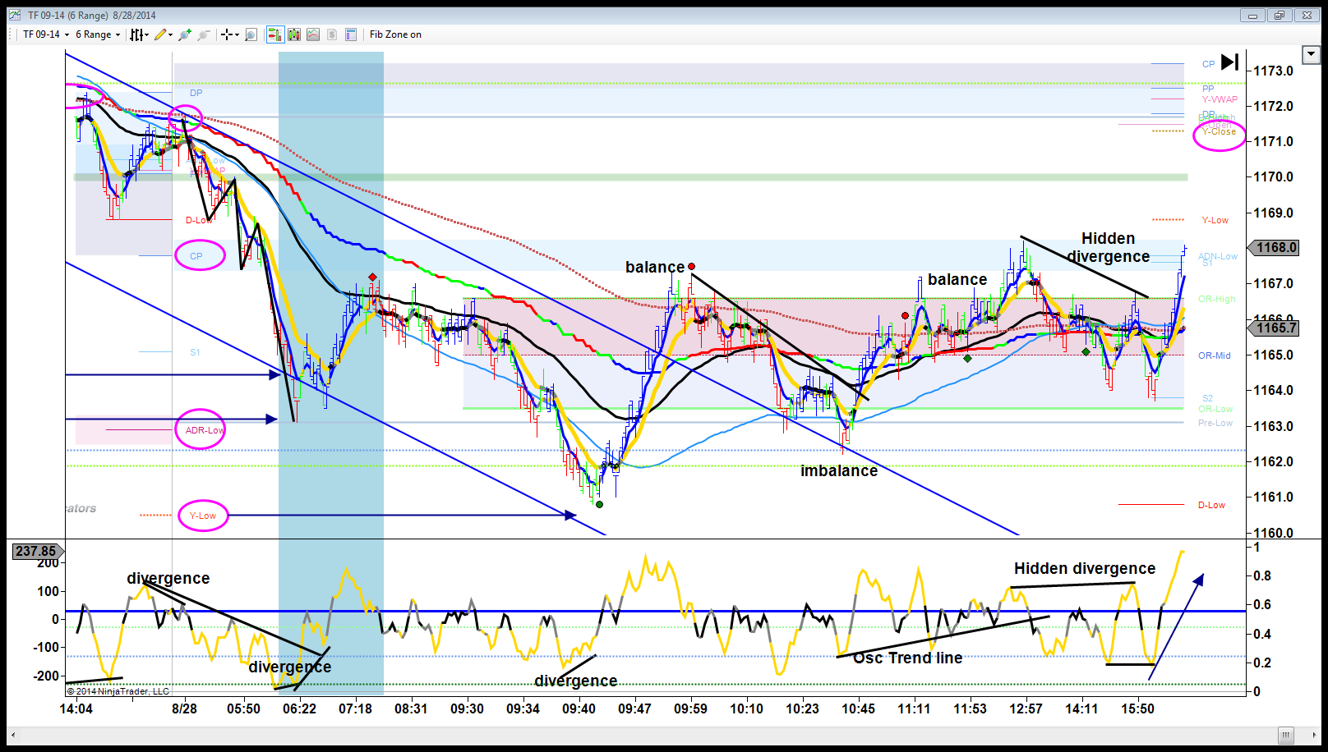
Imbalance Example: TF

Slide 27
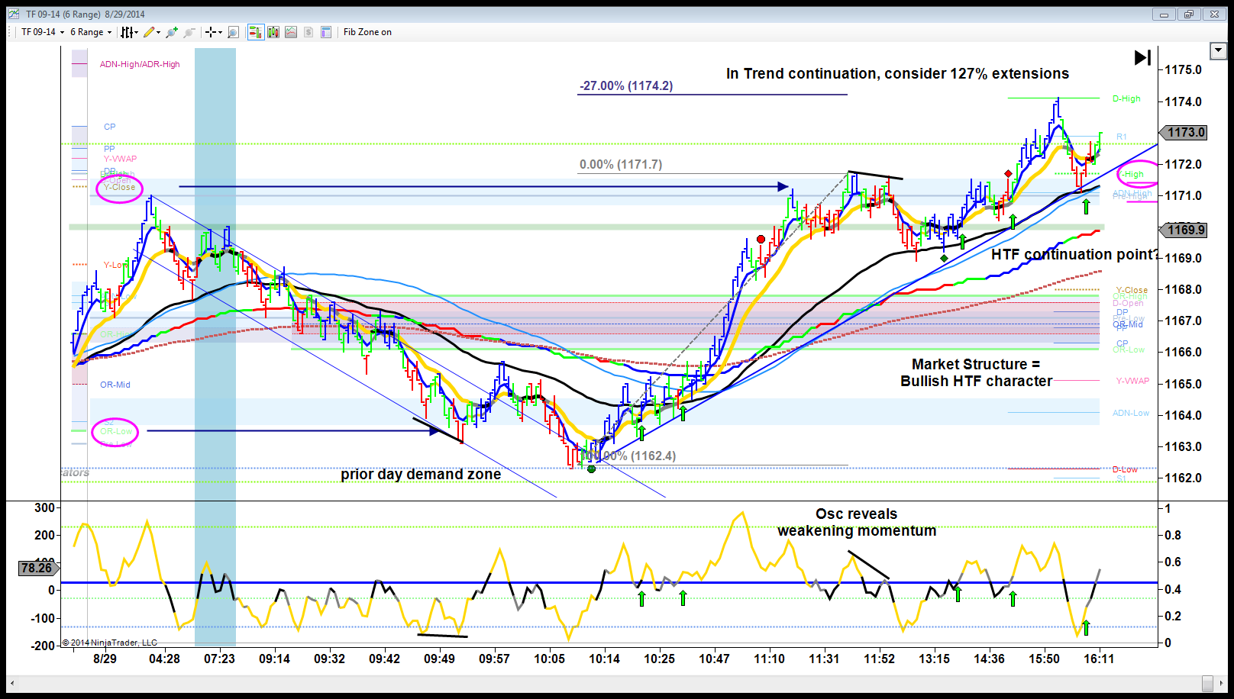
Imbalance Example: TF

Slide 28
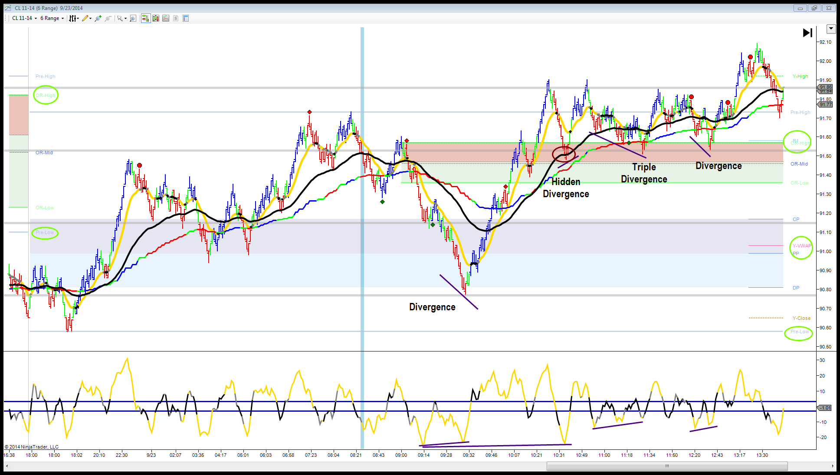
Imbalance Example: CL 11-14.

Slide 29
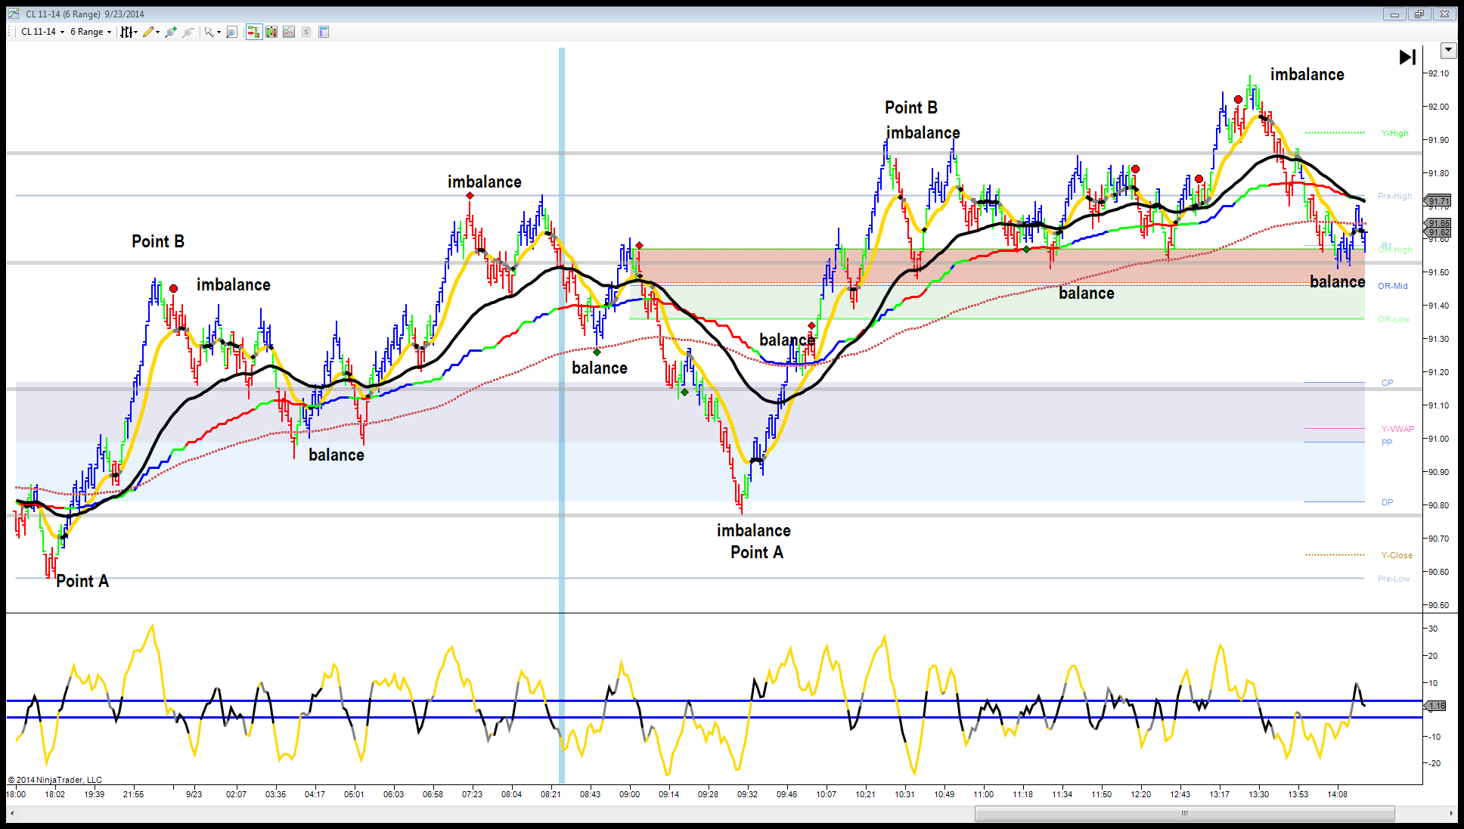
Imbalance Example: CL 11-14.

Slide 30
Once a trader is immersed to the process of manipulation, trading becomes more clear.
Follow the HTF EMA characteristics, harness the 13/50 EMA for near term continuation…be mindful of static price points and what mode the market is in…
Limited Trade Range
Trend Continuation
Major Trend Retracement

Slide 31
Q&A
Further questions,
tradingperspectives@outlook.com

