Slide 1
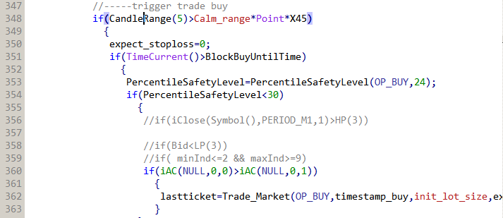
In the past 5 bar (highest to lowest) range is more than 200 points(default)
Time is more than unlock time
Use range from 24 bar (6 hours), and create percent of where current price is relatively to the range. 0 is where Bid is at lowest price of the range, 100 is highest.
  <30 is where price is in 1/3 lower portion
Use AC (accelerate)
  If AC at current bar is more than previous bar then BUY
  If AC at current bar is less than previous bar then sell
v66k

Slide 2
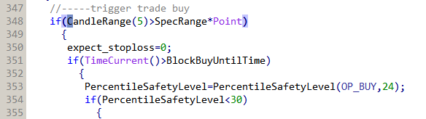
In the past 5 bar (highest to lowest) range is SpecRange (each pair is different)
Time is more than unlock time
Use range from 24 bar (6 hours), and create percent of where current price is relatively to the range. 0 is where Bid is at lowest price of the range, 100 is highest.
  <30 is where price is in 1/3 lower portion
v66m

Slide 3
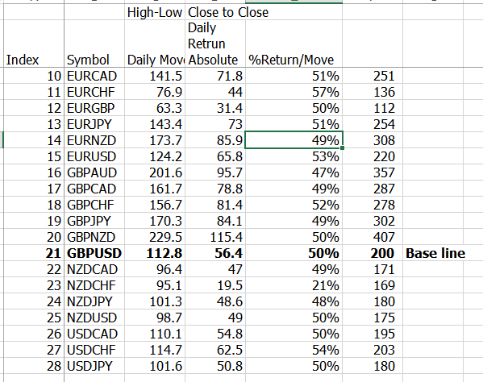
Daily Move
  Is average 200 data points of difference price of highest to lowest price of the day
Daily Return Absolute
  Is average 200 data points of how much price move from close to close each day in absolute distance
v66m

Slide 4
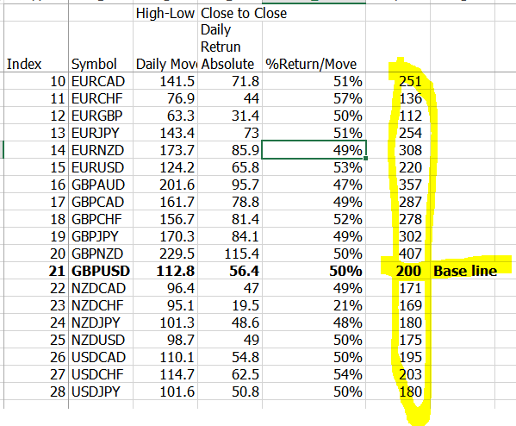
SpecRange
SpecRange is relate value from v66k default setting base on GBPUSD back testing.
GBPUSD 200 points is default.
v66m

Slide 5
Index | Symbol | Daily Move | Daily Retrun Absolute | %Return/Move
1 | AUDCAD | 93.8 | 44.6 | 48% | 166
2 | AUDCHF | 99.6 | 49 | 49% | 177
3 | AUDJPY | 104.2 | 48.2 | 46% | 185
4 | AUDNZD | 85.7 | 41.8 | 49% | 152
5 | AUDUSD | 98 | 45.5 | 46% | 174
6 | CADCHF | 94.5 | 52.8 | 56% | 168
7 | CADJPY | 100.4 | 50.5 | 50% | 178
8 | CHFJPY | 133.9 | 72.59 | 54% | 237
9 | EURAUD | 156.9 | 72.6 | 46% | 278
10 | EURCAD | 141.5 | 71.8 | 51% | 251
11 | EURCHF | 76.9 | 44 | 57% | 136
12 | EURGBP | 63.3 | 31.4 | 50% | 112
13 | EURJPY | 143.4 | 73 | 51% | 254
14 | EURNZD | 173.7 | 85.9 | 49% | 308
15 | EURUSD | 124.2 | 65.8 | 53% | 220
16 | GBPAUD | 201.6 | 95.7 | 47% | 357
17 | GBPCAD | 161.7 | 78.8 | 49% | 287
18 | GBPCHF | 156.7 | 81.4 | 52% | 278
19 | GBPJPY | 170.3 | 84.1 | 49% | 302
20 | GBPNZD | 229.5 | 115.4 | 50% | 407
21 | GBPUSD | 112.8 | 56.4 | 50% | 200
22 | NZDCAD | 96.4 | 47 | 49% | 171
23 | NZDCHF | 95.1 | 19.5 | 21% | 169
24 | NZDJPY | 101.3 | 48.6 | 48% | 180
25 | NZDUSD | 98.7 | 49 | 50% | 175
26 | USDCAD | 110.1 | 54.8 | 50% | 195
27 | USDCHF | 114.7 | 62.5 | 54% | 203
28 | USDJPY | 101.6 | 50.8 | 50% | 180
v66m

Slide 6
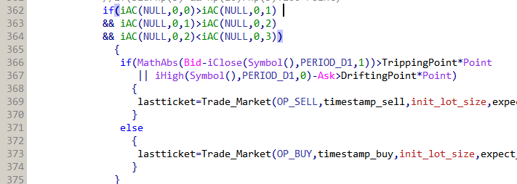
Buy bias
AC[0]>AC[1]
AC[1]>AC[2]
AC[2]<AC[3]
  It will BUY of not meet below condition
Counter exception
  Current price to last day close, If it more than TrippingPoint Or Today’s High to current price is more than DriftingPoint
    SELL
AC
0
3
1
v66m
2

Slide 7
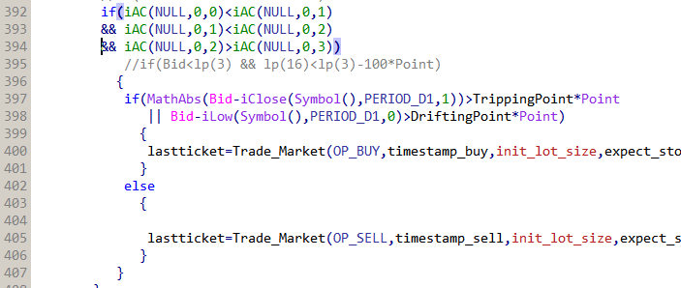
Sell bias
AC[0]<AC[1]
AC[1]<AC[2]
AC[2]>AC[3]
  It will SELL of not meet below condition
Counter exception
  Current price to last day close, If it more than TrippingPoint Or Today’s current price to today’s low is more than DriftingPoint
    BUY
v66m

Slide 8
TrippingPoint (TippingPoint)
  Is the average level of daily move and daily return, assume that price above these level has high possibility to reverse in smaller timeframe
DriftingPoint
  Is the different of price moving distance in average (divide by 2) of daily move and daily return.
  Assumption is that if price move away from either high of the day or low of the day then, the price may have high possibility to continue in bearish or bullish direction in smaller timeframe relatively
  Pseudo retracement
v66m

