Slide 1
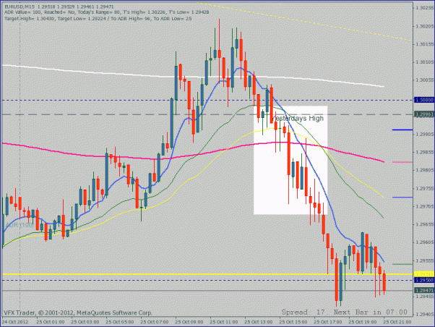
This is where the rejection/bounce begin
Enter at close of this bar for small SL. I was
In this trade. So this is my view.

