Slide 1
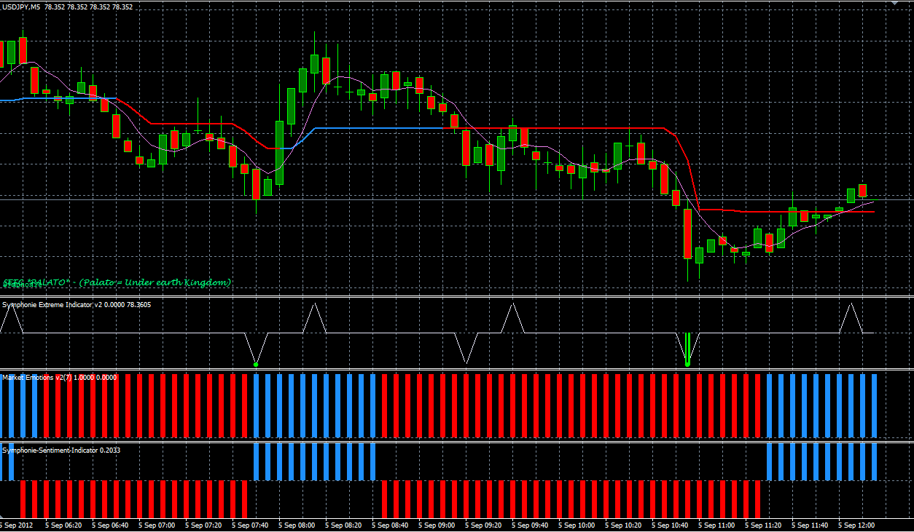
How to superimpose Extreme onto Sentiment indicator ?

