Slide 1
Load indy to TDW

Slide 2
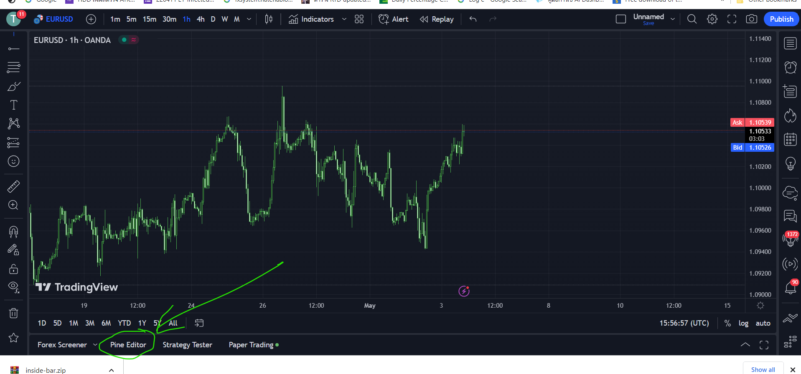

Slide 3
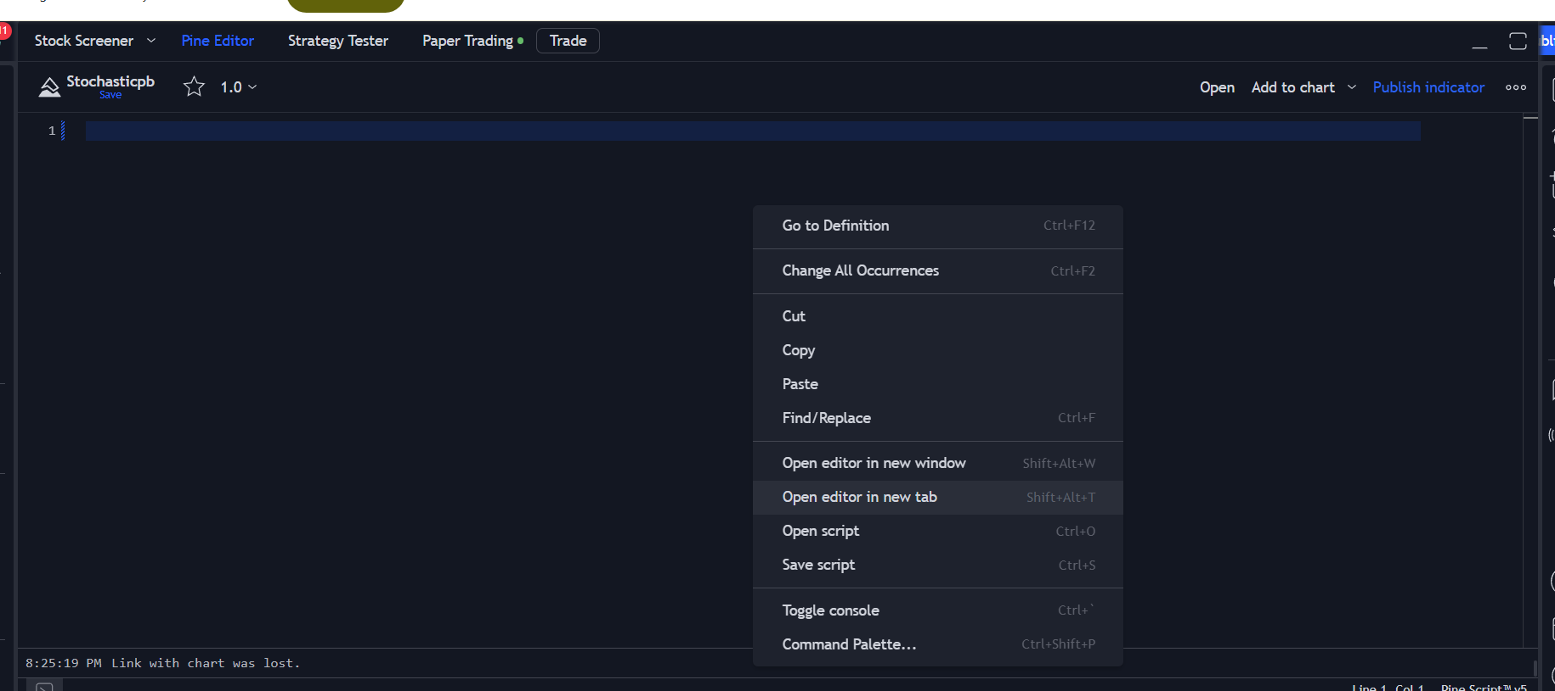
Click mouse select

Slide 4
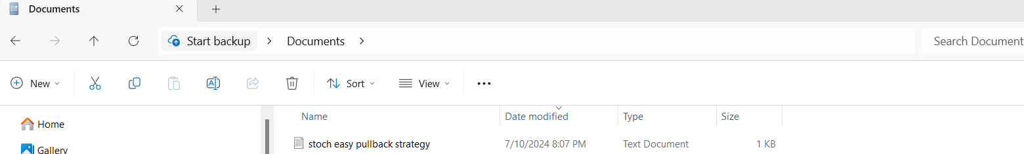
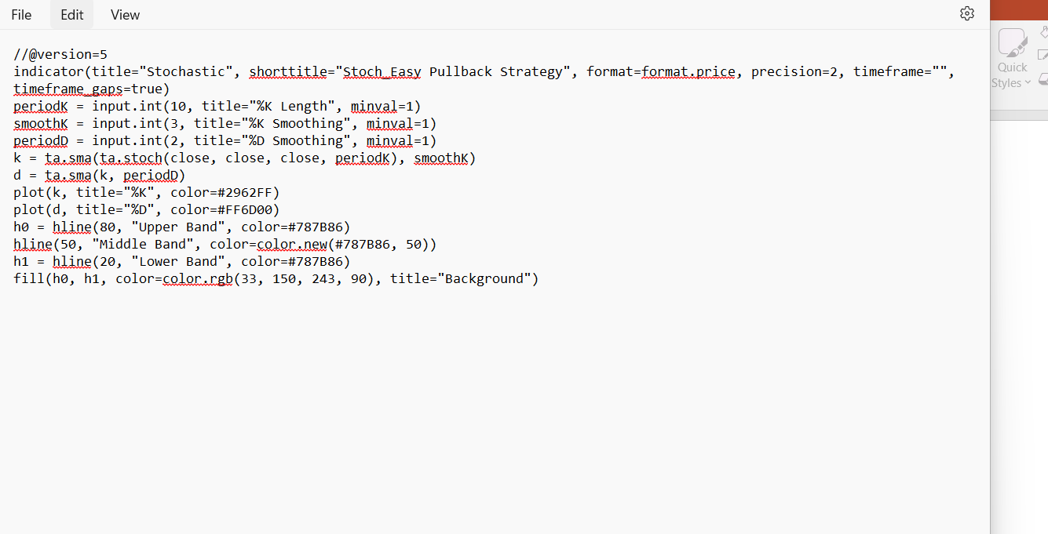
open Files =>Edit => Select all or (Ctrl+A)

Slide 5
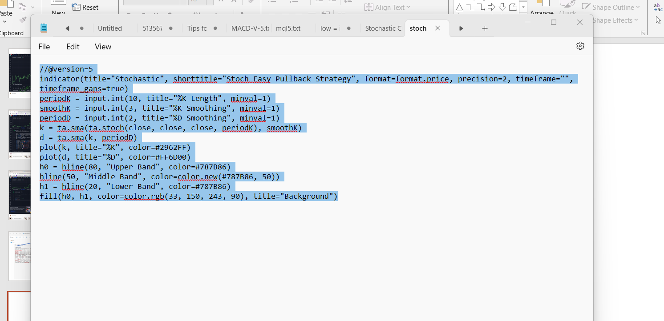
Ctrl +V

Slide 6
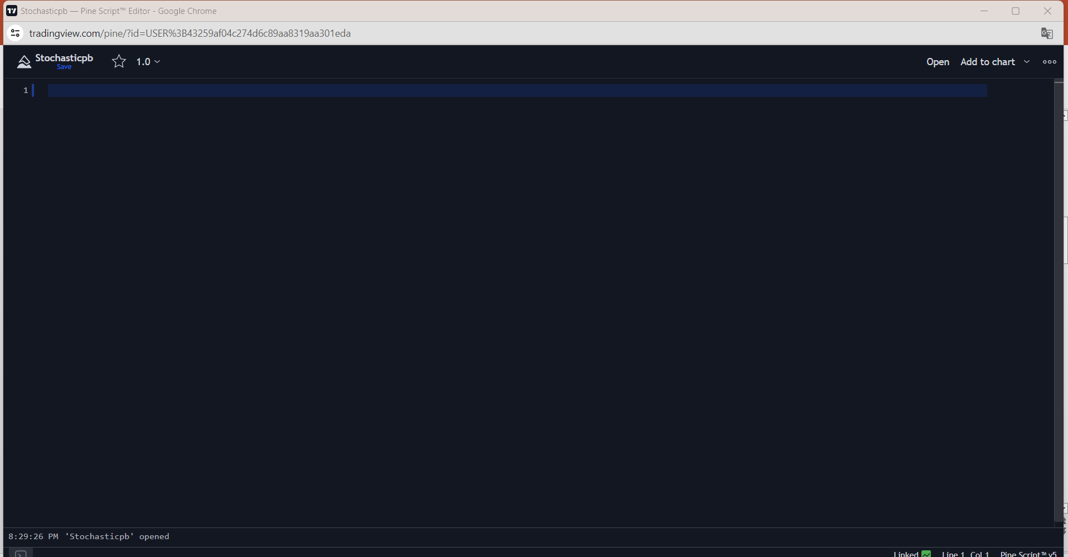
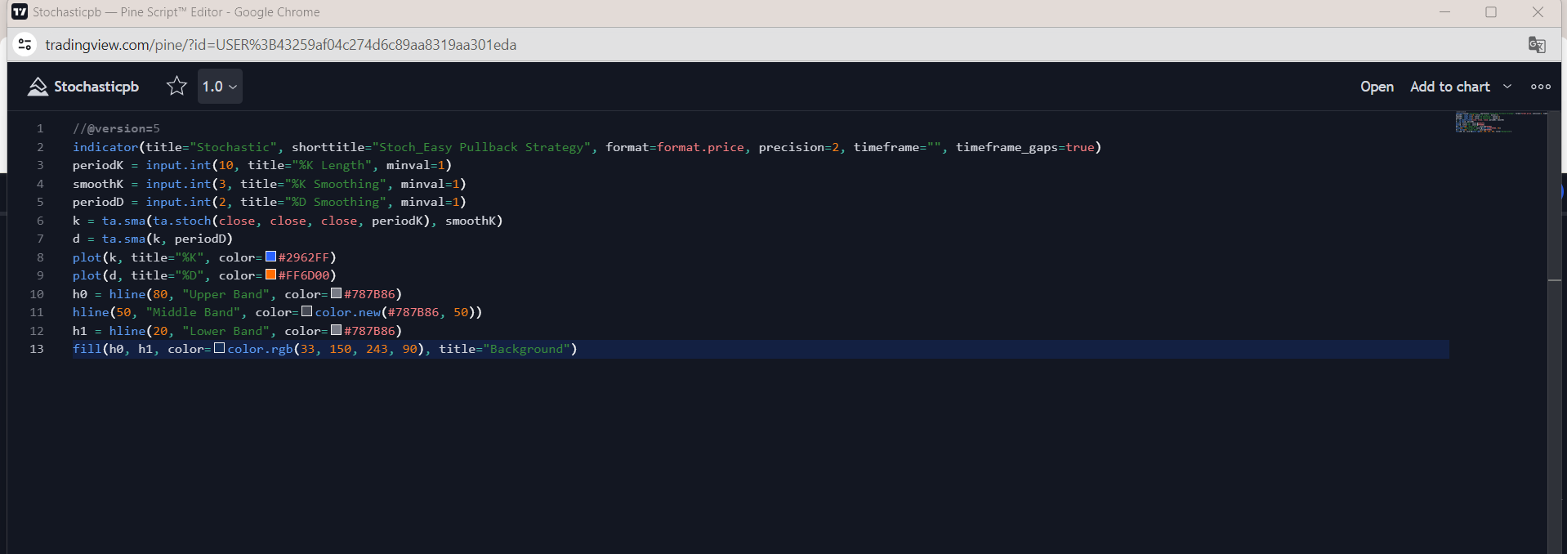
Move to display TDW
Ctrl +A
Move to display TDW
Ctrl +V

Slide 7
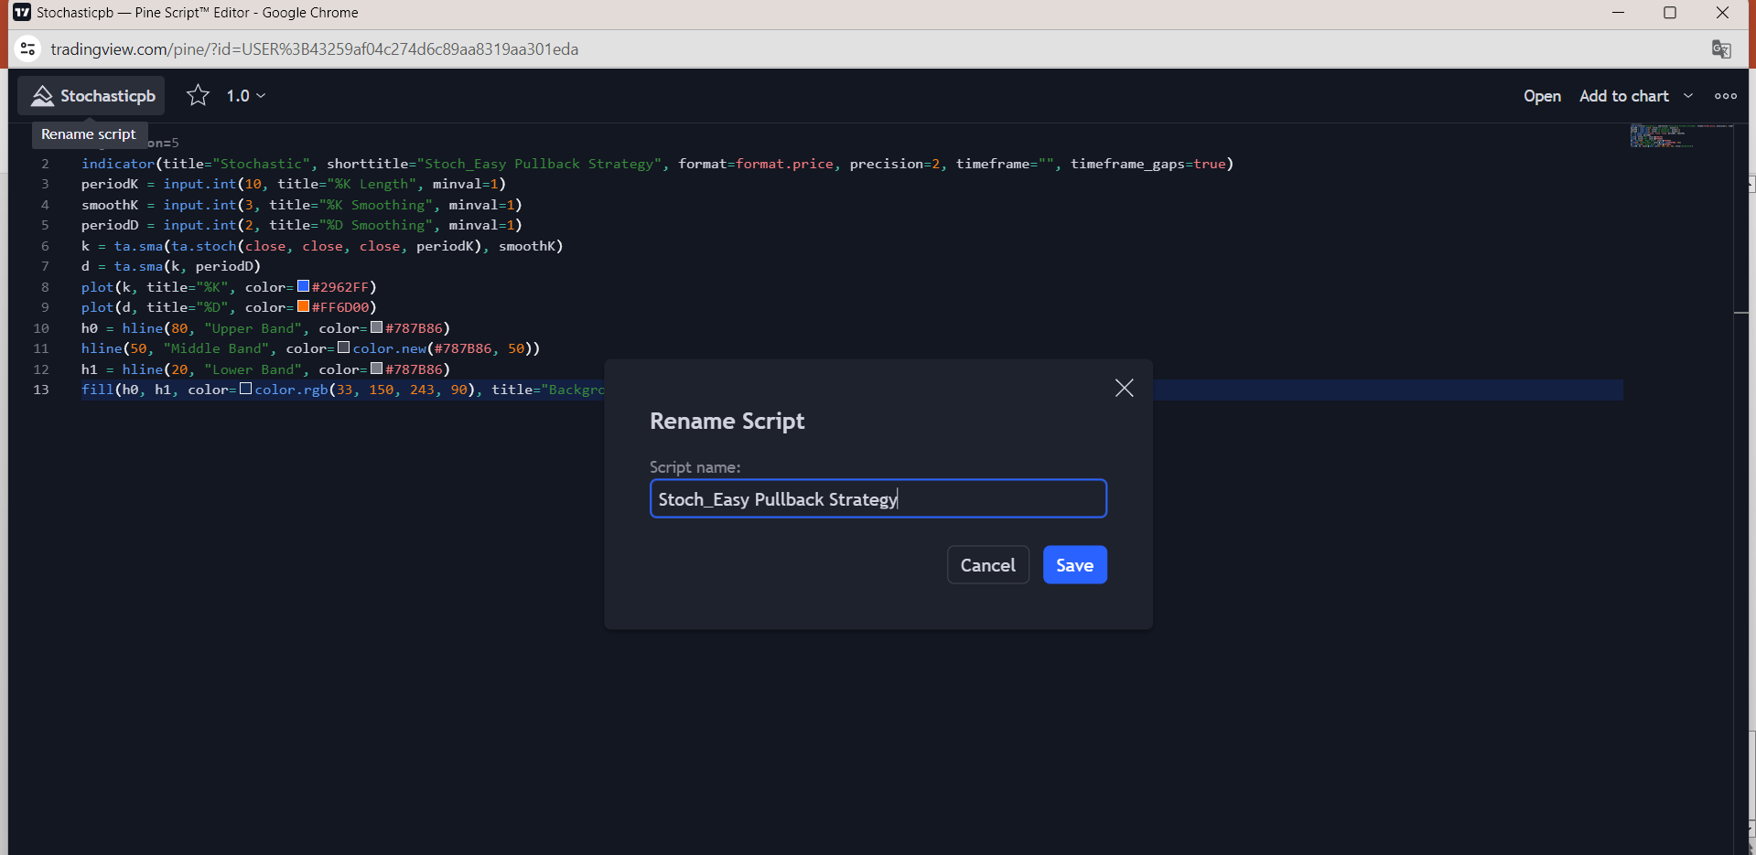
1 click
2) Show save name
3) Write “name” save name

Slide 8
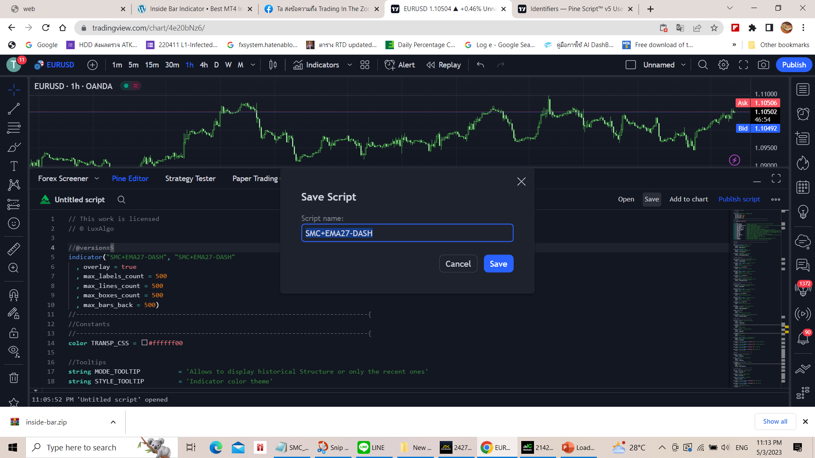
Stoch_Easy Pullback Strategy

