Slide 1
WAVES
A STATISTICAL STUDY

Slide 2


Slide 3
The Initial Test
Year 2005
Study on > 29 Millions Ticks
in the Forex Euro / Usd Database
Trader : Duane Archer
Programmer : James Bickford

Slide 4
1 CRITERION - 3 OPERATORS
Main criterion
The criterion for identifying a configuration in 3 waves is the existing relationship between the heights of each of the 3 waves.
3 logical operators :
> greater than
= equal to
< smaller than

Slide 5
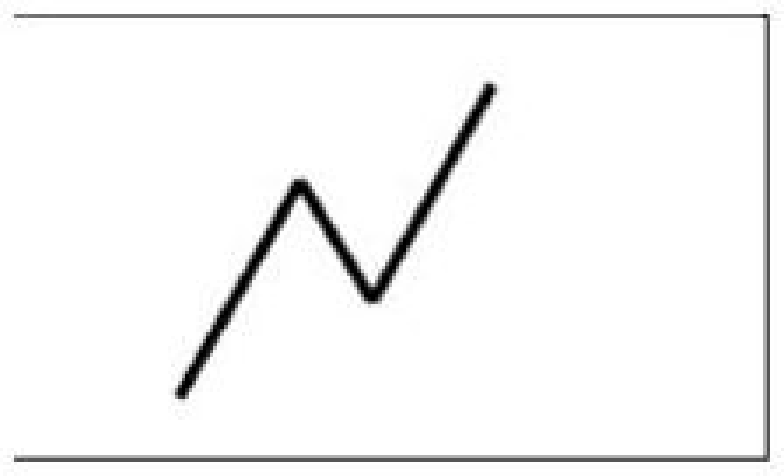
IMPULSIVE WAVE
Formula = Wave 1 > Wave 2 < Wave 3

Slide 6
These 3 operators = / > / < allow to define :
9 configurations in 3 unique bullish Waves
9 configurations in 3 unique bearish Waves

Slide 7
IMPULSIVE WAVE
Very Significant : 34 % of all configurations

Slide 8
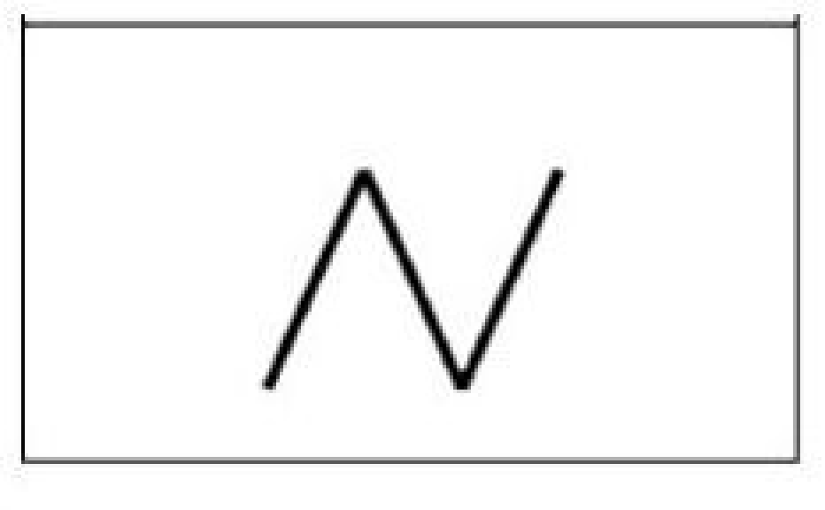
RECTANGLE
Formula = Wave 1 = Wave 2 = Wave 3

Slide 9
RECTANGLE
Insignificant : 0, 3 % of all configurations

Slide 10
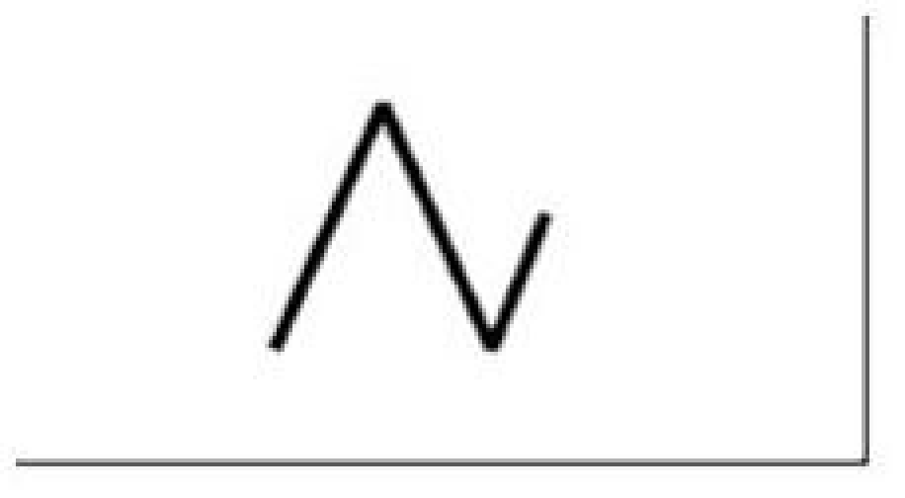
CONTRACTING DESCENDING TRIANGLE
Formula = Wave 1 = Wave 2 > Wave 3

Slide 11
CONTRACTING DESCENDING TRIANGLE
Insignificant : 0, 3 % of all configurations

Slide 12
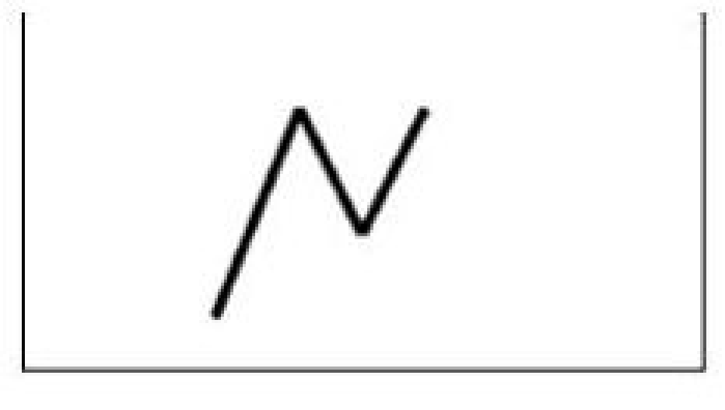
CONTRACTING ASCENDING TRIANGLE
Formula = Wave 1 > Wave 2 <= Wave 3

Slide 13
CONTRACTING ASCENDING TRIANGLE
Insignificant : 0, 7 % of all configurations

Slide 14
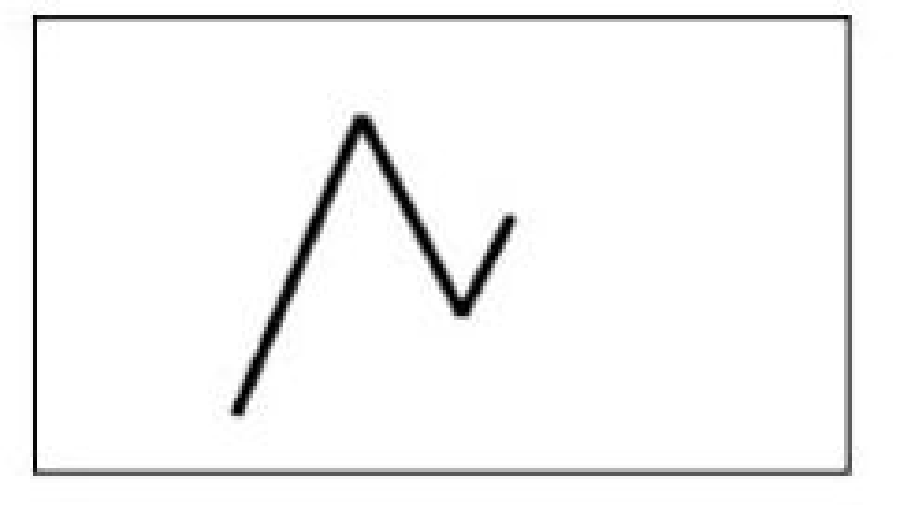
CONTRACTING SYMMETRICAL TRIANGLE
Significant : 13,5 % of all configurations

Slide 15
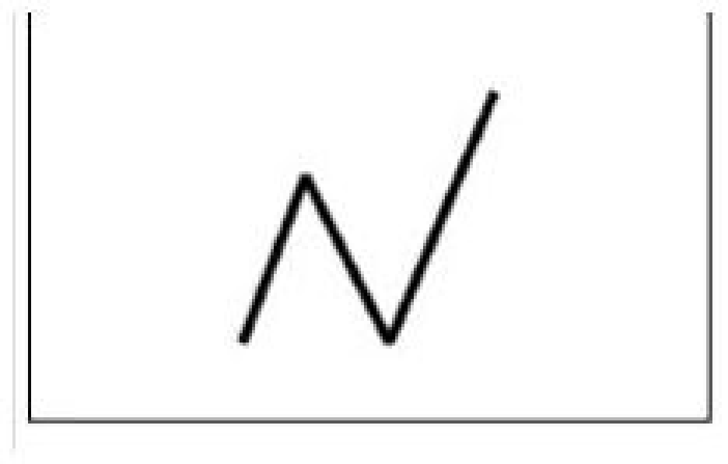
EXPANDING ASCENDING TRIANGLE
Formula = Wave 1 = Wave 2 < Wave 3

Slide 16
EXPANDING ASCENDING TRIANGLE
Insignificant : 0, 8 % of all configurations

Slide 17
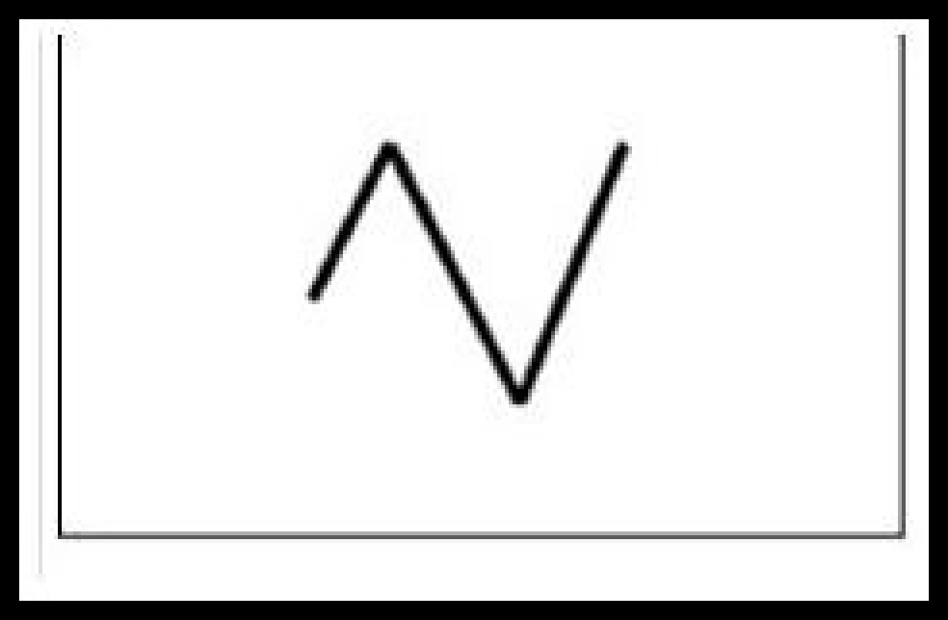
EXPANDING ASCENDING TRIANGLE
Formula = Wave 1 < Wave 2 = Wave 3

Slide 18
EXPANDING DESCENDING TRIANGLE
Insignificant : 0, 4 % of all configurations

Slide 19
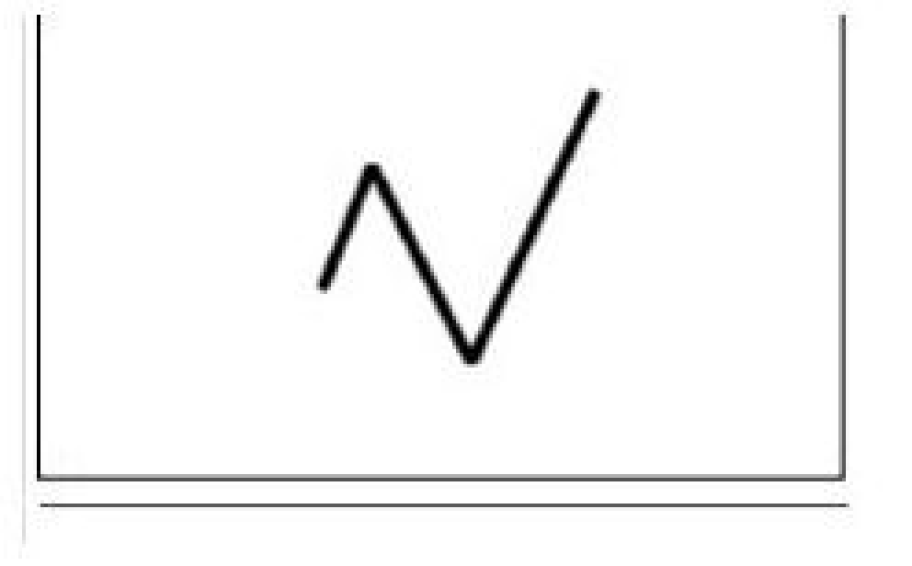
SYMMETRICAL EXPANDING TRIANGLE
Formula = Wave 1 < Wave 2 < Wave 3

Slide 20
SYMMETRICAL EXPANDING TRIANGLE
Significant : 16,6 % of all configurations

Slide 21
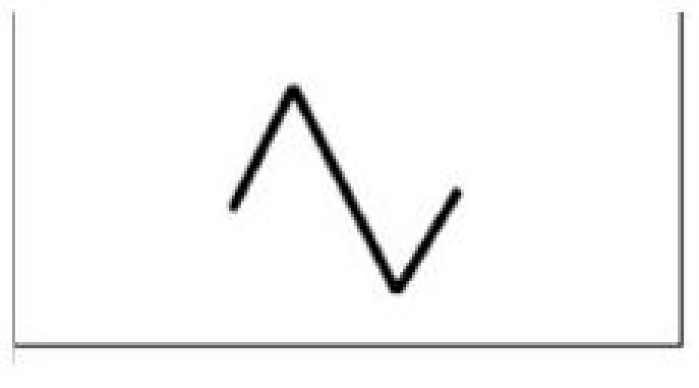
CONNECTOR
Formula = Wave 1 < Wave 2 > Wave 3

Slide 22
CONNECTOR
Very significant : 34 % of all configurations

Slide 23
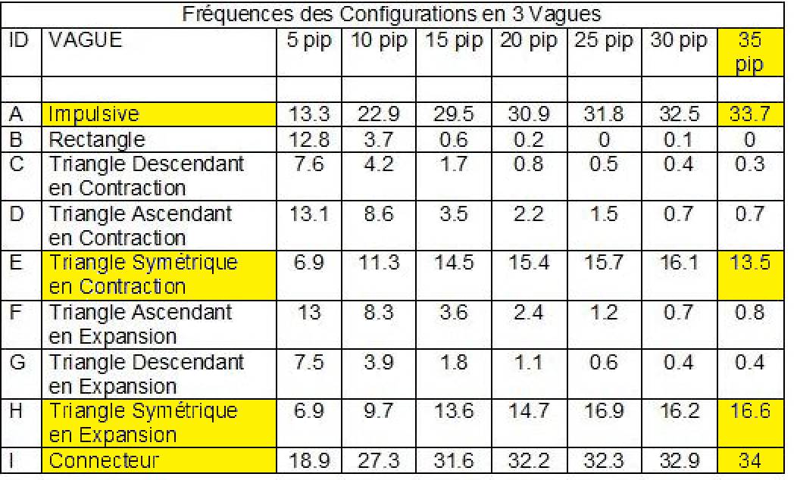
3 Waves Configurations Frequencies

Slide 24
Key points to remember
More the minimum amplitude determining a Trend Reversal grows :
More we notice an increase of the frequency :
Of the Impulsive Wave
Of Contracting and Expanding Symmetrical Triangles
Of the Connector

